Slide 1
Mobile Data Collection (MDC) with OpenDataKit
2024
Enumerator Training

Slide 2
01
Introduction
can be hidden if not necessary
02
Phases of a Mobile Data Collection
mandatory
03
Phase 2 – Collect : Getting to know ODK Collect
mandatory
04
Standard Operating Procedures (SOPs)
mandatory
Notes:
Slide containing instructions on how to use this presentation – keep it hidden.

Slide 3
Introduction
What is MDC (Mobile Data Collection) ?
MDC with UNHCR
Notes:
Section “Introduction to MDC” to be kept if not familiar to MDC and an introduction to MDC is needed. Otherwise, whole section can be deleted.

Slide 4
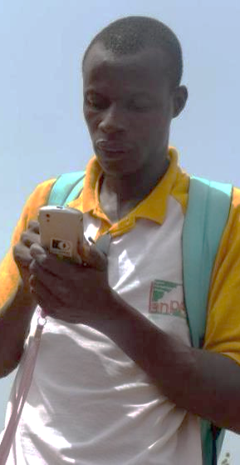
What is Mobile Data Collection ?
Mobile Data Collection
MDC: use of new technologies to collect data (smartphones or tablets instead of paper forms).
Used by CartONG since 2010 with many partners (UNHCR, Terre des Hommes, MSF, Solidarités International, REACH, Caritas, UNICEF, etc.)
Possible use cases: surveys, assessments (potentially in emergency), tracking (distributions & such), monitoring and evaluation, etc.

Slide 5
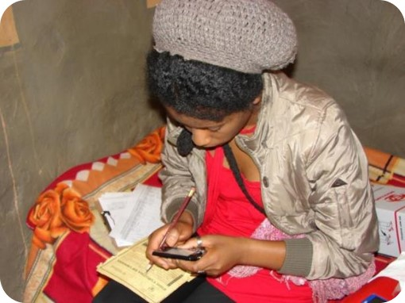
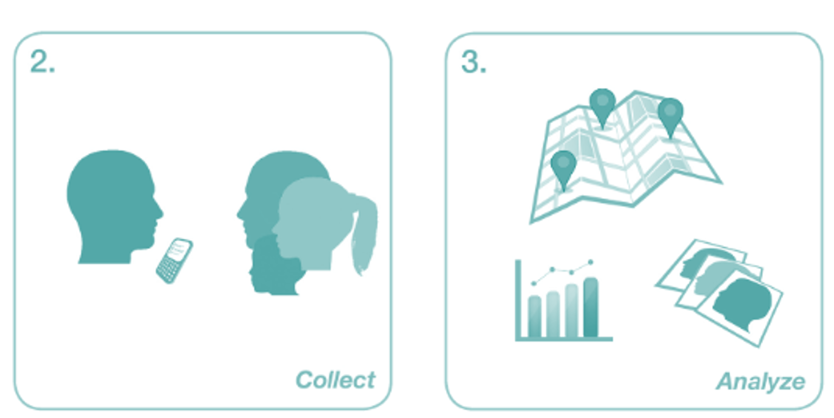
MDC
Mobile Data Collection
Mobile tech is a major improvement in information management (IM).
It is now possible in real time or near real time to :

Slide 6
Exercise 1
Mobile Data Collection
MDC Advantages
MDC Disadvantages

Slide 7
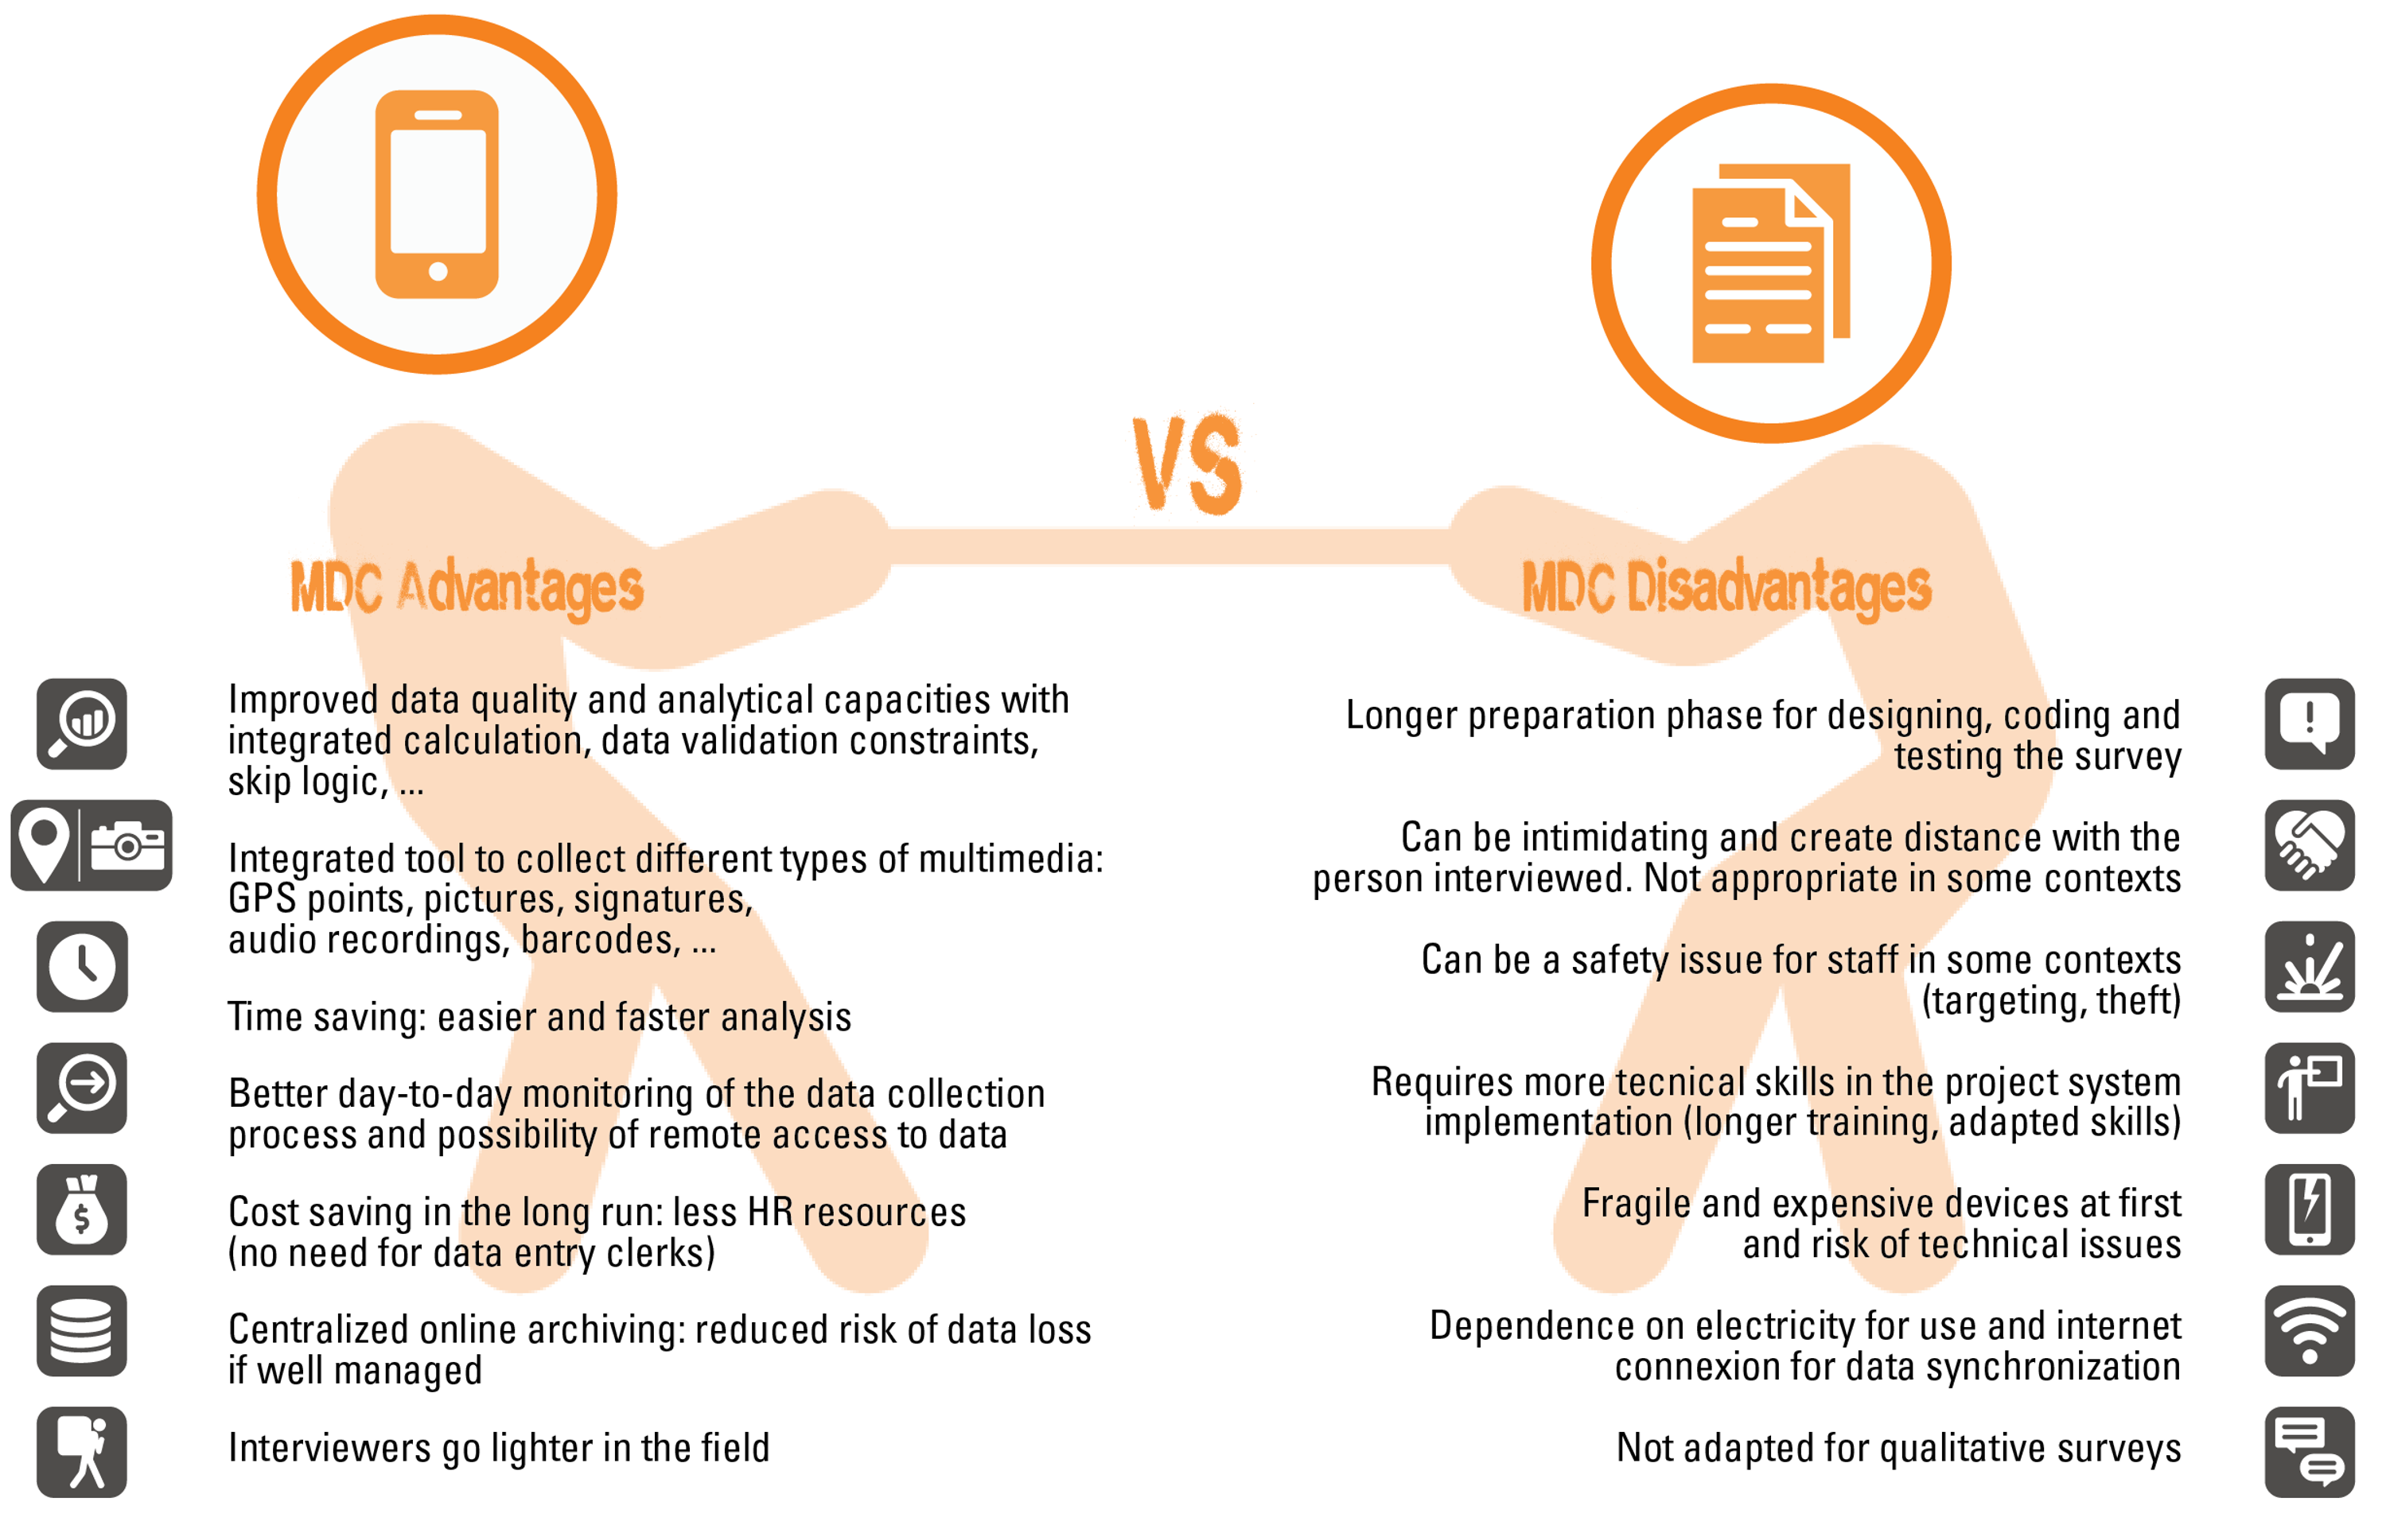
Exercise 1
Mobile Data Collection

Slide 8
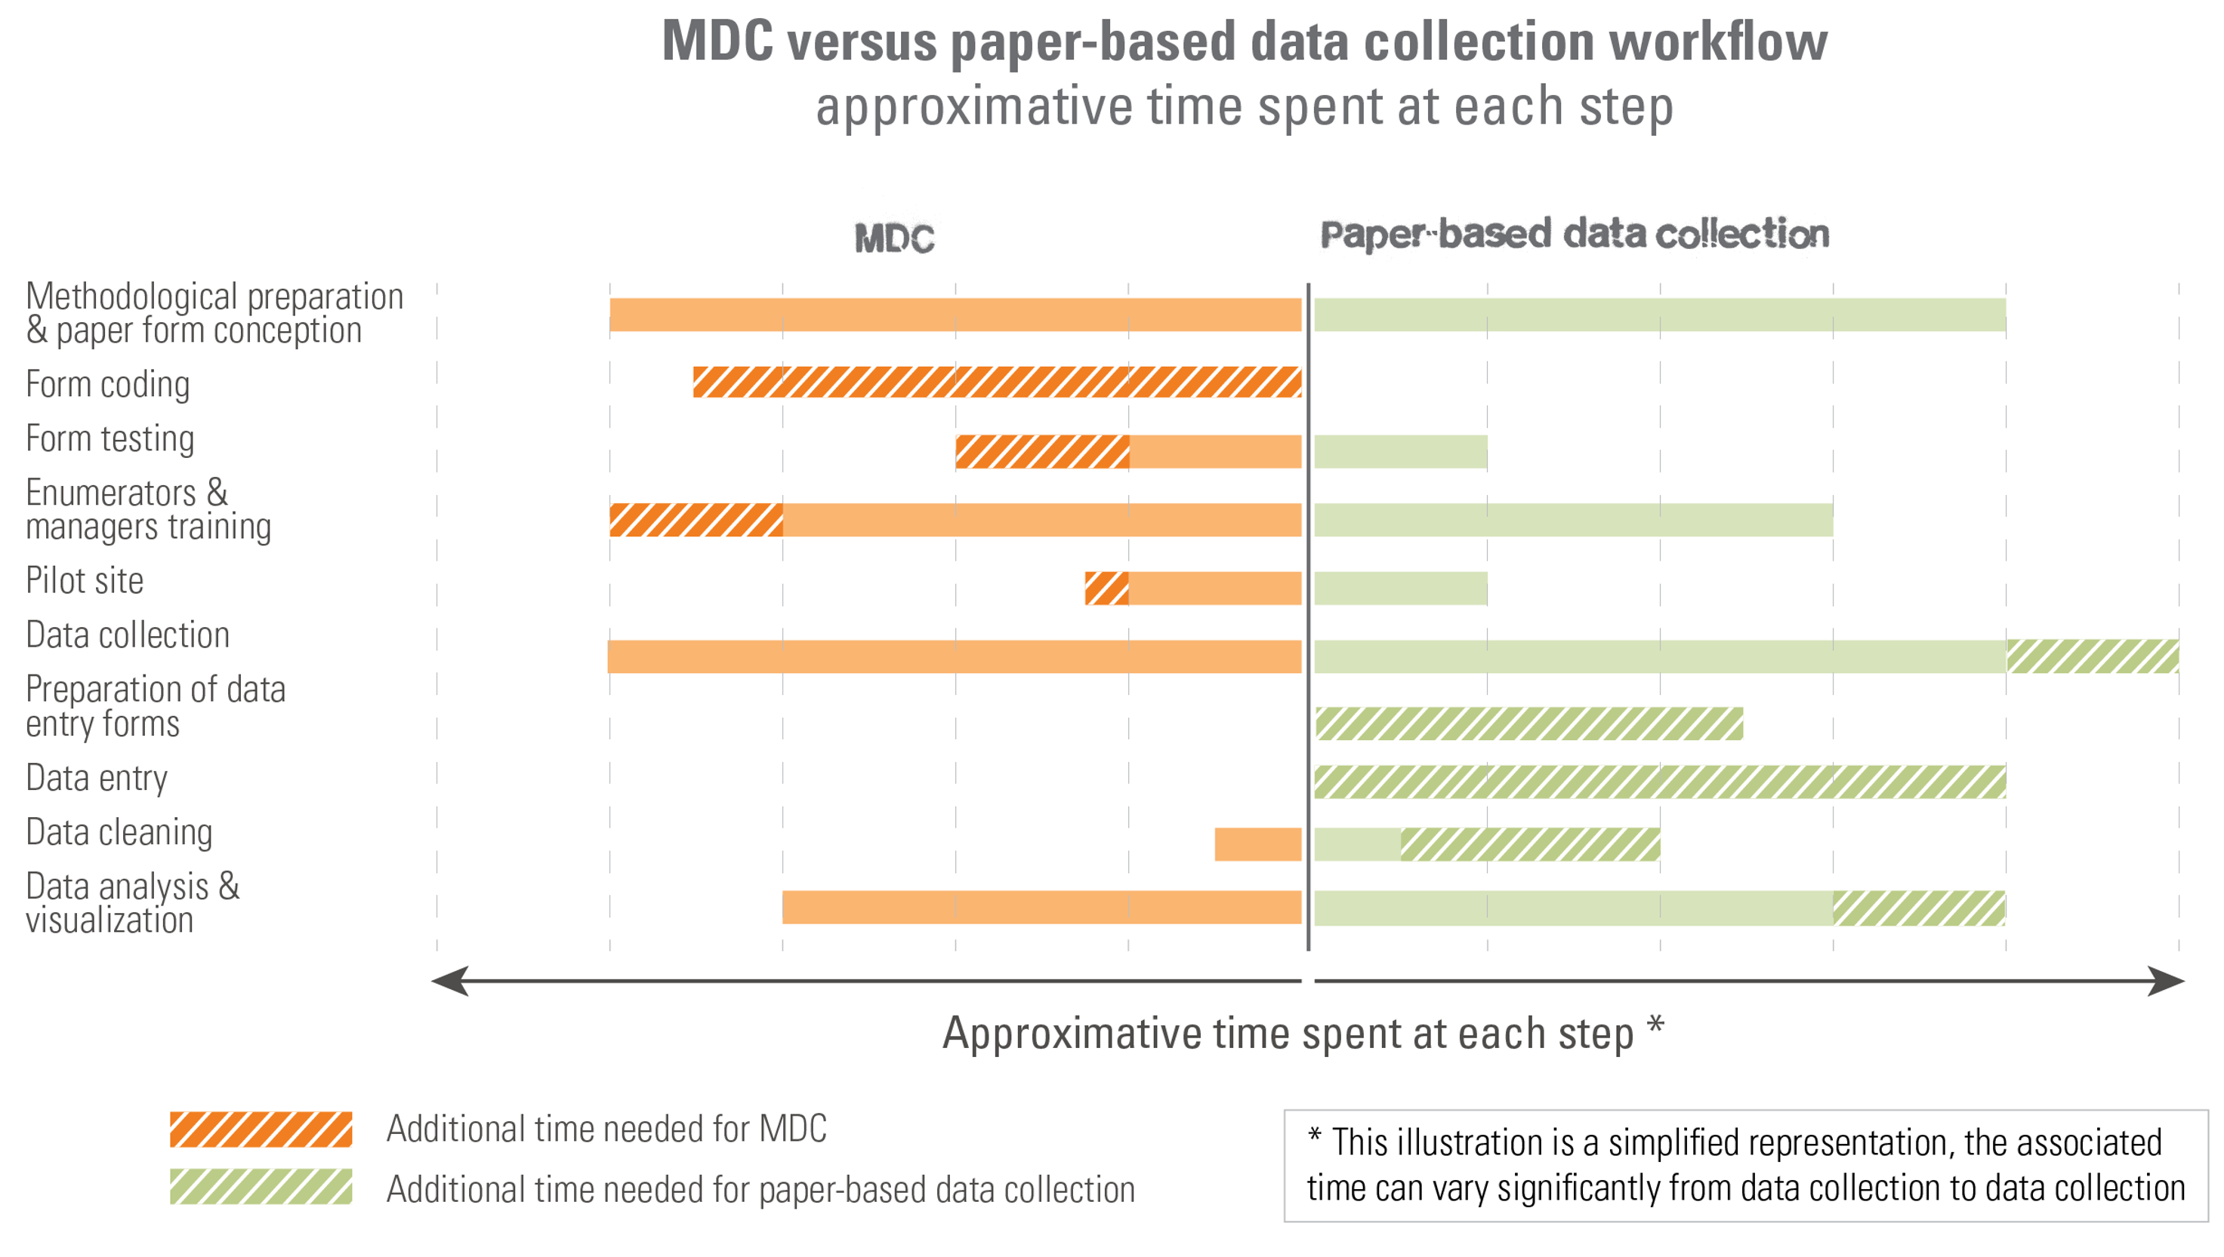
Data collection workflow (time spent)
Mobile Data Collection

Slide 9
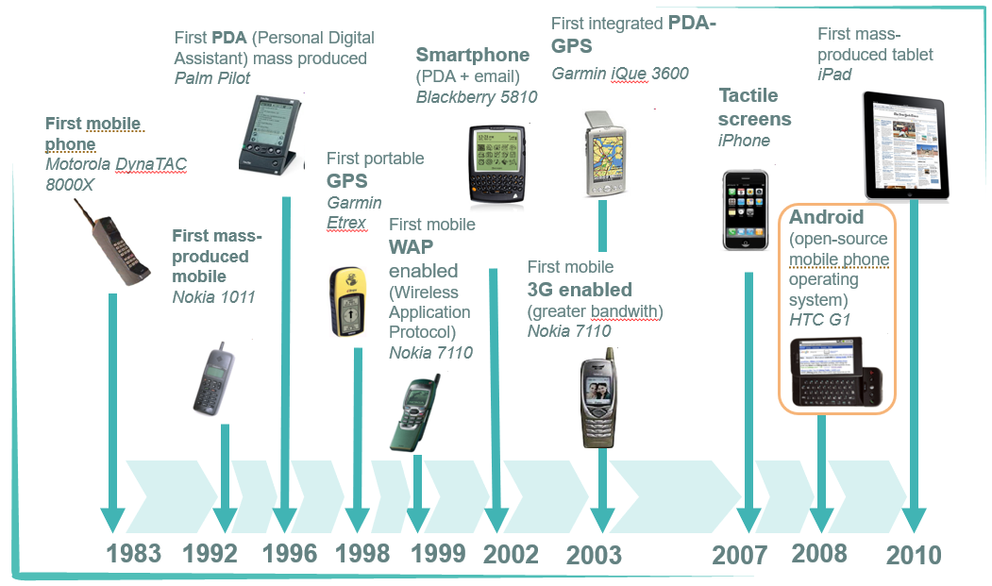
Evolution of technology
Mobile Data Collection

Slide 10
Introduction
What is MDC (Mobile Data Collection) ?
MDC with UNHCR

Slide 11


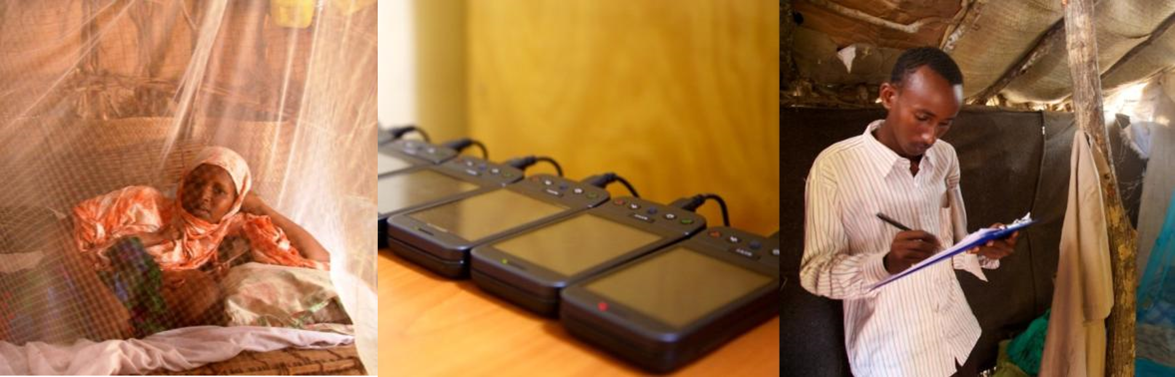
MDC for PHS (UNHCR)
Mobile Data Collection
First deployment :
Kenya: Mosquito nets with ODK (Open Data Kit) 2010, UNHCR
Tools: ODK Collect & ODK Aggregate
Since then, dozens of deployments!
From the field : Sara Hoibak, consultant UNHCR

Slide 12
Exercise 2
Mobile Data Collection
What are the main phases of a mobile data collection campaign for you?

Slide 13
02
Phase of a Mobile Data Collection

Slide 14
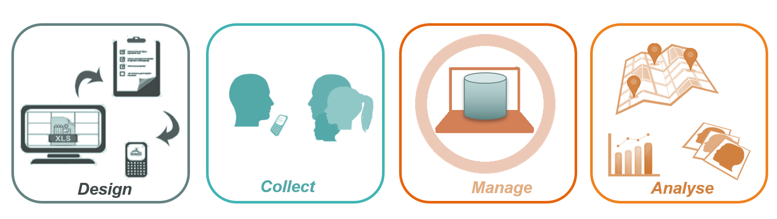
Phases of a MDC

Slide 15
03
Phase 2 – Collect :
Getting to know ODK Collect
Check smartphone’s settings
ODK data entry, review, and edit

Slide 16
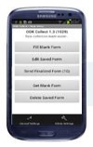
Phases of an MDC
ODK Collect
ODK Collect

Slide 17
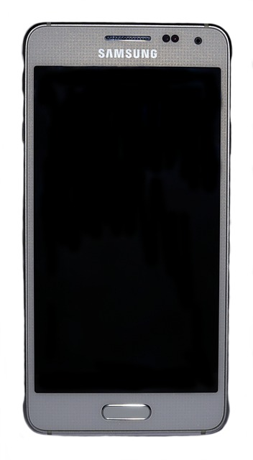
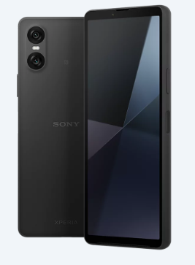
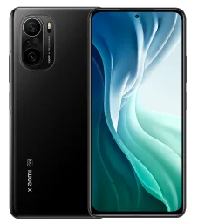
Smartphones (1) - Model
ODK Collect
Sony Experia : Xiaomi : Samsung :
Please make sure that you have the latest android enabled phone.
Notes:
.

Slide 18
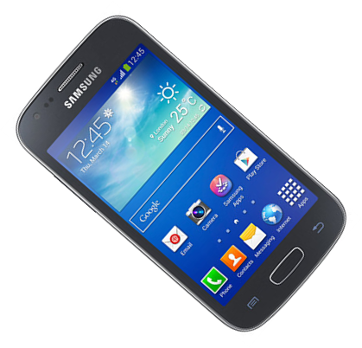
Smartphone (2) - Control
ODK Collect
Varies from models to models (layout, buttons physical VS virtual etc.)
Core components are similar between models :
Power ON / OFF
Turn off display
Flight Mode
Return
HOME : Brings you back
to main screen
Volume
MENU (Additional options)

Slide 19
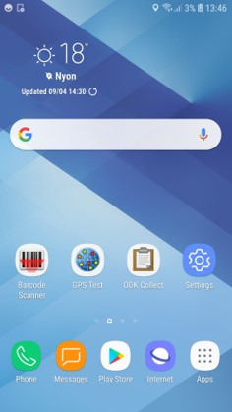
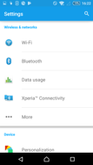
Smartphones (3) - Homescreen
ODK Collect
Example : Samsung Galaxy
1
Status bar : WIFI / Network /
Flight Mode /USB / Battery.
2
Homescreen : Bring all necessary applications to your homescreen and delete all apps which will not be used in survey.
3
ODK Collect : The application used
for data collection on the phone.
4
Settings :
Change various
phone settings.
Shortcuts at the bottom are accessible from all screens.
Please don’t download unnecessary apps or use the survey phone for other purpose beyond data collection.
5
Applications : Access all applications installed on the phone.

Slide 20
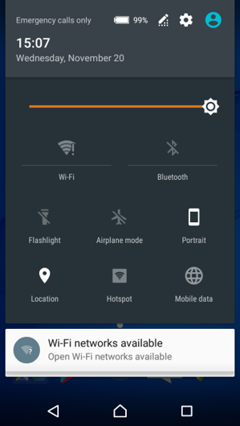



Smartphones (4) – Energy Saving
ODK Collect
To save energy:
Plane mode
WIFI OFF
Lower luminosity of the display;
Set display turn off;
Charge up battery daily if possible;
Turn off GPS when not in use
Use dark themes on ODK Collect (change settings in ODK Collect);
Use Power Bars / USB Chargers for remote place.

Slide 21
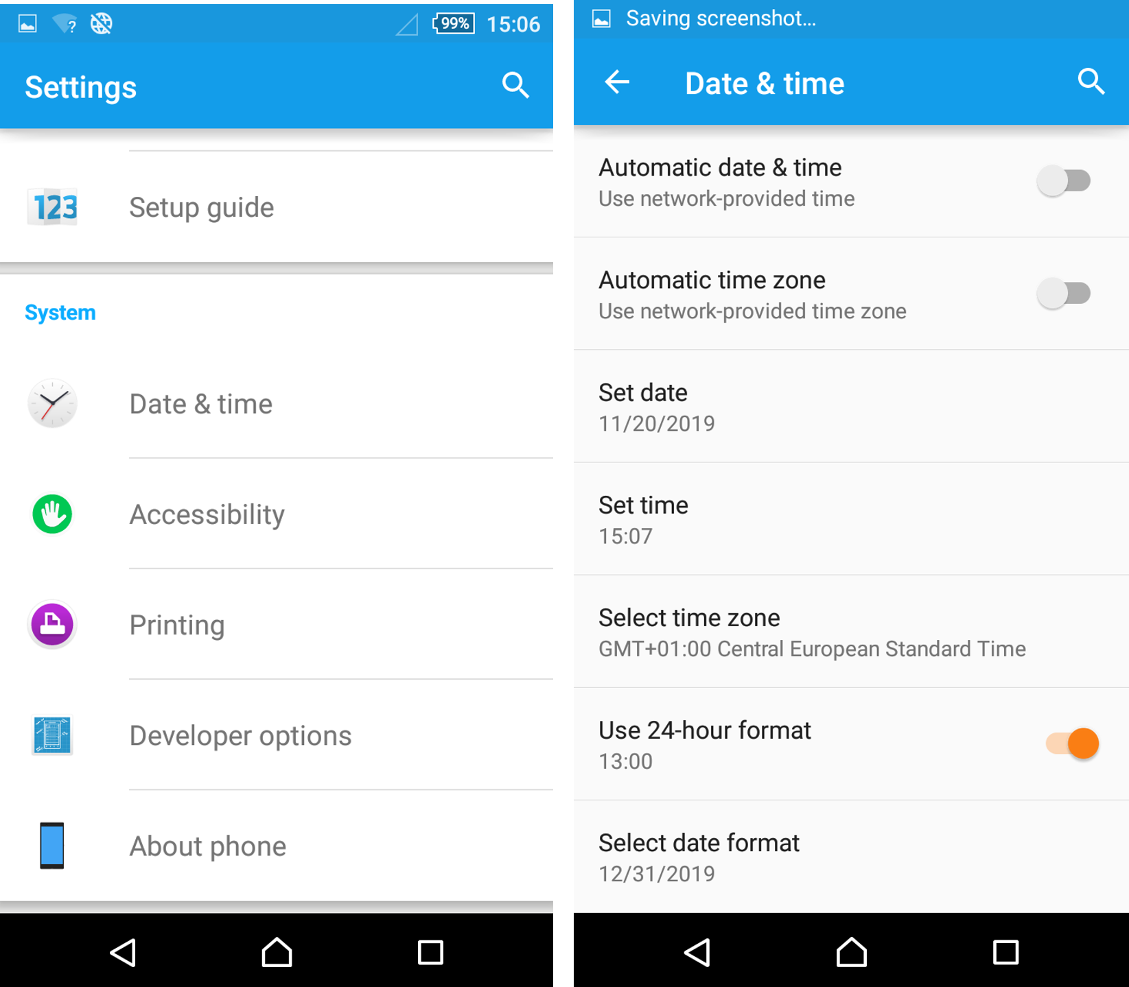
Smartphones (5) – Date & Time
ODK Collect
If auto parameters are not correct, uncheck « Automatic » & adjust date/time manually.
Set the time zone first, then date/time. These parameters must be correct.

Slide 22
Apps (1) – OpenDataKit (ODK) Collect
ODK Collect
Most well-known MDC solution in the humanitarian sector.
Open-source solution for Android :
Widely used
Basis for numerous systems
Powerful and flexible
Secure storage on your own servers possible
Different deployment profiles possible (offline with USB, offline on local network, online, etc.)

Slide 23
Exercise 3
ODK Collect
Set parameters on the phone
Set the date to today’s date and the current time.
Ensure that the phone is in flight mode, that the WIFI is off and display brightness is set to low.
Discussion:
How do these settings impact the survey?
What happens if you accidentally remove the ODK Collect shortcut from the home screen?

Slide 24
03
Phase 2 – Collect :
Getting to know ODK Collect
Check smartphone’s settings
ODK data entry, review, and edit

Slide 25
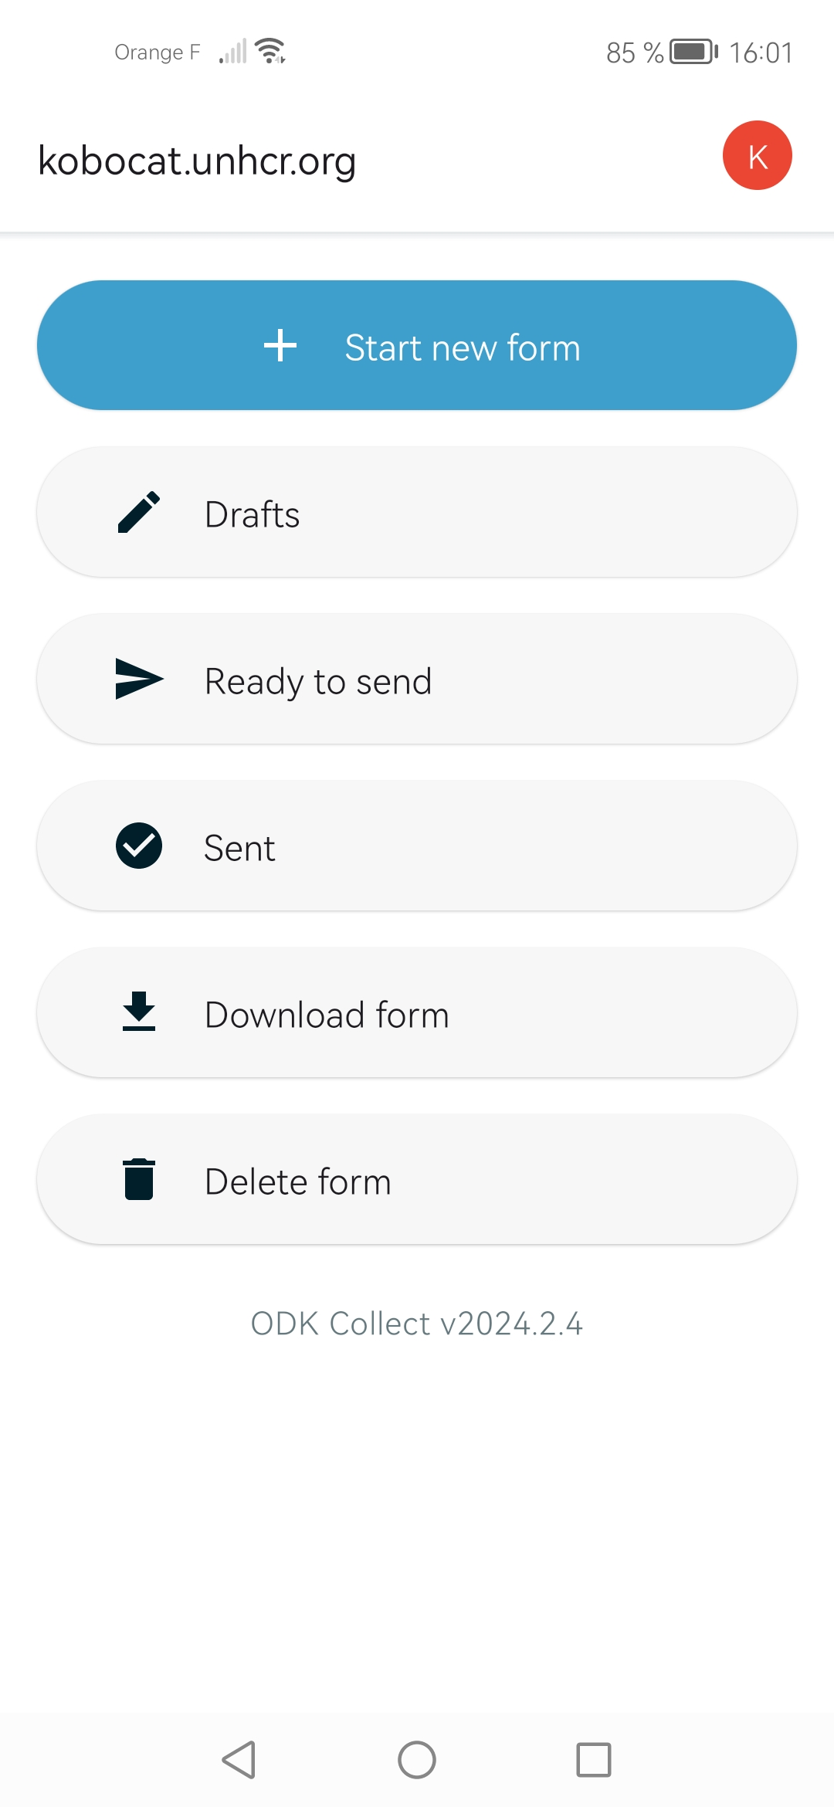
Fill the Form (1) – Start new form
ODK Collect
The most commonly used feature is « + Start new form».
→ Used to enter a new data entry.

Slide 26
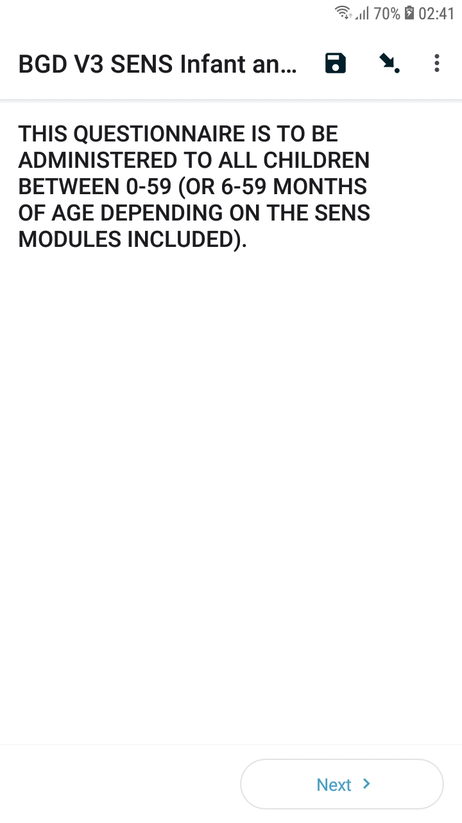
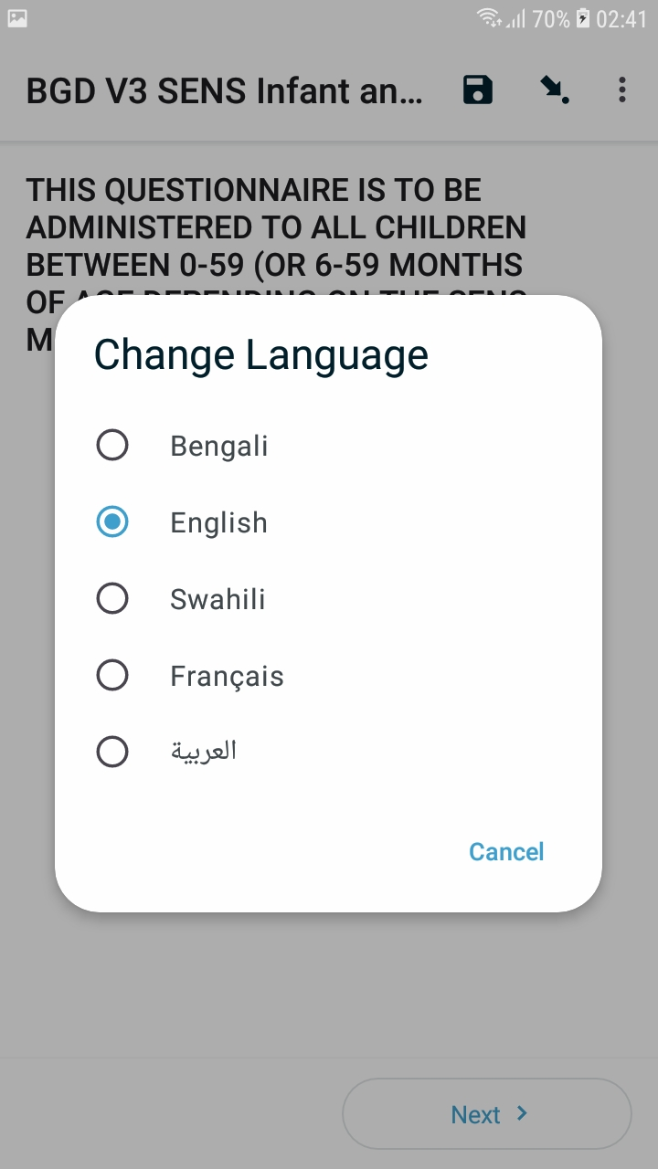
Fill the form (2) – Change Language
ODK Collect
To change the survey language, open a blank form or an already saved form.
Then tap the « Menu » button top right and tap « Change Language ».

Slide 27
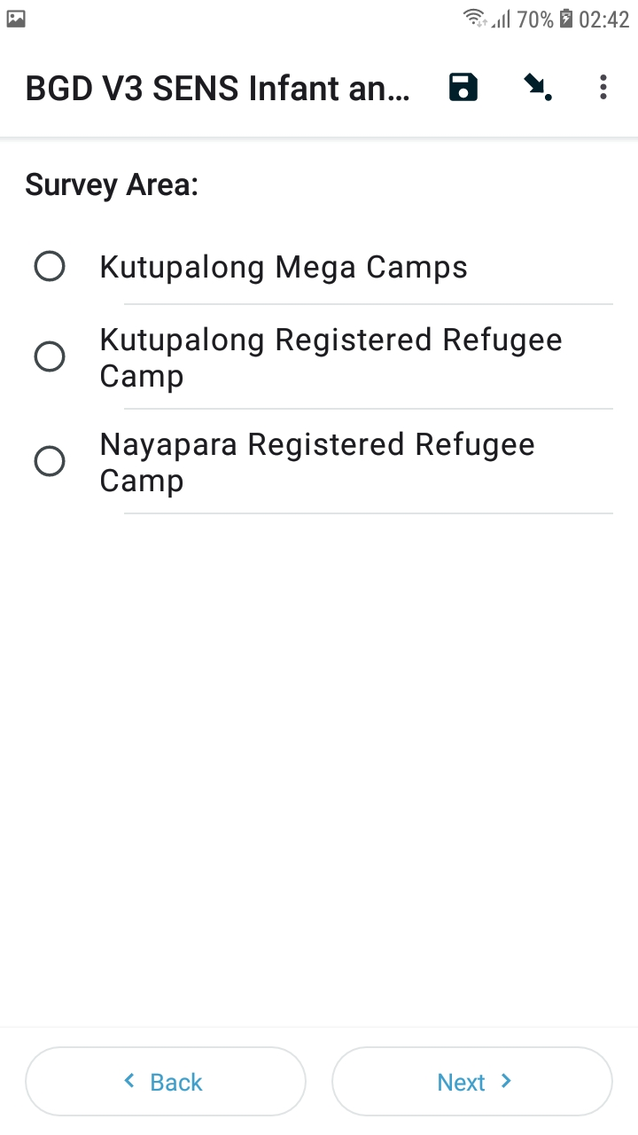
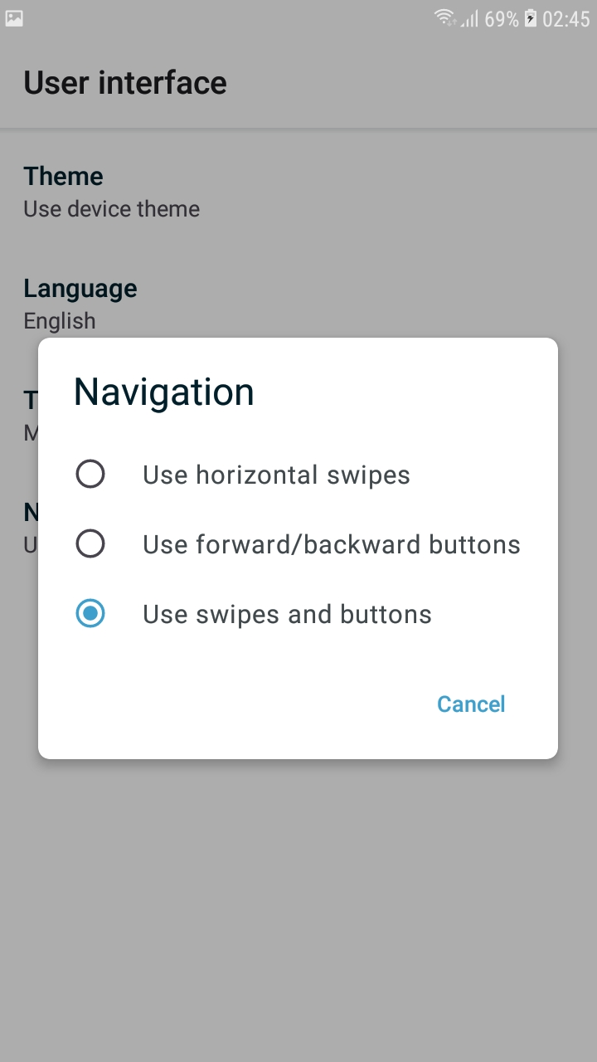
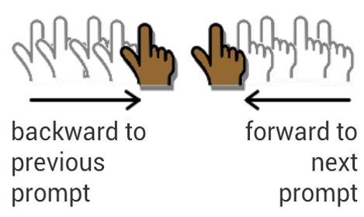
Fill the form (3) – Navigation in form
ODK Collect
You can slide your finger to the left or the right to move forward or backward in the form, much like reading a book.
The 3 following navigation options can be found in the “User interface”

Slide 28
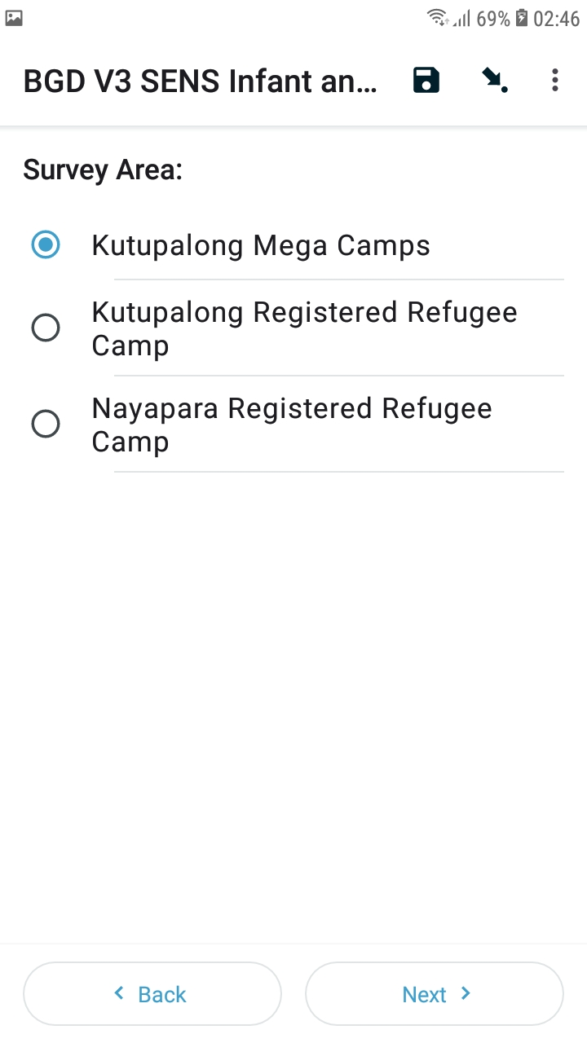
Fill the form (4) – Select an option
ODK Collect
In this example one of the answers can be selected.
When the icon is a circle (radio button), only ONE answer can be selected.

Slide 29
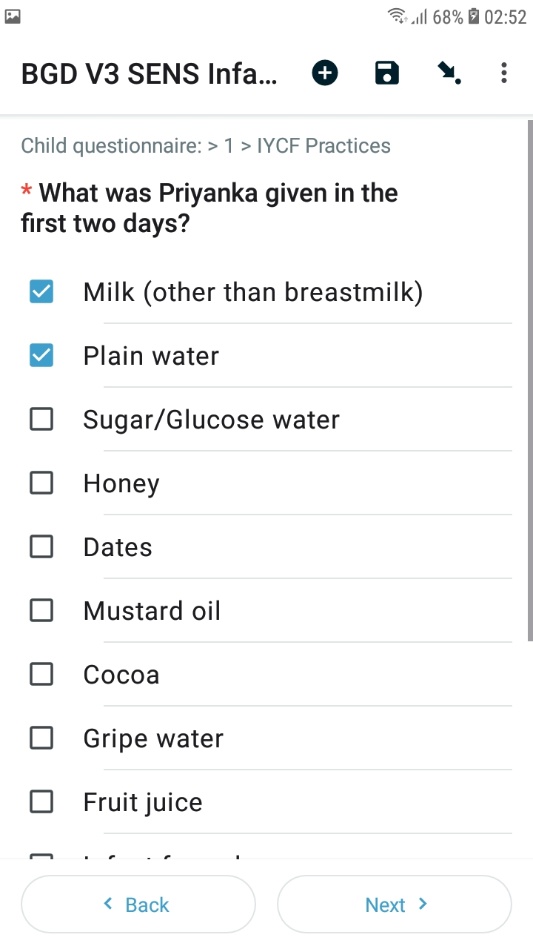
Fill the form (5) – Select multiple options
ODK Collect
When the icon is a square, SEVERAL answers can be selected.
The questions asked to the respondents are in bold.
The capitalized sentences are the instruction to you, please don’t read the instruction to the respondents, and operate following the instruction.

Slide 30
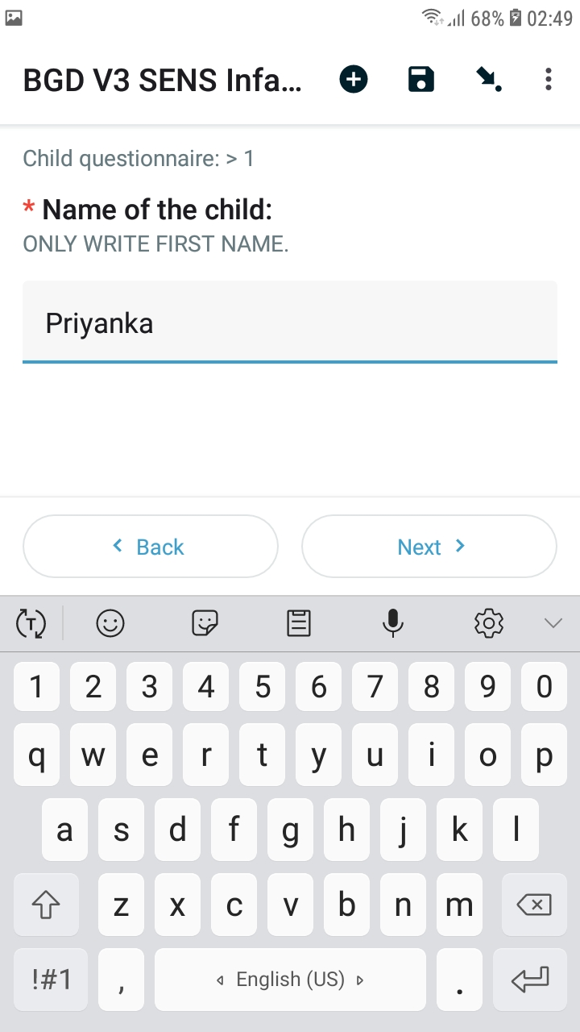
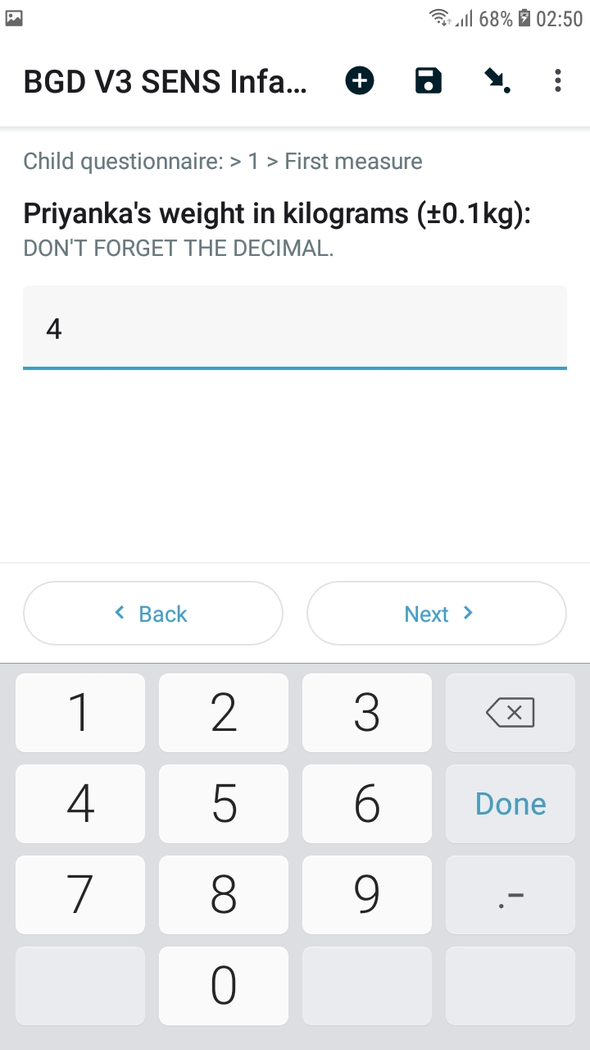
Fill the form (6) – Enter text / number
ODK Collect
Example :
Some questions require text entries.
For some fields, only letters can be used, while for others both integers/letters are accepted. Constraints may also be used to control input.

Slide 31
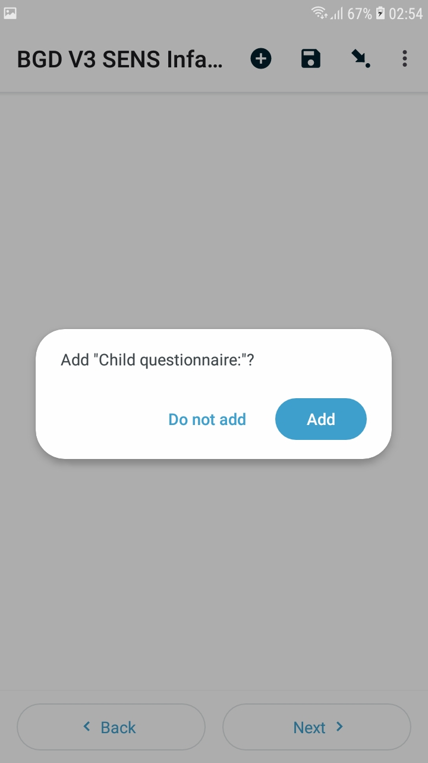
Fill the form (7) – Add a group
ODK Collect
Example:
Adding a group for the « Child » form
Each child in the HH will be a group member
If the filled group number doesn’t match the total number of the member in the household, a notification will be given before it can be finalized. Please review the number of group and add/delete the missing/repeated member accordingly.
How to remove a group if too many have been added ?

Slide 32
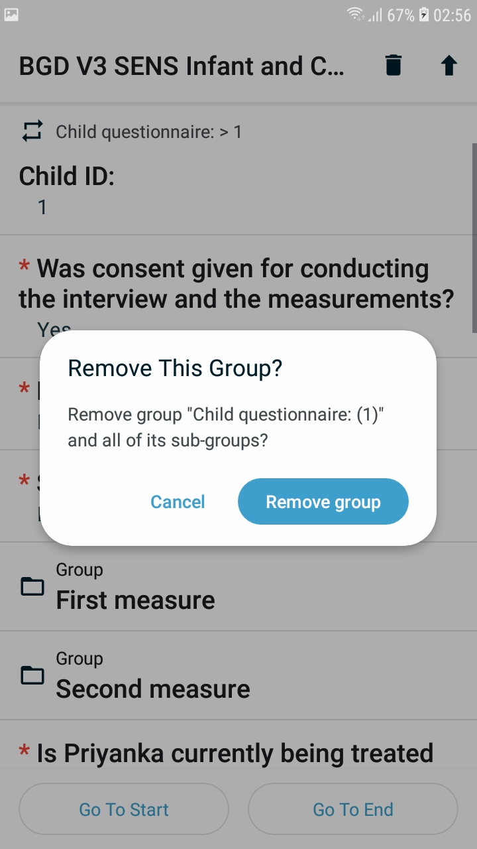
Fill the Form (8) – Delete a group
ODK Collect
In forms where groups are used, if a group has been erroneously added, it can be removed.
To do so, press and hold on the response field.
Then select « Remove group ».

Slide 33
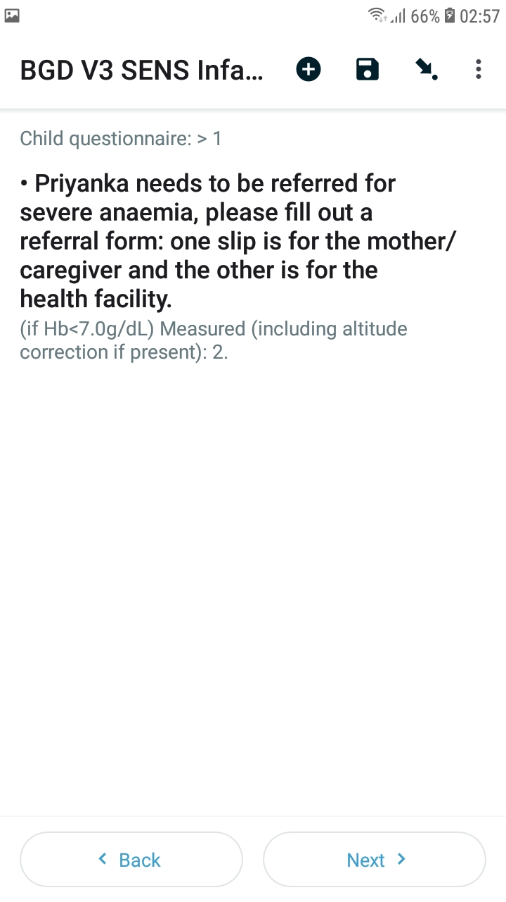
Fill the Form (9) – Automatic Referral
ODK Collect
If the child is either malnourished or has severe anaemia, and is not involved in the treating program, an automatic referral information will be shown on the screen.
Please fill the referral clips accordingly.

Slide 34
Review and Edit Data (1)
ODK Collect
If a form has been saved (done automatically as it is filled), it is possible to edit the answers with: “Drafts”.

Slide 35

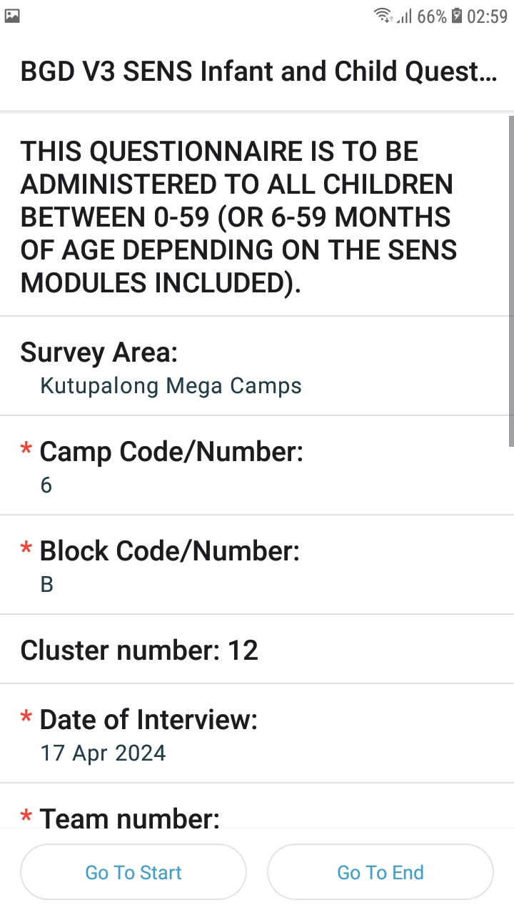
Review and Edit Data (2)
ODK Collect
Once the form is selected, click on the arrow in the top right of the screen for “prompt mode”.
This allows all the responses to be reviewed more conveniently as shown in second screenshot.

Slide 36
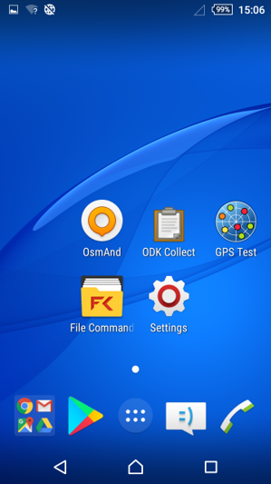
Exercise 4
ODK Collect
Tap the « ODK Collect » icon.
Select « + Start new form ».
Fill out the « Global V3 SENS Women Questionnaire » form and keep it saved on your form.

Slide 37
04
Standard operating procedures (SOPs)
In-deployment : SOP of enumerators

Slide 38
Typical day : Enumerators
SOPs
On the first day, sign the waiver. Otherwise, ensure you receive the HH composition & data collection control sheets. Check that all phone settings are ok (date/time, display, plane mode, Wi-Fi off...)
6h45
Phones distributed to supervisors
7h00
7h30 – 12h30
12h30 – 13h00
13h00 – 16h00
16h00 – 17h00
17h30
1730 - 18h30 –
During the evening
Phones distributed to enumerators
Data collection
Lunch
Data collection
Phones received by supervisors
Phones received by survey manager
Data analysis, backups
Phones charged
Return to incomplete surveys from the previous day. Then proceed as expected given the data collection control sheet. Do not mark as finalized – but do indicate in the end if you consider the survey final or not (second to last question).
Explain the use of phones to beneficiaries to avoid misunderstandings.
Give back phones & paperwork.
Teams are generally composed of :
Team leader (data quality, fill individual forms & supervision)
Enumerators (fill HH level modules)
Measurers for anthropometric data
Hb measurers
Translator/local helper (if needed)
To be adapted to your context.

Slide 39
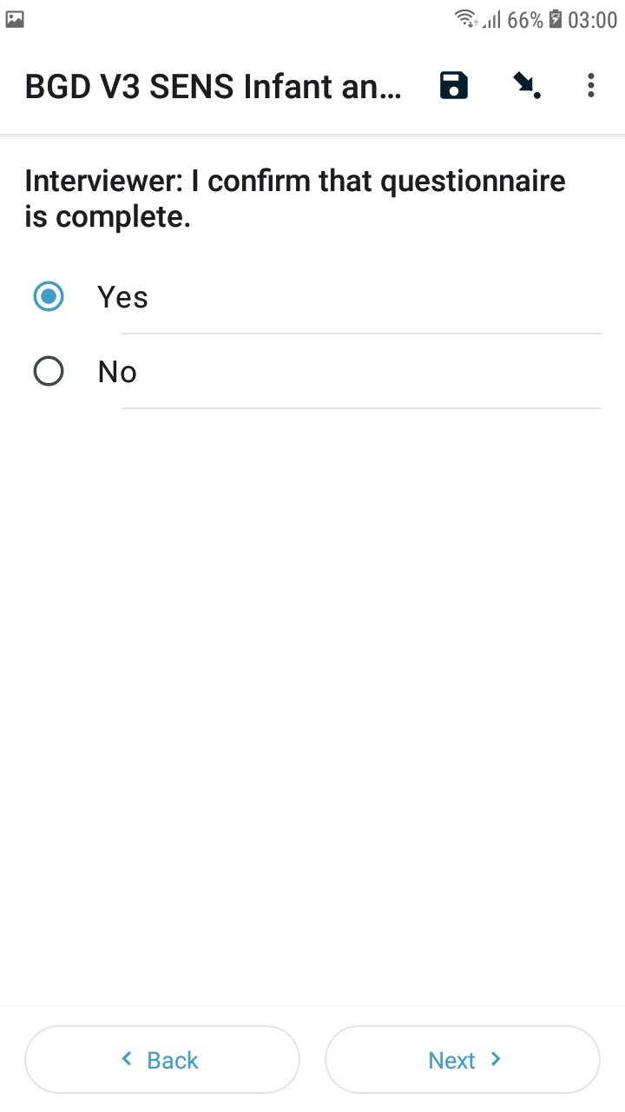
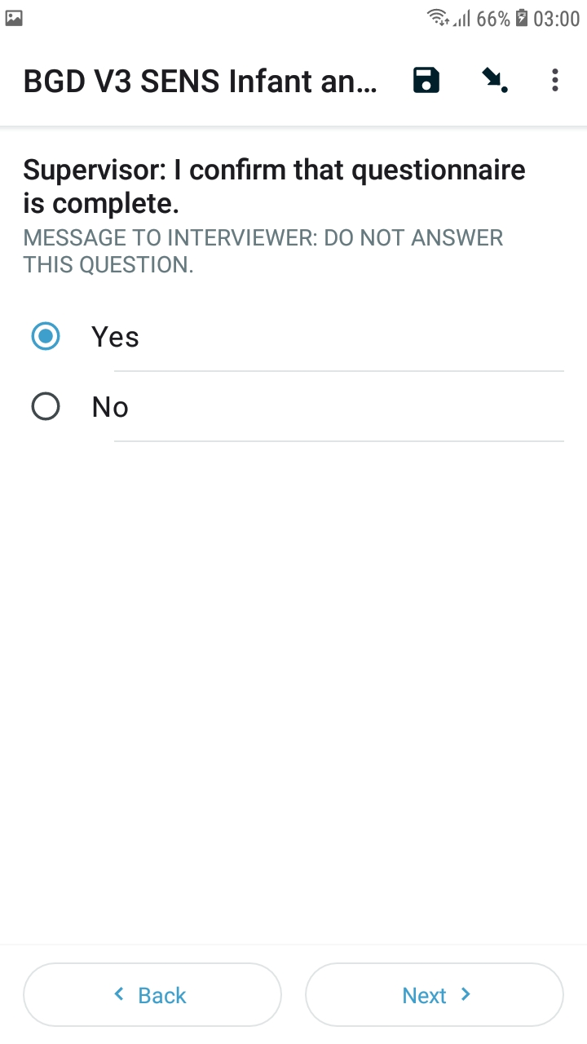
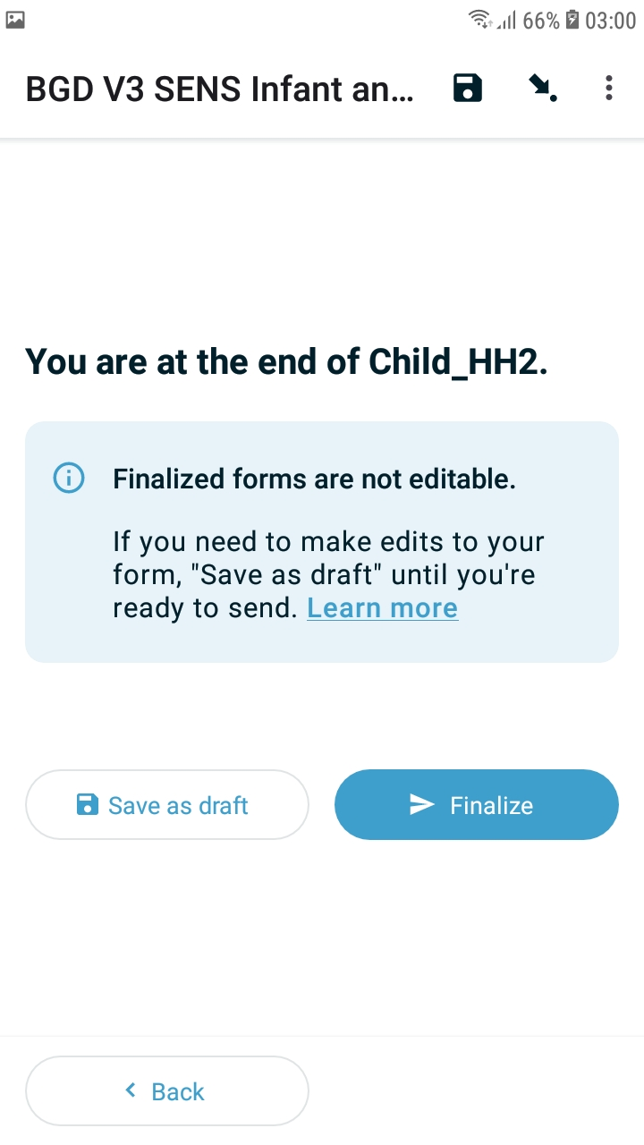


Lifecycle of a form
SOPs
Ongoing (not finalized, absent, etc.)
Considered finished by enumerator
Considered finished by supervisor
Marked as finalized by supervisor

Slide 40
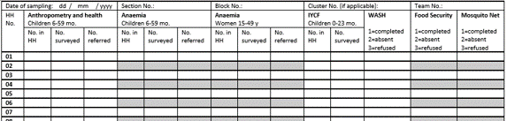
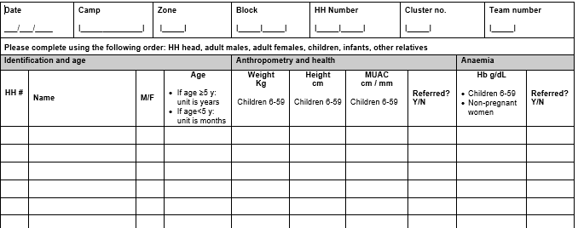
Support documentation
SOPs
Data collection control:
Overview of all HH to be visited;
One per block/cluster.
HH composition sheet:
Overview of the composition of each HH;
One per HH.
Only useful when it is actually being used!

Slide 41
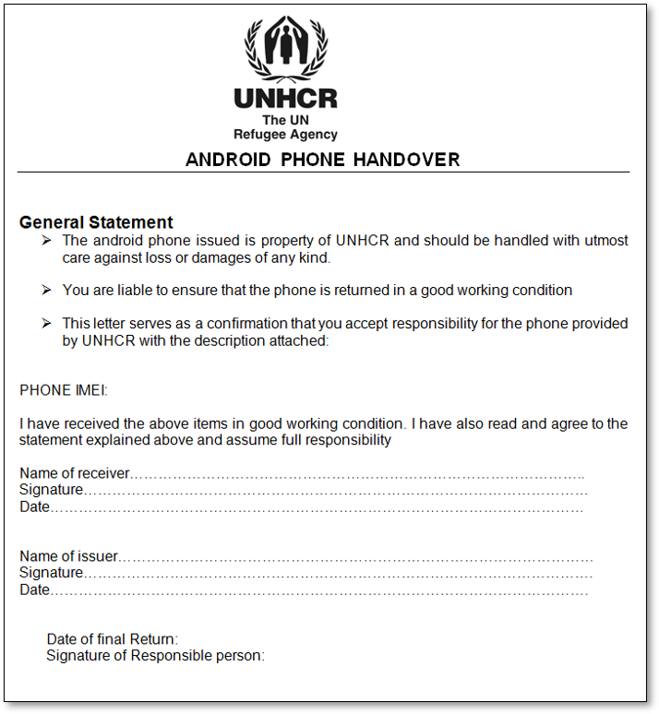
Phone ownership and responsibilities
SOPs
Signed once before the start of the survey when the phones are distributed.

Slide 42
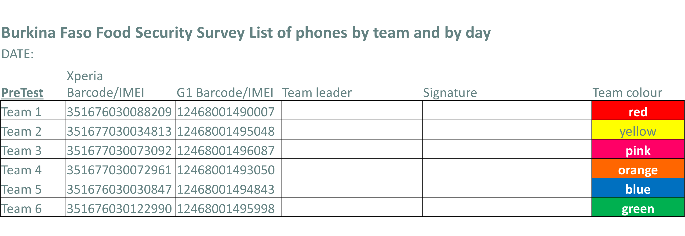
Daily phone management
SOPs
Must be signed once by the enumerator in the morning, when they receive the material. The supervisor signs at the end of the day when the phones are returned.

Slide 43
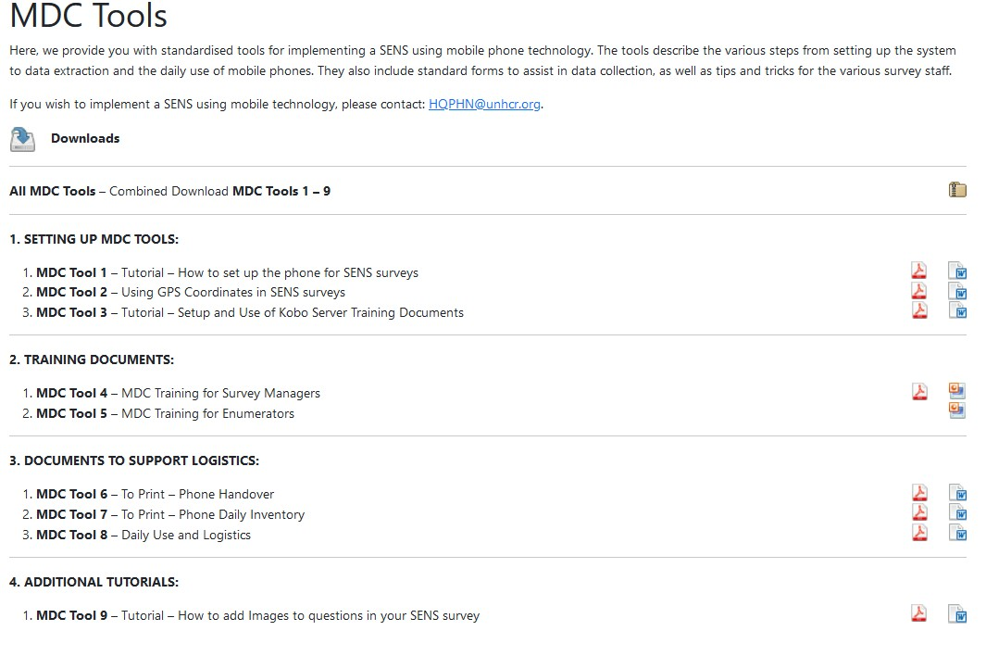
Support documentation available
SOPs

