Slide 1
SENS Surveys [Camp/Setting names] Region, Country - Time frame
Survey Training
[PLACE, DATES]
[LOGO PARTNERS]

Slide 2
Session 6: Anaemia
Generalities, target group and sampling
Material needed
Standard procedures
Ethical considerations
Blood samples and security measures
Common errors
Demonstrations, practical exercise and standardization exercise

Slide 3
Generalities

Slide 4
Key Terms
Haemoglobin: The oxygen-carrying part of red blood cells. The amount of haemoglobin (Hb) in blood is typically expressed in g/dL (grams of Hb per decilitre of blood). It is also sometimes expressed in g/L (grams of Hb per litre of blood)
Anaemia: A condition caused by a reduced Hb concentration in the blood (i.e. decrease in number of red blood cells). This results in reduced oxygen-carrying capacity, and may lead to reduced aerobic activity in the body’s cells
Iron deficiency: Not enough iron in the body can result in iron deficiency anaemia because iron is necessary to make Hb. Iron deficiency is due to inadequate dietary iron and blood loss. The most common type of anaemia is due to iron deficiency resulting from inadequate iron intake from foods
HemoCue: Portable device used to measure Hb concentration in the blood

Slide 5
Key Messages
Data on the prevalence of anaemia is essential to collect in refugee settings for monitoring purposes
Standard methods should be followed for measuring haemoglobin (Hb) using the HemoCue machine and for standardizing the process → To maintain the quality, reliability and usability of the results
Definition
« Anaemia is said to exist when the level of circulating Hb in the patient is lower than that of healthy persons of the same age group and sex in the same environment »

Slide 6
Anaemia Definition (Source: WHO 2000)
Age/Sex Groups | Categories of Anaemia* (Hb g/dL)
 | Total | Mild | Moderate | Severe
Children 6-59 months | <11.0 | 10.0-10.9 | 7.0-9.9 | < 7.0
Non-pregnant adult females 15-49 ans ** | <12.0 | 11.0-11.9 | 8.0-10.9 | < 8.0
Pregnant Women*** | <11.0 | 10.0-10.9 | 7.0-9.9 | < 7.0
* These categories are for people living at sea level. At elevations above 1000m, Hb concentrations increase as an adaptive response to the lower partial pressure of oxygen and reduced oxygen saturation of blood. The compensatory increase in red cell production ensures that sufficient oxygen is supplied to tissues.
** This category includes lactating women.
*** Anaemia cut-offs for pregnant women should be adjusted depending on the stage of pregnancy. In surveys, gestational age is difficult to ascertain and rarely collected. Because of these difficulties and the small sample size, pregnant women are not included in nutrition surveys for the assessment of anaemia in refugee settings.

Slide 7
Objectives
Primary objective
To measure the prevalence of anaemia in children aged 6-59 months and in women of reproductive age between 15-49 years (non-pregnant)
Secondary objective
To determine enrolment into Antenatal Care Clinic (ANC) and coverage of iron-folic acid supplementation in pregnant women

Slide 8
Key Terms
Antenatal Care Clinic (ANC): Commonly referred to as ANC. Those clinics provide care and follow-up for pregnant and lactating women
Iron-folic acid supplements: Supplements provided to pregnant women. WHO recommends daily oral iron and folic acid supplementation with 30mg to 60mg of elemental iron and 400μg of folic acid for pregnant women to prevent maternal anaemia, puerperal sepsis, low birth weight and preterm birth

Slide 9
Target group and sampling

Slide 10
Target Group and Sampling
To be adapted
Example:
Children 6-59 months→ All children in all selected households (Anaemia)
Women 15-49 years (NON-PREGNANT) → All women every second selected households (including lactating women) (Anaemia)
Women 15-49 years (PREGNANT) → All pregnant women every second selected households (including lactating women) (ANC, iron-folic acid supplementation)
Notes:
To be adapted to the survey context.
Refer to Step 8 in the SENS Pre-module and to Module 3 Anaemia for more information on sampling.

Slide 11
Material needed

Slide 12
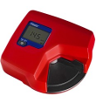
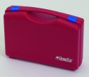
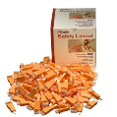
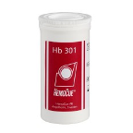
Material Needed (1/2)
HemoCue Hb 301 Analyser and Analyser cases
Safety lancets (sizing of at least 2.25 mm)
HemoCue Microcuvettes

Slide 13
Material Needed (2/2)
HemoCue cleaning spatula → for cleaning interior of HemoCue machine
Eurotrol Hb 301 Control Solutions (high, low, normal) → to verify HemoCue device and microcuvettes quality
Alcohol swabs
Gloves
Tissue paper → for wiping blood drop
Biohazard waste containers → for sharps and contaminated supplies
Spare batteries → for HemoCue machine
Referral forms → to refer severely anemic children and women for treatment

Slide 14
Standard Procedures

Slide 15
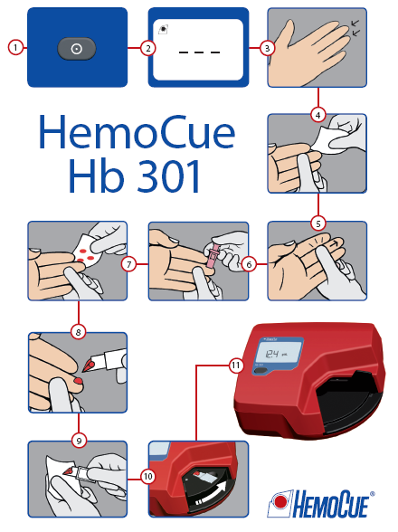
Standard Procedures

Slide 16
Stick a finger (1/6)
Explain procedure
Briefly explain the procedure and explain that they may experience a pain from the finger prick
Explain that the benefits to participants will be that their anaemia status will be known and that they will be referred to the health clinic if they are found to be severely anemic
If the woman is uncomfortable with the procedure, answer any questions she may have. Ensure that the woman knows that she is free to withdraw from the survey at any time and that nothing bad will happen if she does

Slide 17
Stick a finger (2/6)
Prepare work station
Put a new pair of gloves and layout all the supplies to be used for the measurement on a piece of paper roll
Close the microcuvette container immediately after taking out the microcuvette
Ensure correct position of the participant
Face the participant and, if you are right-handed, position yourself to be able to comfortably hold the woman’s finger with your left hand while using your right hand to hold the lancet or microcuvette (reverse if you are left-handed)
A young child who is tested should be seated on the mother’s or caregiver’s lap, and be provided with reassurance and distracted during testing

Slide 18
Stick a finger (3/6)
Hold participant’s hand
Do not hold the woman’s hand so tightly so as to obstruct blood flow
Select finger
Choose the participant’s middle or ring finger for the finger stick. The selected finger should not be swollen and should be minimally callused
Remove any rings that are on this finger because the ring might interfere with blood flow. Rings on other fingers do not have to be removed unless they are in the way of the measurer
Check finger
Feel the woman’s fingers for warmth. If the fingers are cold, rub the fingers vigorously. If warm water is available, you can also warm them by washing them in the warm water

Slide 19
Stick a finger (4/6)
Massage finger
Hold the participant’s finger for the finger stick. Use a rolling motion to gently massage the finger from the top of knuckle towards the fingertip to increase blood flow
Disinfect finger
Clean the participant’s fingertip with the disinfectant and allow to air dry
Hold finger
Hold the participant’s finger and apply gentle pressure to firm the skin so that the lancet will go deeper into the finger

Slide 20
Stick a finger (5/6)
Place lancet
Hold the lancet between two fingers and rest the thumb on the needle trigger
Place the lancet on the side of the fingertip rather than on the pad of the fingertip (this will especially help in case fingers are heavily callused)
Stick finger
Use a rolling motion to massage the participant’s finger even more from the top of knuckle towards the fingertip to increase blood flow
Push firmly the lancet against the participant’s skin before triggering the needle with your thumb
Dispose of the lancet immediately after use in a biohazard waste container

Slide 21
Stick a finger (6/6)
Initiate blood flow
Apply gentle pressure to the wrist, palm and top of knuckle to initiate blood flow
Do not squeeze or rub the tip of the finger because you may dilute the blood drop with interstitial fluid

Slide 22
Fill the microcuvette (1/4)
Wipe away 1st and 2nd blood drop
Using a clean tissue paper, wipe away the first two drops of blood
Do not wipe away the drops with alcohol
Sample the 3rd drop of blood
The drop of blood should be large enough to fill the microcuvette in one touch
Fill microcuvette
Hold the finger in one hand
Touch the tip of the microcuvette into the middle of the blood drop and fill the microcuvette completely with a single drop of blood in one step → The microcuvette fills itself by capillary action

Slide 23
Fill the microcuvette (2/4)
Inspect microcuvette
Inspect the microcuvette for air bubbles and check if it is completely filled by holding it up to the light
If you see air bubbles or if you see that it is not completely filled, discard the microcuvette
Never refill a partially filled microcuvette with the same drop of blood because the blood may have started to clot and will give an incorrect reading
If a new microcuvette is needed, refill a new microcuvette from a new blood drop from the same finger puncture if feasible. Otherwise, you may have to make a new prick. If you do need to make another prick, you should use another finger

Slide 24
Fill the microcuvette (3/4)
Wipe off excess blood
Carefully wipe off any excess blood from the flat sides of the microcuvette with a clean dry tissue paper
Make sure that no blood is sucked out of the microcuvette while wiping it
Place microcuvette in holder
Immediately place the filled microcuvette into the microcuvette holder and read the microcuvette within three minutes of sampling
Slide holder
Gently slide the microcuvette holder into the machine until the stop point is reached
Do not ‘slam’ the holder into position for reading; this may spray blood droplets, which negatively affects the reading

Slide 25
Fill the microcuvette (4/4)
Apply a cotton ball
While the HemoCue machine is reading the sample, apply a cotton ball to the puncture wound on the participant’s finger
Record reading
After a few seconds, the Hb value will appear on the display → Record this value
Dispose of the microcuvette
Dispose of the microcuvette immediately in the biohazard waste container after reading it

Slide 26
ETHICAL ConsidErationS

Slide 27
Referral Form (1/2)
Obtain the consent from the head of household and/or caretaker of children under 5 years of age and women before to start
All children and women with signs of severe anaemia will be given a referral form to go to the nearest health facility:
Child → Hb<7.0 g/dL
Woman → Hb<8.0 g/dL
Referral form → 2 copies
Team copy (for Supervisor/Survey manager)
Caregiver/Mother copy

Slide 28
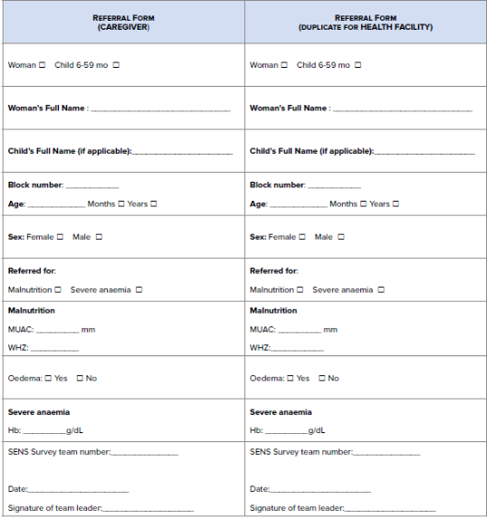
Referral Form (2/2)
Notes:
For a template of the referral from to use and adapt to the refugee setting, see SENS Anthropometry and Health Tool #3

Slide 29
BLOOD SAMPLES AND SECURITY MEASURES

Slide 30
Blood Sample
All blood samples and contaminated supplies should be handled with extreme care!
Blood is a potential source of infection with HIV, Hepatitis B and C Virus and other blood-borne pathogens

Slide 31
Checklist (1/3)
To protect themselves and the survey population from exposure to blood
Wash your hands
Always wash hands with soap and water at the start and end of the workday (or before and after each break)
Cover your cuts
Cover all cuts with bandages to prevent any possibility of blood from survey population coming into contact with any cuts
Avoid penetrating injuries !
Although gloves can prevent blood contamination, they cannot prevent penetrating injuries caused by the instruments used for finger sticks

Slide 32
Checklist (2/3)
Wear gloves
Always wear well-fitting disposable latex gloves when sampling blood to protect against exposure to blood. Gloves must be worn during Hb measurement until all specimens and materials are disposed of
Gloves must be disposed of as bio hazardous waste. Gloves must be never reused!
Use new pairs of gloves for each participant
Clean up blood spills
Immediately clean up any blood spills with an antiseptic so that survey workers and women do not touch any blood

Slide 33
Checklist (3/3)
Disposal in biohazard waste
All materials coming in contact with blood must be placed in bio hazardous waste containers after use and disposed of according to standards. Immediately dispose of any tissue paper, gloves, used lancets, microcuvettes and other supplies that have been in contact with blood in the biohazard waste container
If an accident occurs
Any skin surfaces or mucous membranes that come in contact with blood must be immediately and thoroughly washed with a large amount of water and soap
The supervisor is to be contacted immediately

Slide 34
Common errors

Slide 35
Common Errors (1/6)
Common error | Description | Solution
Improperly stored microcuvettes | Improperly stored microcuvettes should not be used for testing. Microcuvettes should not be kept in unsealed containers for longer than 3 months. | The containers must be kept closed when not in use to avoid exposure to moisture.
Not setting-up properly | Not preparing all needed materials before testing a participant may affect the quality of the reading. | Place a microcuvette, cotton ball with antiseptic solution, a tissue paper, and a lancet on a ‘work station’; turn on HemoCue machine; pull out microcuvette holder to ‘locked’ position so that digital screen is ready; put on latex gloves.
Removing microcuvette from container with fingers wet with alcohol | This can result in alcohol coming into contact with the microcuvette; thus the selected microcuvette as well as others inside the container can be destroyed. | Take the microcuvette out of its container before handling an alcohol swabs.

Slide 36
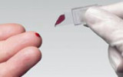
Common Errors (2/6)
Common error | Description | Solution
Underfilling the microcuvette | The microcuvette is only partially filled or only the red circle of the microcuvette is filled with blood. Never use an under filled microcuvette and never refill a partially filled microcuvette with same drop of blood because the blood may have started to clot and will give an incorrect reading. | Refill a new microcuvette from a new blood drop from the same finger puncture if feasible. Otherwise, you may have to make a new prick. If you do need to make another prick, you should use another finger.

Slide 37
Common Errors (3/6)
Common error | Description | Solution
Mixing alcohol with blood drop | Not letting finger to dry completely after disinfecting with alcohol will give a faulty reading. Even a trace of alcohol getting into the microcuvette will affect the reading. | Allow finger to air dry after wiping with alcohol.
Shallow finger puncture | A finger puncture that is too shallow because lancet was not properly placed or not enough pressure was placed while releasing the lancet will restrict blood flow. | A deep puncture done with a quick stab will result in better blood flow and more rapid completion of the test.
Obstructing blood flow | Restricting blood flow to the woman’s fingertip following the finger stick because the finger is held tightly will affect testing. | Release the woman’s finger after the stick to allow blood flow; also hold the woman’s hand without squeezing and restricting blood flow to the fingertip.

Slide 38
Common Errors (4/6)
Common error | Description | Solution
‘Milking’ the finger | Excessive massaging or squeezing of the finger will cause tissue juice (interstitial fluid) to mix with and dilute the blood. This will result in erroneous test results, particularly in yielding low levels of Hb concentration in the blood. | A good finger stick should result in spontaneous blood flow, negating the need to apply pressure to the finger. If stimulating blood flow is needed, apply gentle pressure with your thumb on the opposite side of the participant’s finger from the puncture site.
Using the wrong drop of blood | Not appropriately wiping off the first two drops may result in an unrepresentative blood sample being tested. | Firmly wipe off the first two large blood drops. Firm wiping will stimulate blood flow. Discarding the first two large drops will allow flow of a representative blood sample.
Air bubbles in microcuvette | Holding the microcuvette in inverted position (slit facing down) during filling can lead to air bubbles being trapped resulting in erroneous reading. | Hold the microcuvette with the slit facing up and the pointed tip touching the blood drop.

Slide 39
Common Errors (5/6)
Common error | Description | Solution
‘Topping off’ the microcuvette | ‘Topping off’ a partially filled microcuvette with repeated blood collection will result in erroneous measurement. Red cells of blood introduced later will not be adequately analysed. | Allow a large blood drop to form on the woman’s finger so that it will completely fill the microcuvette in one motion. Once filled, hold the microcuvette in place for about 2-3 seconds longer to ensure complete filling.
Blood on outside of microcuvette | Not cleaning off blood on outside of microcuvette before testing can result in erroneously high reading. | Wipe off excess blood from sides of microcuvette using a ‘butter knife’ motion to ensure that blood from inside the microcuvette is not removed.

Slide 40
Common Errors (6/6)
Common error | Description | Solution
Inadequate placement of the microcuvette | ‘Slamming’ the microcuvette holder into place can lead to blood drops spattering inside the reading chamber. This action can damage the reader. | Push the microcuvette holder gently into position. Clean the microcuvette holder with disinfectant solution, and completely dry before testing. (Clean the interior of the HemoCue machine with a spatula).
Not referring the severely anaemic participants according to local treatment standards | The participant is diagnosed as severely anemic and the surveyors do not refer the participant according to the local treatment standards when a facility is available. | Participants should be referred for treatment if found to be severely anemic according to the local treatment standards and should be given a paper referral slip to take with them to the health facility.

Slide 41
Demonstrations

Slide 42
Practical Exercise

Slide 43
StandardiZation Exercise

Slide 44
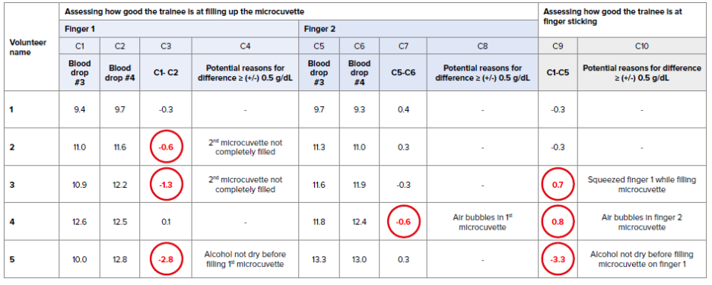
Standardization Exercise
Notes:
An exercise to standardise the trainees’ Hb measurements should be conducted. For instructions on the recommended exercise see Annex 8 or see SENS Anaemia tool: [Tool 4- Anaemia Standardisation Exercise]

Slide 45
ANY Question? Discussion

Slide 46
THANK YOU FOR LISTENING!
[LOGO PARTNERS]

