Slide 1
READ ME FIRST
The Facilitation Package is meant to be used as facilitation material for in-person workshops targeting UNHCR and partners’ frontline workforce, who work across different sectors of the humanitarian response, who are not GBV specialists, and who are in direct contact with displaced and stateless persons. This could include diverse colleagues such as drivers and security guards (all referred to hereafter as frontline workers). It aims to promote discussion, critical thinking and exchange between participants. The Package can also be used as self-study material. Prior to undertaking this learning, it is recommended to complete UNHCR GBV eLearning Level 1 and 2.
Facilitators of the Package should be experienced GBV specialists. It is recommended that the workshop based on this Package is co-organized with technical sector leads and/or Heads of Field or Sub-Offices who can support the engagement of UNHCR and partners’ frontline workforce in the learning, jointly deciding on the most appropriate participant audience (eg. joint sectors, partners, coordination, and/or UNHCR workforce only etc.). The session on handling disclosures of child survivors could be co-facilitated together with a child protection specialist, if needed. The prior completion of UNHCR GBV eLearning Level 1 and 2 as well as a self-study of the Inter-Agency Minimum Standards for GBV in Emergencies are mandatory for facilitators. Another recommended useful resource for facilitators is the Facilitator’s Guide: Applying and Understanding the Inter-Agency Minimum Standards for GBV in Emergencies Programming.
It is recommended that facilitators adapt the content of the Package to their context and audience before delivering the sessions. Please note that:
The examples and exercises can be adjusted and contextualized.
Not all content in the Package is relevant for UNHCR partners and can be removed or hidden.
The Package can be adjusted for online delivery.
The Package can be facilitated in a compact or more extended version with additional information and activities depending on the time allocated for facilitation. The short version of the workshop, takes approximately 6 hours and 45 minutes to deliver, including at least 165 minutes of interactive discussions and exercises. The longer version offers additional 150 minutes of content, exercises and scenarios. Optional slides are marked with an icon for facilitators to include in their session or omit. Facilitators can remove the icon when the slide is used.
The Package can be facilitated in separate segments, or in a consecutive workshop.
As sessions are highly interactive and active engagement of all participants is expected, facilitators should consider a maximum number of participants suitable to the context.
The timeframes indicated in the slides are estimates and may vary according to the facilitation modality (in-person/online),
the number of participants as well as how facilitators may adapt the Package based on local context and audience.

Slide 2
READ ME FIRST
The notes section of the presentation slides include the information facilitators should deliver during the workshop. The slide notes also contain facilitation tips, including if-asked information, timings and references to key resources. It is important to review the slide notes in full before facilitating this Facilitation Package. The notes should appear in the dock below the image of the slide when View is set to Normal. If the notes are not visible, hold your cursor on the thin gray bar at the bottom of the window and drag the bar upwards. The notes section will appear. To view the slides with the notes in large text below them, move your cursor to the top of the window and click View, then Notes Page. To print the slide notes with images of the slides (handy for facilitating for the first time, especially for lengthy teaching segments), click Print, then under Print Layout, choose Notes Pages.
Most slides have animations, which means that certain text, elements or images, appear one at a time by clicking through. These animations are meant to aid the facilitators in revealing content on the slide in stages and in a certain order. It is recommended that the facilitators become fully familiar with the animated slides ahead of the workshop.
The notes of the presentation refer to the Activity Sheets, which are annexed to this Package. The Activity Sheets correspond to the different exercises in this Package (discussion questions, activities and group work) and contain the same information as the relevant activity slides with facilitator notes. The Activity Sheets are meant to be utilized as stand-alone exercises in case not the entire Package is used, but could also assist the facilitator in guiding some of the more complex exercises.
Notes:
NB: Slide adjusted from the UNHCR/IOM, Training Package: SOGIESC and working with LGBTIQ+ persons in forced displacement, 2021, available from (https://www.unhcr.org/workingwithlgbtiq-sogiesc-trainingpackage.html)

Slide 3
Safe disclosure of gender-based violence (GBV) incidents
Graphic Design - REC Design
How to safely handle disclosures of GBV incidents and refer GBV survivors
© UNHCR May 2023
Notes:
When using the images/illustrations for other purposes than in the context of the Facilitation Package, please make sure to accredit the graphic designer REC Design.

Slide 4
Learning objectives
Understand GBV basic concepts and principles.
Know how to safely handle disclosures of GBV and refer GBV survivors.
Notes:
FACILITATOR NOTES
Read the objectives of the session to participants.
Make sure that participants understand that a disclosure of GBV refers to the sharing of information by a survivor or other person concerning an incident of GBV.

Slide 5
Opening remarks
Why are we here?
What are our commitments?
Notes:
FACILITATOR NOTES
As the Safe Disclosure Package is intended for the broader UNHCR and partner workforce, and relates to our joint commitment to facilitate access to quality support for survivors of GBV, it is recommended that at the start of the session a senior colleague from the operation, office, sector or programme management (eg. representative, head of office, head of sector/unit) presents this slide and reinforces some key messages. The advocacy and prioritization of management to integrating UNHCR GBV policy commitments into their work can help lead to outcomes for GBV prevention, risk reduction and response, as well as the outcomes of the operation or sector itself.
Below are some recommended key messages that senior colleague from the operation, office, sector or programme management can share at the start of the session to engage the active participation, learning and commitment from all team members. The messages can be adapted to the context and the GBV specialist may be able to support with the adaptation.
The office/operation can decide who best to select to present the messages, it should ideally be someone in a leadership role and/or that has management responsibilities for the participants, e.g. representative, head of office, head of sector/unit. When training partners it may also be appropriate for leadership/management from the partner organisation to engage participants with key messages, this is the choice of the operation based on what is best.
It is recommended that beyond delivery of the key messages, leadership/management/sector leads also participate in the GBV Safe Disclosure learning session, supporting and reinforcing the facilitators messages where possible, also ensuring the active engagement and participation of staff.
Recommended key messages:
All of the work we do aims to contribute to the protection of forcibly displaced and stateless people, in particular those at most risk.
GBV is a major concern in our context [insert contextual GBV risks/trends], it is critical for UNHCR’s protection mandate that we work collectively to address GBV.
Our work [insert operation/sector/program] must be collaborative and know how to link survivors of GBV to support, this is part of the UNHCR GBV Policy which is a mandatory policy for us all.
The learning session today is an opportunity for us gain important knowledge about how best to support GBV disclosure and link survivors with support, it is essential that we all know how to do this in a safe and survivor-centred way to avoid doing harm.
We are not specialists, we would like to thank the facilitation of [insert GBV specialist details] who is the GBV specialist/focal point supporting us. This is a great opportunity for us to ask questions and clarify any doubts we may have. [Insert GBV specialist details] is available to guide and support you beyond this learning session.
It is important we all focus well on the session, some of the concepts might be new ideas to us or different to what we might have thought before; all learning at UNHCR is a journey we take together to improve the way we support forcibly displaced and stateless people.
Thank you for your participation.

Slide 6
Agenda
 | Core content | Optional content
Welcome and opening | 10 mins | 10 mins
Session 1: GBV basic concepts | 70 mins | 50 mins
Session 2: Survivor-centered approach, GBV response services and referral pathways | 85 mins | 40 mins
Session 3: How to handle a disclosure and refer a GBV survivor? | 80 mins | 50 mins
Session 4: Considerations for child survivors | 60 mins | -
Session 5: Do’s and don’ts in handling disclosures | 90 mins | -
Wrap-up | 10 mins | -
TOTAL | 405 mins | 150 mins
Notes:
FACILITATOR NOTES
Facilitators should adjust the agenda tailored to the delivery method chosen and based on the Facilitation Package adaptation made, depending on audience, contextual learning needs and priorities. Facilitators are recommended to build in breaks as required, to allow time for pause and reflection between the different sessions.

Slide 7
Introductions
Name
Role
Organization
Notes:
FACILITATOR NOTES
Option A: 5 mins
Facilitators introduce themselves and ask participants to write their name, organization and role on a name tag.
Explain that given the brevity of the session and the many topics to cover, there is no time for a round of full introduction.
Option B: 15 mins
Facilitators introduce themselves and ask participants to write their name and role on a name tag.
In addition, invite participants to introduce themselves by sharing their name, organization and position.

Slide 8
Group norms
Do not share identifiable information during the workshop about incidents of violence that you may have experienced, heard of, or that may have been disclosed to you.
If sensitive information is inadvertently disclosed during the sessions, it should not be shared any further.
Be aware of your own biases and respectful of each other's view.
Notes:
FACILITATOR NOTES
Before the sessions start, explain that some group agreements will be set that will help to make sure that this is a safe space for all participations to express their opinions and ideas freely.
Some of the topics discussed may be quite sensitive, thus inform participants not to share any information that can identify a survivor of violence. Emphasize that if any sensitive information is inadvertently disclosed this should not be shared any further.
Remind participants that we all bring our beliefs and attitudes to this work, and some of these attitudes may be harmful to survivors without us realizing it. It is important to recognize this and begin to challenge our own attitudes.
It is also key to create a safe and supportive environment during the sessions by respecting other participants and show them that their opinions are important and listened to.

Slide 9
^{SESSION 1}
GBV basic concepts
Notes:
FACILITATOR NOTES
Expected duration of session:
70 mins (core content)
70 + 50 mins (optional content)
Explain the learning objectives:
Have a basic understanding of what GBV is.
Be familiar with different forms of GBV and its consequences.
Understand the difference between GBV prevention, risk mitigation and response.
Be aware of the responsibility of all UNHCR workforce and partners towards GBV risk mitigation anchored in the GBV Policy, including regarding the safe handling of GBV disclosures.

Slide 10
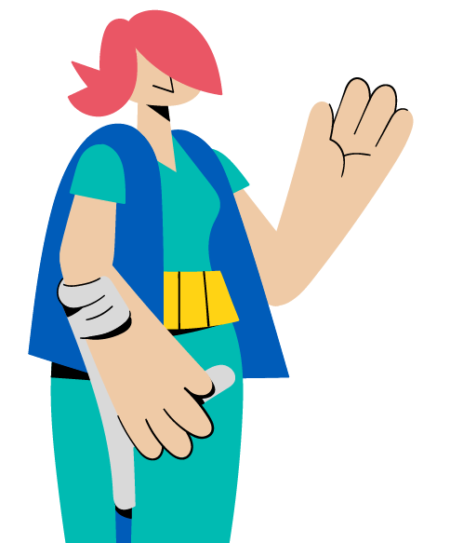
Discussion True or false?
GBV is about rape and sexual violence.
GBV can be perpetrated against boys and men.
Culture needs to be always respected, even if it is harmful for women and girls.
GBV is always the fault of the perpetrator.
Intimate partner violence is the result of poverty and lack of education.
Notes:
FACILITATOR NOTES
Expected duration: 20 mins
Objective: debunk common myths about GBV and reinforce correct understanding of basic GBV concepts
Inform participants that they are going to do a GBV quiz.
Read a statement after which participants will indicate whether they think the statement is true or false.
If there is enough space and not too many people: put two signs on the wall in different corners of the room: “true” and “false”. Ask participants to move to the sign reflecting their opinion about the statement on the slide.
If there is not adequate space or too many people: ask participants to stand up when they think the statement is true and remain seated if they think the statement is “false”.
Facilitate a discussion between “true” and “false” groups for 3 minutes. After each statement, explain why the statement is “true” or “false”. Make the next statement appear on the slide after each discussion.
Statements:
GBV is about rape and sexual violence.
FALSE: There are different types of GBV, including but not limited to rape and sexual violence, which will be discussed in more detail shortly.
GBV can be perpetrated against boys and men.
TRUE: GBV can be perpetrated against boys and men. However, the vast majority of survivors are women and girls due to gender inequality and power imbalance between males and females. GBV is understood as predominantly men’s violence against women and girls, however it also includes some forms of violence against men and boys. At the heart of this interpretation is the understanding that violence is used with the view of reinforcing dominant forms of masculinity and their position of power in society. GBV includes physical, psychological, sexual and socio-economic violence against women and girls, and/or various types of violence targeting persons with diverse sexual orientation, gender identity, gender expression and sex characteristics (SOGIESC) that do not conform to prevailing sociocultural norms, as well as sexual violence against men and boys. This Package will refer to the female pronoun (“she”/”her”) when referring to GBV survivors (excepts in parts that specifically refer to men/boys/non-binary gender identities), given that structural and systemic gender inequality and discrimination puts women and girls are higher risk of GBV, while having less access to services and humanitarian assistance.
Culture needs to be always respected even if it is harmful for women and girls.
FALSE: Harmful practices such as child marriage and female genital mutilation (FGM) cause negative impact to the survivor, family and community. These harmful practices need to be addressed even if it is a part of the culture of the society. Many aspects of culture are highly contested within the culture itself and cultural consensus should not be assumed; some segments of society may be keen to change a cultural practice while others, particularly those who benefit from it, may fight to maintain it. Moreover, inequality of women and girls in itself is deeply rooted in a society’s notions of how women and men “should be” and “should behave”. These “gender norms” are influenced by history, tradition, culture and religion, all of which change over time.
4. GBV is always the fault of the perpetrator.
TRUE: GBV is a choice made by the perpetrator to use his power over another person. It is never the fault of the survivor. Common excuses of perpetrators are that they were provoked by the survivors, e.g. by the way the survivor dressed or behaved – this is called survivor-blaming and it is a harmful attitude. It is important to remember that ats of GBV are always the fault of the perpetrator.
5. Intimate partner violence is the result of poverty and lack of education.
FALSE: Intimate partner violence does not occur in all families of which its members are poor and have limited educational background. Intimate partner violence can also happen within a wealthy and educated family. Poverty and the lack of education are only contributing factors. Intimate partner violence happens because of the gender inequality and power imbalance between males and females.

Slide 11
Definition of GBV
GENDER-BASED VIOLENCE (GBV) is an umbrella term for any harmful act that is perpetrated against a person’s will and that is based on socially ascribed (i.e. gender) differences between males and females.
It includes acts that inflict physical, sexual or mental harm or suffering, threats of such acts, coercion, and other deprivations of liberty. These acts can occur in public or in private.
IASC Guidelines for GBV Interventions in Humanitarian Emergencies
Notes:
FACILITATOR NOTES
Ask participants if anyone can explain what they believe is gender and what is GBV – before making the content of the slide appear.
Emphasize that GBV is based on based on unequal power relations between men and women and gender inequality.
It is important that the participants understand the key elements of the GBV definition:
Harmful act: this could be sexual, physical, socio-economic or psychological - often a combination of these.
Against a person’s will: this is about lack of consent; a person needs to be informed about consequences and be able to freely make choices to give consent. Children cannot give consent, and there may be power dynamics which put children at risk even if they appear mature enough to give consent. Consent can be given and taken away, if consent is given once for sex in a relationship, it does not mean that it cannot be taken away. In case facilitators would want to further elaborate on the concept of consent, the following video may be used when contextually appropriate and is available in different languages : https://www.youtube.com/watch?v=fGoWLWS4-kU / https://www.youtube.com/playlist?list=PL31mb_Z-mPI82axgO7apljYMUOSwgjU9J (“Tea Consent” ©2015 Emmeline May and Blue Seat Studios).
Bases on socially ascribed gender differences: this is not about the biological difference between male and female but the social and cultural difference between men and women which come from society and are marked by unequal power relationships and gender inequality between men and women.
If time allows, use the optional “power walk” activity to explain the concept of unequal power relationships as well as the gender equality discussion – see next slides.
Resource: Inter-Agency Standing Committee (IASC), Guidelines for GBV Interventions in Humanitarian Emergencies, 2005 (https://interagencystandingcommittee.org/iasc-sub-working-group-gender-and-humanitarian-action/iasc-guidelines-gender-based-violence-interventions-humanitarian-settings-2005).

Slide 12
“ GBV is a human rights violation that affects all aspects of a person's protection and well-being. It is a core component of UNHCR's protection mandate. GBV can be the impetus that compels people to flee; it also occurs during flight and refuge. Regardless of the reason for displacement, the risk of GBV is heightened, especially for women and girls. Programming to
prevent, mitigate, and respond to GBV is lifesaving in humanitarian settings. ”
UNHCR GBV Policy
Notes:
FACILITATOR NOTES
Introduce the UNHCR Policy on the Prevention of, Risk Mitigation, and Response to Gender-based Violence, 2020 (hereafter referred to as the GBV Policy, available at https://www.unhcr.org/publications/brochures/5fa018914/unhcr-policy-prevention-risk-mitigation-response-gender-based-violence.html), as the overarching framework for how UNHCR works on GBV prevention, risk mitigation and response. The GBV Policy reflects the long-standing work of UNHCR and partners on addressing GBV. It further institutionalizes UNHCR’s work on GBV, which is a collective accountability across the organization and requires the commitment and support of all members of the workforce.
Use this slide to explain why UNHCR is engaged in addressing GBV.

Slide 13
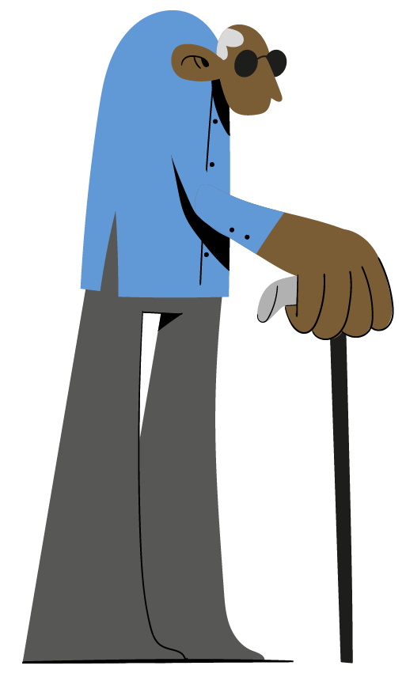
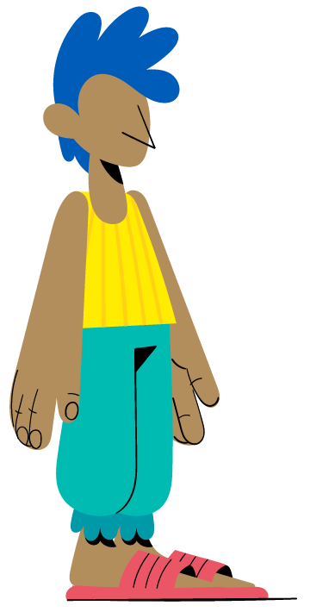
Optional
Activity Power walk
Notes:
FACILITATOR NOTES
Expected duration: 40 mins
Objective: enhance participants’ understanding of unequal power relations and differences in control over decision-making and access to opportunities, services and resources
NB: remove the optional icon when the slide is used.
It is recommended to adjust the character cards and statements (see below and in the Activity Sheet) based on the local context.
Move participants to an area with enough space for them to line up in one row across the room or space, next to each other.
Give each participant a character card.
If the group is mixed, hand out women’s cards to men, and men’s cards to women.
If possible, ask participants to attach the character card where others can see it.
Read out a series of statements – see below.
Explain that if the statement is (expected to be) true for the character on their card, participants may take one step forward. If it is not (expected to be) true, they remain where they are.
Encourage women to challenge men who step forward inappropriately (as their women characters) - this can be powerful for men in understanding the challenges faced by women, and for women in being able to experience a taste of the freedoms of men.
Character cards
Young girl head of household with 2 younger siblings
Unemployed man
Adolescent girl
Religious leader (male)
Woman engaged in the sale and exchange of sex
Market shop owner (male)
School teacher (male)
Social worker of a local NGO (female)
Homosexual man
Host community member (female)
Man living with HIV/AIDS
Widow with 2 children
Pregnant woman
Breast-feeding woman
NGO director (male)
Female survivor of intimate partner violence
International humanitarian worker (female)
Police officer (male)
An adolescent girl recently married to male adult
Military/soldier (male)
Out-of-school youth (male)
Transgender woman
Older woman with children in her care
A man living with a physical disability
National authority managing the camp (male)
Truck driver of food distribution agency (male)
Minority group member (male)
10-year old boy
Doctor (male)
WASH committee member (male)
Camp leader (male)
Statements
I control the money that I earn.
My work is paid and generally well-considered.
I can travel around the camp/settlement/community easily.
I do not fear for my safety if I move around after dark.
I have leisure time.
I am among the first to speak in meetings.
My children have my family’s name.
I am not generally afraid of being sexually assaulted or raped
My spouse (or someone else) looks after my children.
I can wear any clothes I like without fear of sexual assault.
I am of the same sex as the police, community leaders and religious leaders.
I have had the opportunity to be educated.
I decide when to have sexual relations with my partner.
I can get access to services without being forced to engage in sexual acts.
I do not have to account to my partner for where I have been or how I spend my time.
I am generally listened to by the leaders in my community.
I can determine when and how many children I have.
I can go to the police, be treated respectfully and not be worried about being threatened with arrest or violence.
I can travel anywhere I like without an escort.
Discussion
Lead a debrief using the following discussion questions.
What do we see at the end of this exercise?
Who is in front? Who is behind?
What did it feel like to move forward? What did it feel like to stay behind?
What differences did you notice between women and between men?
What does this difference mean to you?
Who has a card with a humanitarian worker? Are they in the front or the back?
Key considerations
This exercise is about the power and privilege that men enjoy in most societies simply by virtue of the unequal status and power afforded to them at birth.
These differences are not based on skill or experience, but socialized power inequality, perpetuated by cultures and norms.
Women experience this inequality throughout their lives, and it is the foundation upon which violence develops and is perpetuated.
Of course, not all men are the same, and not all women are the same. Even within those groups, there are significant differences of power and privilege – associated with status, physical ability, education, wealth, etc. However, even with those differences it is obvious that men are in general much further ahead than women.
It is critical for participants to understand power imbalance between humanitarians and the persons we serve, as it explains how difficult it could be for them to approach humanitarian workers to seek help.
Activity derived and adjusted from the Inter-Agency GBV Case Management Training Package (https://www.gbvims.com/gbv-case-management-guidelines/gbv-case-management-training-materials/) and the IASC Guidelines Training Package, Module 3, 2015 (https://gbvguidelines.org/en/capacity-building/module-3-gbv-in-emergencies/).

Slide 14
Optional
Discussion Gender inequality
Gender inequality
exists in all societies.
What examples of gender inequality do you see in your community?
Notes:
FACILITATOR NOTES
Expected duration: 10 mins
Objective: increase awareness of gender inequalities in own context
NB: remove the optional icon when the slide is used.
Invite participants to share their reflections on the question in plenary.
Encourage participants to discuss what society expects of men and women, their roles, privileges and limitations.
Key considerations
Gender refers to the social differences between males and females.
It is determined by social factors – history, culture, tradition, societal norms, and religion – all of which change over time.
These preconceptions determine what society expects of men and women, their roles, privileges and limitations.
If asked: sex refers to the physical and biological characteristics that distinguish males and females. It refers to a person’s anatomy and physical attributes.
Gender inequality is deeply rooted in a society’s notions of how women and men “should be” and “should behave” in one’s culture.
It is this gender inequality and these often-rigid gender norms that are considered a root cause of GBV.
The slide refers to gender inequality between women and men, however it is important to note that this may or may not include persons with diverse sexual orientation, gender identity, gender expression and/or sex characteristics (SOGIESC). By not conforming to prevailing social and gender norms, this group is of increased risk of exposure to GBV, rooted in gender inequality and discrimination.
Examples
The belief that boys should receive preferential access to education over girls.
The belief that men should have decision-making power over women.
Rigid gender roles that define masculinity in terms of honour, dominance and aggression and ask that men be family protectors and decision-makers.
Rigid ideas which impose that women stay at home, take care of the house and children and are main caregivers also of older persons or persons with disabilities.
National legislation that supports child and forced marriage and does not recognize intimate partner violence.
Beliefs and practices, including laws, that blame the survivor.
Beliefs and practices that limit adolescent girls' mobility.
A perceived lack of value for women’s work and their contribution to society.
Discriminatory land, inheritance and property rights.
Self-perceived lack of capacities (or lack of self-confidence) of women to engage in economic opportunities due to established power dynamics.
Key resources
UNHCR Gender Equality Toolkit (https://www.unhcr.org/publications/manuals/5e5cd64a7/unhcr-gender-equality-toolkit.html);
UNHCR Policy on Age, Gender and Diversity, 2018 (https://www.unhcr.org/5aa13c0c7.pdf );
UNHCR, Need to Know Guidance: Working with Lesbian, Gay, Bisexual, Transgender, Intersex and Queer Persons in Forced Displacement, 2021 (https://www.refworld.org/docid/4e6073972.html);
UNHCR/IOM, Training package: SOGIESC and working with LGBTIQ+ persons in forced displacement, 2021 (https://www.unhcr.org/workingwithlgbtiq-sogiesc-trainingpackage.html).

Slide 15
Discussion Forms of GBV
Physical
Psychological
Socio-economic
Sexual
Notes:
FACILITATOR NOTES
Expected duration: 10 mins
Objective: participants acknowledge that different forms of sexual, physical, psychological and socio-economic violence are considered GBV
Explain to the participants that GBV can take different forms, highlighting the four categories in the circle diagram.
Explain that GBV survivors often experience a combination of different forms of GBV. For instance, intimate partner violence could take many forms and is often a combination of psychological, physical, sexual and socio-economic violence.
Ask participants for some examples of GBV that are prevalent in the context where they work. Encourage participants to consider the different forms of GBV. Refer to the examples below and highlight that this is not an exhaustive list.
Emphasize that it is crucial to understand that GBV happens everywhere and is underreported worldwide for many reasons, including fear of stigma or retaliation, shame, limited availability or accessibility of trusted service providers, impunity for perpetrators, and lack of awareness of the benefits of seeking care. Recorded cases represent only a small fraction of the overall incident total, and it should always be assumed that GBV is occurring.
Rape: non-consensual penetration (however slight) of the vagina, anus or mouth with a penis or other body part. Also includes penetration of the vagina or anus with an object.
Sexual assault: any form of non-consensual sexual contact that does not result in or include penetration. Examples include: attempted rape, as well as unwanted kissing, fondling, or touching of genitalia and buttocks. Female genital mutilation (FGM) is an act of violence that impacts sexual organs, and as such should be classified as sexual assault. Sexual slavery is defined by the circumstances during which multiple acts and various forms of sexual violence are perpetrated over a period of time.
Physical assault: an act of physical violence that is not sexual in nature. Examples include: hitting, slapping, choking, cutting, shoving, burning, shooting or use of any weapons, acid attacks or any other act that results in pain, discomfort or injury.
Forced marriage: the marriage of an individual against her will.
Denial of resources, opportunities or services: denial of rightful access to economic resources/assets or livelihood opportunities, education, health or other social services. Examples include: a widow prevented from receiving an inheritance, earnings forcibly taken by an intimate partner or family member, a woman prevented from using contraceptives, a girl prevented from attending school, etc.
Psychological / emotional abuse: infliction of mental or emotional pain or injury. Examples include: threats of physical or sexual violence, intimidation, humiliation, forced isolation, stalking, harassment, unwanted attention, remarks, gestures or written words of a sexual and/or menacing nature, destruction of cherished things, etc.
Six core types of GBV derived from the GBVIMS Classification Tool (https://www.gbvims.com/gbvims-tools/classification-tool/).

Slide 16
Women and girls are disproportionately affected
Women and girls are at increased risk of GBV and face additional barriers to accessing services due to systemic gender inequality and other forms of discrimination.
LGBTIQ+ persons encounter distinct GBV risks because of their real or perceived SOGIESC do not conform to prevailing social and gender norms.
Women and girls who are at particular risk of GBV include:
adolescent girls;
women and girls with disabilities;
women and girls from ethnic or religious minority groups;
women and girls with diverse SOGIESC;
older women.
Notes:
FACILITATOR NOTES
Explain to participants that men have more power in most societies simply by virtue of the unequal status and power afforded to them at birth. Refer back to the ”power walk” activity if this was done.
Women experience this inequality throughout their lives, and it is the foundation upon which violence develops and is perpetuated. Of course, not all men are the same, and not all women are the same. Even within those groups, there are significant differences of power and privilege – associated with status, age, physical ability, wealth, etc. However, men are in general much further ahead than women.
UNHCR fully recognizes that women and girls are disproportionately affected by GBV and that individuals with diverse sexual orientation, gender identity, gender expression and/or sex characteristics (SOGIESC) are also at increased risk of GBV. Across their lifetime, 1 in 3 women are subjected to physical or sexual violence by an intimate partner or sexual violence from a non-partner – a number that has remained largely unchanged over the past decade (WHO). Evidence suggests that people who experience multiple forms of marginalisation are at increased risk of violence, and that LBQ women, trans people, non-binary people and intersex people face particularly high rates of violence (What Works to Prevent Violence Against Women and Girls, Ending Violence Against LGBTQI+ People, Global evidence and emerging insights into what works, 2022 (https://ww2preventvawg.org/evidence-hub/ending-violence-against-lgbtqi-people-report)). “Persons with diverse SOGIESC” is often used to describe LGBTIQ+ persons. Remember! everybody has SOGIESC.
Referring back to the GBV quiz opening this session, remind participants that men and boys can be subjected to sexual violence. Men and boys may be targeted for abuse because of reduced power and status based on age, disability, sexual orientation, gender identity and other inequalities (e.g. men and boys in detention, unaccompanied boys, men and boys with diverse SOGIESC etc.).
Disabilities refer to long term sensory, physical, psychosocial, and/or intellectual impairments. Women with disabilities are twice as frequently subjected to IPV as other women. "Women and girls with disabilities, and particularly women and girls with psychosocial, hearing and intellectual disabilities, are at higher risk of sexual violence and other forms of GBV. Repeated and regular rape by multiple perpetrators is the most common form of GBV reported” (IASC Guidelines, Inclusion of Persons with Disabilities in Humanitarian Action, 2019, https://interagencystandingcommittee.org/iasc-guidelines-on-inclusion-of-persons-with-disabilities-in-humanitarian-action-2019).
Older women may have less access to GBV information and services, while also facing risks of GBV. All forms of elder abuse, including GBV are under-reported, largely because they are often perpetrated by family members, a carer, or other people on whom the older person may depend. The shame and stigma attached to sexual abuse or GBV may prevent survivors from reporting it (UNHCR, Working with Older Persons in Displacement, 2021 (https://www.refworld.org/cgi-bin/texis/vtx/rwmain?page=search&docid=4ee72aaf2&skip=0&query=need%20to%20know%20guidance%20older%20people)).
Remind participants of the linkages between persons at heightened risk of GBV and displacement. GBV can be the impetus that compels people to flee; it also occurs during flight and refuge. Regardless of the reason for displacement, the risk of GBV is heightened, especially for women and girls.

Slide 17
Persons with diverse SOGIESC
Sexual Orientation
Gender Identity
Queer
Heterosexual
Asexual
Pansexual
Lesbian
Bisexual
Gay
Genderqueer
Genderfluid
Woman
Agender
Non-Binary
Man
Trans/Transgender
Lesbian, gay, bisexual, transgender, intersex and queer (LGBTIQ+) persons are at increased risk of exposure to GBV.
LGBTIQ+ persons encounter distinct GBV risks because their real or perceived sexual orientation, gender identity, gender expression and/or sex characteristics (SOGIESC) do not conform to prevailing social and gender norms.
Gender Expression
Sex Characteristics
Fluid
Feminine
Gender Non-Conforming
Masculine
Androgynous
Female
Intersex
Male
Notes:
FACILITATOR NOTES
Please note the terminology: the acronym SOGIESC (sexual orientation, gender identity, gender expression and/or sex characteristics) is the most updated to use (see the resource in the slide, referenced below), instead of SOGI as stated in the UNHCR GBV Policy. “Persons with diverse SOGIESC” is often used to describe LGBTIQ+ persons. Remember! everybody has SOGIESC.
Studies from all over the world reveal high rates of GBV based on SOGIESC targeting LGBTIQ+ people. Experiences of GBV often start in childhood and continue throughout life – at home, in school, in communities, in institutions, and in cyberspace. (Source: What Works to Prevent Violence Against Women and Girls, Ending Violence Against LGBTQI+ People, Global evidence and emerging insights into what works, 2022 (https://ww2preventvawg.org/evidence-hub/ending-violence-against-lgbtqi-people-report))
Use the illustration to highlight that LGBTIQ+ persons are not a homogenous group and their risks of experiencing GBV are distinct. Sexual orientation, gender identity, gender expression and sex characteristics are separate components of the SOGIESC acronym, and we cannot make assumptions about individuals based on our knowledge of some of the components. Although LGBTIQ+ people may share some experiences, their needs and GBV risks are also quite distinct, depending on their SOGIESC and on other age, gender and diversity factors such as their nationality, ethnicity, faith, socioeconomic background, level of education, physical appearance and disability.
Remind participants that “Women and girls at risk” includes women and girls with diverse SOGIESC.
Resources:
UNHCR, Need to Know Guidance: Working with Lesbian, Gay, Bisexual, Transgender, Intersex and Queer Persons in Forced Displacement, 2021 (https://www.refworld.org/docid/4e6073972.html).
Image derived from Slide derived and adjusted from the UNHCR/IOM, Training package: SOGIESC and working with LGBTIQ+ persons in forced displacement, 2021 (https://www.unhcr.org/workingwithlgbtiq-sogiesc-trainingpackage.html).

Slide 18
GBV: causes, contributing factors and consequences
Notes:
FACILITATOR NOTES
https://www.youtube.com/watch?v=o02V6FBJy9c&list=PLk83Ra7kAz5HQymFMdS79dryet14pn8YS&index=2
Duration: 5.02 mins

Slide 19
Addressing GBV: what, how, who?
Risk Mitigation
Prevention
Response
What: interventions to prevent GBV from first occurring.
How: address root causes.
Who: responsibility of ALL! Could be carried out by GBV specialists OR other humanitarian actors as appropriate.
What: interventions to avoid increasing or to reduce the risk of exposure to GBV.
How: be aware of and, if possible, address contributing factors.
Who: ALL humanitarian actors, governments, communities: everyone!
What: interventions to address the consequences of GBV after it has happened.
How: provide specialized services.
Who: specialized staff, with specific training and experience.
Notes:
FACILITATOR NOTES
Refer back to the GBV-tree in the video when explaining the differences between prevention, risk mitigation and response. Ask participants for 1-2 examples of activities under each category:
Prevention: life-skills for adolescent boys and girls; gender dialogues; transformative gender work to challenge negative gender norms (e.g. workshops with men and women, or group training for couples on shared decision making and non-violent behaviour); empowerment activities for women and girls and/or LGBTIQI+ persons; introducing gender-transformative school curricula etc.
Risk mitigation: ensuring women, girls and other other at-risk groups are consulted and participate throughout the programme cycle; training of frontline workforce on how to handle safe disclosures; specific actions to ensure programmes do not expose displaced and stateless persons to additional and/or new risks to GBV (e.g. gender-disaggregated and lockable toilets in a safe location; privacy measures in shelters; providing adequate lights in camps; fuel-efficient stoves; building schools and play areas in safe locations; mmonitoring school premises; engaging the community in organizing security patrols or community watch groups etc.) etc. Note that GBV risk mitigation will be discussed in more detail in the next slides.
Response: GBV case management; psychosocial support; clinical care; safe house/shelter; legal aid; economic reintegration etc.
Content derived and adjusted from CVA & GBV Compendium: Practical Guidance for Humanitarian Practitioners: A Companion Guide to the IASC GBV Guidelines, 2019 (https://gbvguidelines.org/en/cash-voucher-assistance-and-gbv-compendium-training-modules).

Slide 20
UNHCR’s GBV Policy
The Policy requires that all UNHCR workforce and partners are appropriately trained to safely handle disclosures of GBV incidents and to make referrals.
Objectives:
Risk of GBV is reduced for all displaced and stateless persons;
All GBV survivors have adequate and timely access to quality services.
Compliance is mandatory and implementation requires collective action of all members of the workforce, including you!
Notes:
FACILITATOR NOTES
Recall the GBV Policy introduced earlier in this session. As part of the GBV Policy’s commitment to GBV risk mitigation, emphasize that it is mandatory according to the Policy that all UNHCR workforce and partners are trained on how to safely handle a disclosure on GBV, this is why we are here today.

Slide 21
GBV risk mitigation: responsibility of all!
GBV risk mitigation = reducing the risk of exposure to GBV in all aspects of programming
Mainstream actions in each humanitarian sector and area of work to reduce risks and exposure to GBV and to improve safety.
All UNHCR workforce and partners know how to safely handle a GBV disclosure and refer a survivor.
Notes:
FACILITATOR NOTES
GBV risk mitigation specifically refers to reducing the risk of exposure of GBV. Explain the two areas of GBV risk mitigation, emphasizing the role of all workforce to address GBV.​
​
Mainstreaming does not replace GBV specialized programming (i.e. prevention and response); rather it ensures mainstreaming of GBV risk mitigation across all stages of the programme cycle across all sectors and all functional levels.
An important resource on GBV risk mitigation is the IASC Guidelines for Integrating Gender-Based Violence Interventions in Humanitarian Action, 2015 (https://gbvguidelines.org). These guidelines provide sector-specific guidance for integrating risk mitigation into interventions that apply to IDP settings and could also be used mixed and refugee settings. This is of particular importance to UNHCR-led/co-led clusters/sectors which have particular responsibilities in this regard.

Slide 22
Key messages
GBV survivors often experience a combination of different forms of GBV, which can include psychological, physical, sexual and socio-economic violence.
GBV is caused by gender inequality systemic discrimination and unequal power relations.
Diverse women and girls are disproportionately affected because of gender inequality and unequal power relations between males and females.
GBV can have severe, wide-ranging and long-lasting consequences for survivors. Not all survivors experience GBV the same way and have the same needs.
As part of the collective accountability to mitigate the risk of GBV, all UNHCR workforce and partners should know how to safely handle a GBV disclosure and refer survivors.

Slide 23
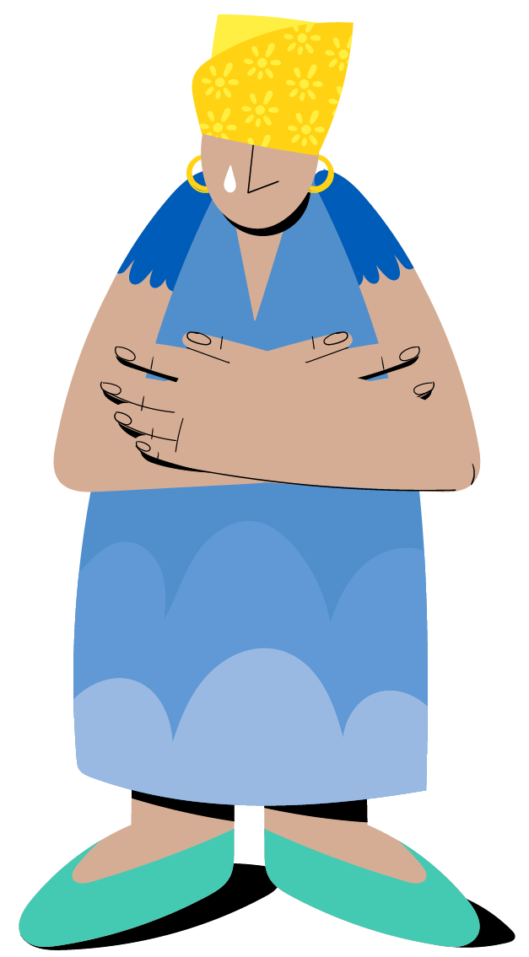
^{SESSION 2}
Survivor-centred approach, GBV response services and referral pathways
Notes:
FACILITATOR NOTES
Expected duration of session:
60 mins (core content)
60 + 65 mins (optional content)
Explain the learning objectives:
Be familiar with the GBV guiding principles.
Understand what the survivor-centred approach means in practice.
Understand the role of GBV case management services.
Understand what a GBV referral pathway is.
Be familiar with the local GBV referral pathway.

Slide 24
Survivor-centred approach
Notes:
FACILITATOR NOTES
https://www.youtube.com/watch?v=Fk3pQyeobZE&list=PLk83Ra7kAz5HQymFMdS79dryet14pn8YS&index=4
Duration: 4.38 mins

Slide 25
GBV guiding principles
Survivor-centred approach – right to: | VS. | Survivor-blaming attitudes
Safety |  | Being cast out
Privacy and confidentiality |  | Shame and stigma
Choose |  | Feeling powerless
Information |  | Being told what to do
Non-discrimination |  | Discrimination based on gender, ethnicity, etc.
Right to safety
Right to confidentiality
Right to dignity and self-determination
Non-discrimination
Best interests of the child
A primary and overarching consideration in case of a child survivor. The decisions and actions affecting the child should reflect what is best for the safety, well-being and development of that particular child.
Notes:
FACILITATOR NOTES
Build on the video, repeating that a survivor-centred approach creates a supportive environment in which the survivors’ rights and wishes are respected, their safety is ensured, and they are treated with dignity and respect.
Remind participants that the survivor-centred approach is based on the following guiding principles:
Safety: The safety and security of survivors and their children (if any) are the primary considerations (safety is to be considered as both physical and emotional safety).
Confidentiality: Survivors have the right to choose to whom they will or will not tell their story, and any information about them should only be shared with their informed consent.
Respect: All actions taken should be guided by respect for the choices, wishes, rights and dignity of the survivor. The role of helpers is to facilitate recovery and provide resources to aid the survivor.
Non-discrimination: Survivors should receive equal and fair treatment regardless of their age, disability, gender identity, religion, nationality, ethnicity, sexual orientation or any other characteristic.
The best interests of the child principle will be discussed in more detail in the session on handling the disclosures of child survivors of GBV.
Reflect on the table comparing the survivor-centred approach with victim-blaming attitudes, derived from the IASC Guidelines for Integrating Gender-Based Violence Interventions in Humanitarian Action - Training Package, Module 4, 2015 (https://gbvguidelines.org/en/capacity-building/module-4-responding-to-gbv-incidents/).

Slide 26
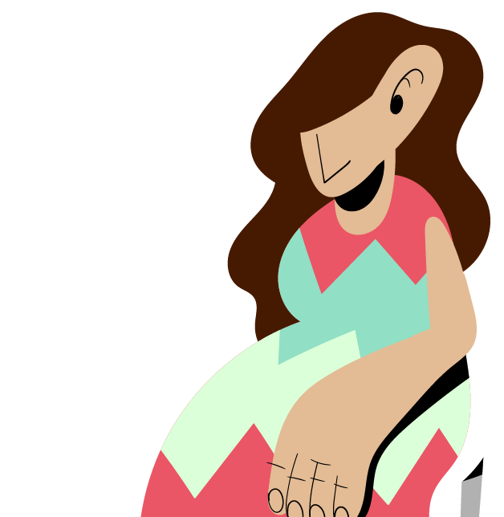
Group work
Recognizing survivor-centred attitudes and beliefs
Notes:
FACILITATOR NOTES
Estimated duration: 25 mins
Objective: enhance participants’ understanding of survivor-centred attitudes and beliefs
Divide the participants in groups.
Distribute a set of attitude cards to each of the groups – see Activity Sheet (copied also below), as well as tape and two flipcharts.
Ask the groups to stick on one flipchart the negative attitudes and beliefs, and on the other the supportive attitudes and beliefs.
Check the flipcharts as the groups are discussing (no plenary debrief).
At the end of the activity, ask the groups if they had any doubts and repeat key considerations below.
Key considerations
We all bring our own attitudes and beliefs to this work, and some of these attitudes may be harmful to survivors without us knowing it. It is important to recognize and begin to challenge our own attitudes.
Survivor-blaming is common in many communities and is something that we must actively strive to avoid and counter in our work with survivors.
Survivors are never responsible for the violence they experience. The use of violence is always a choice made by perpetrators.
This is an essential tenet for ensuring the safety and recovery of GBV survivors and avoiding causing further harm. Survivor-centred attitudes involve putting the best interests of the survivor first, ensuring that all work is based on what the survivor wants and needs rather than our own opinion of what they want and need
Negative attitudes and beliefs:
If women and girls who behave inappropriately are raped, it is their fault.
If a survivor can’t answer the questions asked during an interview, they are making up the incident.
A woman causes her husband’s violence because of her own behavior.
A person who forces another person to have sex is just someone who cannot control their sexual desire.
Intimate partner violence is a family matter and should be handled within the family.
Most men beat their wives only after they have been drinking or using drugs.
A GBV survivor should always report their case to the police or other justice authorities.
A man cannot rape his wife.
It is the job of a humanitarian worker to determine whether a survivor is telling the truth.
Women are raped if they wear the wrong clothes or go to the wrong places.
Women often lie about being raped.
Rape only occurs outside, at night when the victim is alone
If a person doesn’t “fight back” she was not really raped.
If a survivor does not show physical injuries from the rape, she was not raped.
Incest (rape or sexual abuse by family members) is rare.
Sexual assault usually occurs between strangers.
People who sell or exchange sex cannot be raped.
A survivor should not think too much about the violence she has experienced. She should “forget it.”
Supportive attitudes and beliefs:
Rape is choice made by the perpetrator to use his power over another person. It is never the fault of the survivor. Acts of GBV are always the fault of the perpetrator.
The psychological and physical responses to trauma may lead a survivor to be confused and unable to answer questions about the event.
Violence is a choice of the perpetrator and it never is justified to use in relationships.
Most rapists are motivated by power, anger, and control not the desire to have sex. Men can control their sexual impulses. Most rapes are planned in advance – the man is in control when he rapes.
Intimate partner violence should be a significant safety and health concern for a community and is a crime in many countries. Thousands of women are killed every year due to intimate partner violence. Intimate partner violence survivors require community support.
Survivors should be able to choose who knows about their case.
It is the job of humanitarian workers to support survivors and believe them.
Global research shows that, similar to report of other serious crimes, a very low percentage of rape reports are given falsely. This is the same as for other serious violent crimes.
Rape can and does occur anytime and anyplace. Many rapes occur during the day and in the survivors’ homes, e.g. girls and women with disabilities can be raped when they are left at home alone. In addition, often women or girls know the perpetrator (their stepfather, uncle etc.) These rapes often occur in the home.
Rape is potentially life-threatening. Whatever a person does to survive the assault is the appropriate action. This may include not fighting because of fear.
Incest is common and happens in every community.
Survivors who are not allowed to talk about the violence they experienced have a much more difficult time recovering from it. All survivors should be offered the opportunity to talk about the assault with those personally close to them if they wish to do so.
Content derived and adjusted from the IASC Pocket Guide – How to support survivors of GBV when a GBV actor is not available in your area – User Guide, 2018 (https://gbvguidelines.org/en/pocketguide/).

Slide 27
GBV response services
Psychosocial support
Security and protection
Health
Economic reintegration support
Legal/justice
PLACEHOLDER:
Registration services – [facilitator to include/adjust based on operational context]
Notes:
FACILITATOR NOTES
Ask participants what services a GBV survivor may need before making the images appear.
Remind participants of the consequences of GBV covered in the video in the earlier session (physical, psychological or economic, social stigma, isolation and rejection, discrimination etc.) and link them with the response services. The consequences of GBV are different depending on the type of violence perpetrated, the age, capacity and protection mechanism available to the survivor. Each person has a different reaction to the experience of violence and should be respected for it.
Emphasize that the impact of violence on survivors varies from persons to person, each survivor reacts differently and has different needs. In line with the survivor-centred which approach, survivors have the right to chose which services they wish to receive.
GBV response services include:
Health services: life-saving clinical care for rape, sexual violence and other forms of physical and phycological violence, that can prevent that illness, trauma, disability and death. This includes first-line support/psychological first aid, the provision of emergency contraception, HIV post-exposure prophylaxis, treatment of sexually transmitted infections, Hepatitis B immunization, clinical management of rape (CMR), and assessment and management of mental health conditions such as depression, suicidal thoughts or attempts, and post-traumatic stress disorder, addressing the health needs of survivors of child marriage and complications related to female genital mutilation (FGM). More information on how to refer survivors with urgent medical needs covered in the next session.
Psychosocial support: aims to protect or promote psychosocial well-being and mental health, falling across the health and protection sectors. As a critical intervention that contributes to survivors’ safety, healing and recovery, it ranges from basic support by first responders, such as psychological first aid to survivors and families, to more focused case management support (to be discussed shortly), including psychological interventions provided by non-mental health specialists.
Security and protection: responds to the immediate safety needs of the survivor, includinging particularly safe houses/shelters. This service is meant for GBV survivors who are in imminent danger, providing immediate security, temporary refuge, and support to survivors who are escaping violent or abusive situations.
Legal/justice: legal and justice sectors support GBV survivors to access safe and survivor-centred legal services that protect their rights and promote their access to justice. Access to legal aid is fundamental to safeguarding fair, equal and meaningful access to justice. In humanitarian settings, informal justice mechanisms (e.g. negotiated settlements between families, judgments by religious and community leaders) are sometimes utilized by communities to settle what are perceived as “private” matters including GBV incidents. These informal justice mechanisms may pose many risks to women and girl GBV survivors.
Economic reintegration support: participation in economic empowerment and livelihood programmes for women reduces the risk of reoccurrence of GBV, including sexual exploitation and abuse. However, it is important to note that GBV survivors should not be the sole participants of a specific livelihood programme, as this can increase stigma and compromise confidentiality, safety and security.
Registration services: it is recommended that the facilitator adjusts/removes the reference to registration services based on the operational context. Some forms of GBV, including particularly intimate partner violence, may have an impact on the family composition, which depending on the wishes of the survivor may have implications for the registration group that the survivor (and her children) are in, in particular in order for the survivor to continue to have access to assistance and/or durable solutions (e.g. by splitting the registration group).
Note that these services may not be offered by UNHCR, but could be offered by public services, (operational) partners, private service providers or others.
Content derived and adjusted from the Inter-Agency Minimum Standards for GBV in Emergencies Programming, 2019 (https://gbvaor.net/gbviems).

Slide 28
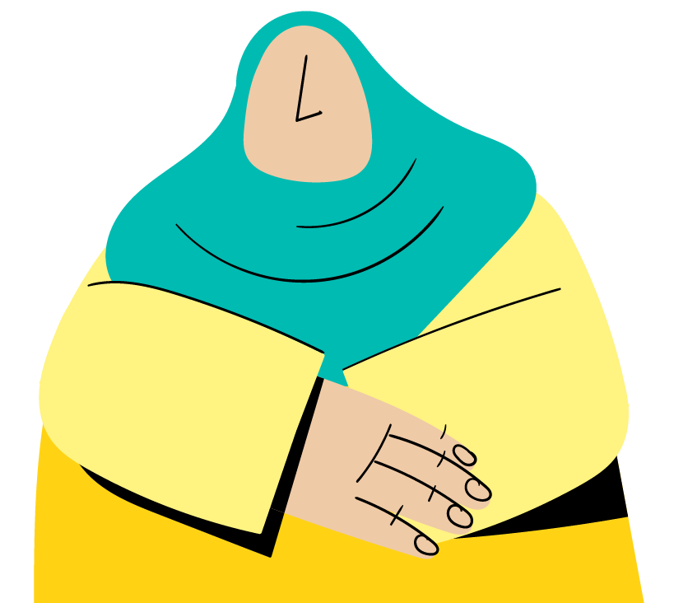
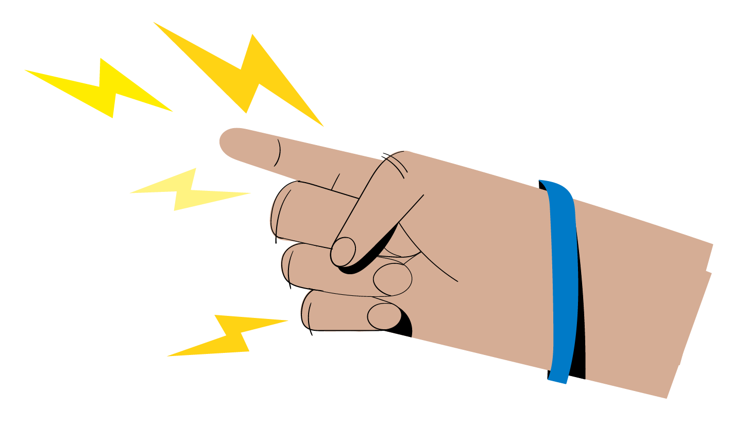
Optional
Group work
From a survivor’s perspective, what are the benefits of seeking support?
From a survivor’s perspective, what are the risks of seeking support?
Notes:
FACILITATOR NOTES
Expected duration: 15 mins
Objective: understand the benefits and risks associated with a survivor seeking support
NB: remove the optional icon when the slide is used.
Divide the participants in groups.
Assign half of the groups to discuss the question regarding the benefits of seeking support and the other half to discuss the risks. Emphasize that the groups should consider these questions from the perspective of a survivor.
Request one group for each question to debrief in plenary and ask if the other groups have anything to add.
Reinforce key considerations below.
Possible benefits for a survivor to seek support:
Access to life-saving support when in distress.
Access to safe, confidential and professional medical care in a timely manner that could prevent HIV and unwanted pregnancy.
Access to other services that provide more dignity and comfort, including options for safety and psychosocial support.
Access to support that may prevent further violence from occurring.
Possible risks for a survivor to seek support, i.e. some of the barriers for survivors to report GBV incidents:
Possibility that the survivor’s friends, family and/or community will find out, which can lead to being stigmatized, kicked out of their home or community, and/or exposed to more violence.
Possibility that the perpetrator(s) finds out other people know what happened, leading to retaliation by harming or even killing the survivor.
Possibility that service providers are exposed to threats and violence by the perpetrator or community if they are seen as helping a survivor.
Possible insensitive response by service providers/justice actors if they are not trained properly.
Besides these risks, other common barriers for reporting could be lack of awareness about services, shame, cultural beliefs, belief that the violence is normal or not serious enough to report, financial barriers, lack of transportation, fear of losing children, fear of getting the offender in trouble etc.
Content derived from the IASC Pocket Guide – How to support survivors of GBV when a GBV actor is not available in your area – Training Package, 2018 (https://gbvguidelines.org/en/pocketguide/).

Slide 29
What is GBV case management?
A structured method for providing help to a survivor, in line with the survivor-centred approach.
Involves one organization, usually a psychosocial support or social services actor, taking responsibility for making sure that:
Issues and problems facing a survivor and her family are identified;
The survivor is informed of all the options available to her;
The survivor’s needs are followed up in a coordinated way;
The survivors is provided with emotional support throughout the process.
Frontline workers should refer a survivor (with consent) to the GBV case management services as the entry point for connecting with other services.
Notes:
FACILITATOR NOTES
The case manager/case worker listens to the survivor’s story and discusses what the person needs to help the person recover. They will help the survivor develop a plan to meet their needs, make appropriate referrals to services, and support her in accessing these services. Throughout the various steps of the GBV case management process, the GBV case manager/case worker is also instrumental in supporting the survivor’s emotional recovery.
The role of frontline workers is to refer a survivor (with consent) to the GBV case management services as the entry point and the case manager/case worker worker will connect the survivor with the other services she wishes to access. More details on the role of frontline workers will be provided in the next session. Remind participants that the term frontline worker applies to any GBV and non-GBV specialists who are in direct contact with displaced and stateless persons, this could include non-technical colleagues as well such as drivers and security guards.
Note that the concept of informed consent, what it means and how to obtain it, will also be discussed in the next session.
In some contexts, remote case management services may be offered, e.g. in case of security restrictions, movement restrictions related to a pandemic, limited availability of local GBV specialized services. This is mainly offered through phone-based case management, which is defined as case management that case managers/case workers provide over the phone to clients . (Inter-Agency COVID-19 Guidance on Remote GBV Services Focusing on Phone-based Case Management and Hotlines, 2021 (https://www.gbvims.com/wp/wp-content/uploads/covid-guidance-on-remote-gbv-services-04012021.pdf)). Also in some contexts case management may be mobile, with services provided in different locations according to a fixed schedule. However, such services would always be provided in safe spaces, by trained case managers/case workers, and meet the same quality standards at static case management services which are provided in a fixed location. (Guidelines for Mobile and Remote GBV Service Delivery IRC https://reliefweb.int/report/world/guidelines-mobile-and-remote-gender-based-violence-gbv-service-delivery-enmy).
Content derived and adjusted from the Inter-Agency GBV Case Management Training Package (https://www.gbvims.com/gbv-case-management-guidelines/gbv-case-management-training-materials/).

Slide 30
What is a GBV referral pathway?
A flexible coordination mechanism that safely links survivors to supportive and competent services in a timely way.
Includes details of different GBV response services.
Regularly consult GBV specialists to make sure you have the most up-to-date version of the referral pathway.
Notes:
FACILITATOR NOTES
Provide participants with a handout of the GBV referral pathway of the relevant context (field location specific, if available) or an example of one from elsewhere if a local referral pathway does not exist (yet), in order to illustrate how a GBV referral pathway looks like. Note that we will look into the local referral pathway in more detail shortly.
The aim of a referral pathway is to:
Coordinate service delivery;
Improve safe and timely access to quality services for survivors of GBV;
Prioritize survivor safety and confidentiality, and respect survivors’ choices; and
Ensure that survivors are active participants in defining their needs and deciding what response and support options best meet those needs.
Emphasize that it is the role of GBV specialists to map GBV services, develop a GBV referral pathway at inter-agency level, and support with strengthening the capacity of GBV services as well as advocating for the accessibility of GBV services for displaced and stateless persons.
Remind participants that the role of frontline workers is to refer and facilitate the survivor’s access to services, with GBV case management services as the main entry point.

Slide 31
Optional
Activity Referral web
Notes:
FACILITATOR NOTES
Expected duration: 25 mins
Objective: identify aspects of referral mechanisms that may compromise a survivor-centred response
NB: remove the optional icon when the slide is used.
It is recommended to adjust the activity prior to the session, ensuring that the roles are appropriate to the context, using names of local service providers and adapting the script to the context.
Item required: ball of wool/yarn.
Ask for volunteers to play the roles of different individuals. Distribute the pre-made “service provider” name tags to the appropriate number of people. Ask these individuals to play the role of the person noted on their name tag.
Sample of service provider name tags:
Mother
Community leader
Traditional birth attendant
Midwife
Doctor
Community Services Worker
Community Services Officer of the Department of Social Welfare and Development
Protection Officer of the Department of Social Welfare and Development
Police
Lawyer
Social worker
Prosecutor
Seat the service providers in a circle. Ask the remainder of participants to stand on the outside of the circle so they can easily see the activity.
Explain that the ball of wool/yarn represents a 20-year-old woman who was sexually assaulted. Confirm with participants that everyone understands what that means.
As the facilitator, stand outside the circle and give the ball to the Mother. Explain that the woman has told her mother about the incident.
Instruct Mother to hold the end of the string firmly.
Tell the story according to the below, of what happens to this woman. Each time an actor is involved, the ball of wool/tarn is tossed across the circle to that actor. Each actor who receives the ball will wrap it around a finger and then toss the ball to the next actor as instructed.
Stop the game when the script is completed.
At the end of the game, there will be a large web in the center of the circle, with each actor holding parts of the string and facilitate a discussion.
Discussion
Pause to look at the web and ask some questions to generate discussion:
What do you see in the middle of this circle?
Was all of this helpful for the survivor? Traumatic?
Observers: How many times did the girl have to repeat her story?
Might a situation like this happen in your setting?
What could have been done to avoid making this web of string?
Key considerations
This activity provides an example of the challenges a survivor of GBV often experiences, reliving the traumatic event more than once due to unorganized response.
It is critical to efficiently coordinate and communicate with other actors in order to protect the wellbeing of survivors.
All frontline workers are responsible for being aware of and reinforcing a functional referral mechanism in which survivors’ care and support can be streamlined in accordance with survivor-centred practices.
A functional referral mechanisms ensures the safety and confidentiality of survivors; one way to do this is to limit the number of times a survivor needs to access services, and when accessing services to be able to do so in an informed way with appropriate support. For this reason, case managers/case workers play a critical role in the management of response services, providing information both to the survivor and to other professionals (abiding by ethical protocols and ensuring the security of the survivor).
Script
A 20-year-old woman was sexually assaulted by a man just outside an evacuation center, and she tells her mother:
Mother takes the survivor to Community leader in order to report what has happened.
Community leader refers the survivor to the Traditional birth attendant because he is concerned about her medical condition.
The Traditional birth attendant helps, but the survivor needs immediate medical care for injuries. The Traditional birth attendant asks the woman to go see her close colleague—the Midwife.
The Midwife realizes that the survivor should be seen by a doctor, so she immediately contacts the Doctor.
The Doctor provides treatment for injuries and a general check-up, and sends the survivor back to Midwife hoping that the Midwife might provide some extra support.
The Midwife knows the survivor may need psychosocial care and refers her to the Community Services Worker.
The Community Services Worker promises the Midwife and the Mother to help, and to make sure that the survivor receives all the services that she should. The Community Services Worker provides emotional support and refers the survivor to the Community Services Officer of the Department of Social Welfare and Development for an assessment, and asks about other programmes or services that the survivor should access.
The Department of Social Welfare and Development Community Services Officer talks with the survivor and discovers the survivor wants to involve the police. Knowing this is time sensitive, the survivor is immediately referred to the Protection Officer of the Department of Social Welfare and Development.
The Protection Officers of the Department of Social Welfare and Development meets the survivor and takes her report. However, a medical report is needed for the report, and so the survivor is referred back to the Doctor.
The Doctor completes the medical documentation and sends the woman back to the Protection Officer of the Department of Social Welfare and Development.
The Protection Officer of the Department of Social Welfare and Development sends the survivor to the Police with the medical file.
The Police take a full report of the incident. However, in order to protect the survivor once the report is filed, they refer her to a Lawyer to ensure that she is represented.
The Lawyer would like to discuss the case with the Prosecutor, so he/she contacts the Prosecutor to speak with the survivor.
The Prosecutor calls the Doctor about the survivor to get information about the medical exam. The Doctor asks to see the survivor again because he/she forgot to collect a needed sample during the exam.
The Doctor refers the survivor to a Social Worker for psychosocial support.
The Social Worker meets routinely with the survivor and sends her back to the Doctor for a check-up, and then to the Protection Officer of the Department of Social Welfare and Development to make sure that the case is progressing.
The survivor then goes to talk with the Community Leader, whom she first saw, because she is confused about the process.
The Community Leader contacts the Prosecutor to find out the status of the case.
The Prosecutor suggests that they contact the Police for a clear update.
The Police refer the Community Leader to the Protection Officer of the Department of Social Welfare and Development.
Derived and adjusted from the IASC Guidelines Training Package, Module 4, 2015 (https://gbvguidelines.org/en/capacity-building/module-4-responding-to-gbv-incidents/).

Slide 32
Discussion Local referral pathway
Notes:
FACILITATOR NOTES
Estimated duration: 30 mins
Objective: familiarize participants with the local referral pathway
If available, it is recommended to include a screenshot in the slide and provide a hand-out of the local referral pathway in order to go in detail through the available services of each of the different service providers – including how to handle urgent cases and/or cases after operating hours of GBV specialized services. Highlight that some service providers may not be offering services to male and/or LGBTIQ+ survivors, and flag which service providers can be used for the referral of male and LGBTIQ+ survivors. A separate referral pathway may exist for child survivors, this will be discussed in a dedicated session on child survivors.
Ask participants:
Have they seen this referral pathway before? Have they used it before? If so, have they experienced any challenges in using it?
What do they know about these services (focal points, location, time of opening, accessibility, possibility to do remote case management etc.)?
Would they add additional service providers, based on the context? If additional service providers are mentioned, reinforce the key message to refer to GBV case management service providers as the preferred first point of referral for frontline workers.
Do they know the contact details of a GBV specialist to ask for an updated version of the referral pathway or consult them for advice for the referral of GBV survivors, if needed?
Remind participants that it is the role of GBV specialists to map these services and develop the referral pathway. Frontline workers should be fully familiar with the referral pathway and relevant details discussed earlier about the available services, making sure they have an up-to-date version of the pathway available.
Emphasize the difference between this inter-agency referral pathway, which includes names and direct contact details of GBV service providers, that should be accessible only to frontline workers, versus GBV information, education, and communication (IEC) for communities that would include hotlines of GBV services providers. It is recommended to show a sample of an IEC material on GBV services during the training as well.
Highlight and clarify the distinction between a GBV hotline and a generic hotline, both of them not to be confused with phone-based remote GBV case management services. A GBV hotline is an established phone service that provides crisis support and information to any survivor who calls. It is open to the general public and sometimes, but not always, for extended hours. The scope of the services may vary somewhat from hotline to hotline, but in general a GBV hotline will listen to callers and provide immediate psychological first aid (PFA) and crisis support; conduct safety planning and crisis management as is necessary; share information about available services for further support; and provide referrals to these services. Hotlines do not typically provide on-going care, support or GBV case management to callers, and it may not always be possible for a caller to speak to the same hotline operator if they call more than once. Even so, callers can certainly contact a hotline multiple times, whenever they are in crisis and/or need information about a potential referral.

Slide 33
No GBV services available
Optional
Even without a GBV specialized service provider available in your area, there may be other services, including at the local/community level, that can be helpful to address a survivor’s needs.
Medical services: [xxxx]
Security actor: [xxxx]
Safe house/shelter: [xxxx]
Psychosocial support: [xxxx]
Legal support: [xxxx]
UNHCR/partner GBV focal point: [xxxx]
Hotline number: [xxxx]
Notes:
FACILITATOR NOTES
This is an optional slide to be used ONLY for contexts where there are no GBV specialized service providers available – in which case this slide should replace the previous slide. NB: remove the optional icon when the slide is used.
It is recommended to include on the slide the relevant referral points/pathway for the location(s) where no GBV services are in place, e.g. referral to UNHCR or partner focal point, medical service providers and security actor. Any available hotline number can also be provided to survivors (more info below).
Ask participants:
Are they already aware of the service providers listed?
What do they know about these services (focal points, location, time of opening, accessibility etc.)?
Would they add additional service providers, based on the context?
Highlight and clarify the distinction between a GBV hotline and a generic hotline, both of them not to be confused with phone-based remote GBV case management services. A GBV hotline is an established phone service that provides crisis support and information to any survivor who calls. It is open to the general public and sometimes, but not always, for extended hours. The scope of the services may vary somewhat from hotline to hotline, but in general a GBV hotline will listen to callers and provide immediate psychological first aid (PFA) and crisis support; conduct safety planning and crisis management as is necessary; share information about available services for further support; and provide referrals to these services. Hotlines do not typically provide on-going care, support or GBV case management to callers, and it may not always be possible for a caller to speak to the same hotline operator if they call more than once. Even so, callers can certainly contact a hotline multiple times, whenever they are in crisis and/or need information about a potential referral.
Content derived and adjusted from the IASC Pocket Guide – How to support survivors of GBV when a GBV actor is not available in your area – Training Package, 2018 (https://gbvguidelines.org/en/pocketguide/) and the Guidance and Guidelines for GBVIMS, GBVIMS+ and Case Management during COVID-19, 2021 (https://www.gbvims.com/guidance-notes-for-gbvims-gbvims-and-case-management-during-covid-19/).

Slide 34
Key messages
A survivor-centred approach seeks to empower the survivor by prioritizing the rights, needs and wishes of the survivor. It is based on the right to safety, confidentiality, non-discrimination, dignity and self-determination.
GBV case management services are the main entry point for connecting survivors with other services.
Frontline workers should be fully familiar with the local referral pathway and details about the services available to GBV survivors.

Slide 35
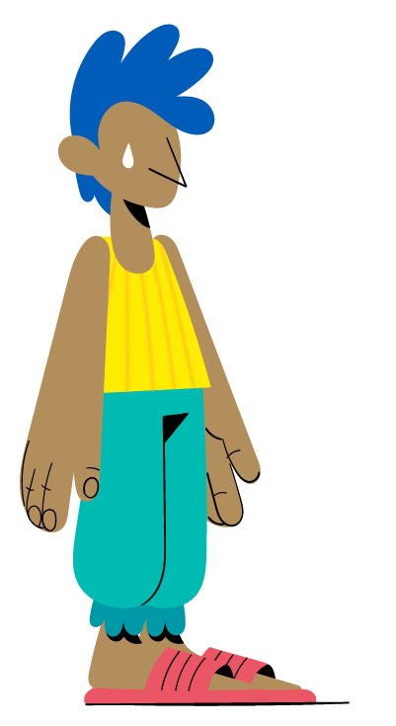
^{SESSION 4}
How to handle a disclosure and refer a GBV survivor?
Notes:
FACILITATOR NOTES
Expected duration of session:
80 mins (core content)
80 + 30 mins (core content + referral tool, if available)
80 + 20 mins (optional content)
80 + 30 + 20 mins (core content + referral tool, if available + optional content)
Explain the learning objectives:
Understand the role and responsibility of frontline workers when safely handling GBV disclosures.
Know how to refer a GBV survivor.
Understand how to apply the survivor-centred approach when responding to a GBV disclosure.
Develop a basic understanding of psychological first aid.

Slide 36
Responding to a disclosure of a GBV Incident
Notes:
FACILITATOR NOTES
https://youtu.be/n_YhXzMv1E4
Duration: 4 mins
This video is developed by the International Organization for Migration (IOM) and the Global Shelter Cluster. Highlight that this video is an introduction to what will be discussed in this session.

Slide 37
Your role and responsibilities as frontline worker
Know the GBV referral pathway and the services that are available in the area that you work in.
Offer a listening ear, free of judgement.
Provide accurate, up-to-date information on available services and let the survivor make their own choices.
Apply a survivor-centred approach.
NEVER proactively identify or seek out GBV survivors.
Notes:
FACILITATOR NOTES
Ask the participants what they think their roles are before making the answers appear.
Remind participants that the term frontline worker applies to any GBV and non-GBV specialists who are in direct contact with displaced and stateless persons, this could include non-technical colleagues as well such as drivers and security guards.
Meeting these responsibilities does not require professional counseling expertise, but rather a sensitivity to the needs of survivors, a commitment to confidentiality and other survivor-centred principles, and an awareness of referral options.

Slide 38
Optional
Group work Why do you need to know how to handle a GBV disclosure?
A survivor of GBV can decide when and how to disclose her experience.
All frontline workers could face a disclosure of GBV from anyone in the communities they work in.
It is extremely difficult for a survivor to disclose a GBV experience, and the first contact at the time of a disclosure plays critical role in her healing process.
Notes:
FACILITATOR NOTES
Estimated duration: 10 mins
Objective: confirm participants’ understanding of why they need to know how to handle the disclosure of a GBV incident
Divide the participants in groups.
Invite them to discuss why they think they need to know how to handle a GBV disclosure.
After a few minutes of group discussion, return to plenary and make the answers appear, whilst reinforcing key considerations below.
Key considerations
As frontline workers, participants are often in direct contact with displaced and stateless persons providing services, undertaking assessments or monitoring activities, consulting community members etc. Therefore, they may develop a relationship of trust, or they may be one of the few frontline workers that they know or are in direct contact with. Based on this, a person may decide to share information about GBV they themselves, or others in their family or community have been exposed to.
This is a critical moment, and it may be the only moment that a survivor decides to seek support. If this turns out to be a negative experience for her, or she does not receive the information about needed services that she is looking for, she may not be willing to seek any further assistance or find again the strength to share this information.

Slide 39
Disclosures
Direct disclosure
A survivor discloses her experience directly to you.
Can be referred with survivor consent.
Indirect disclosure
Someone else discloses an experience of GBV of others.
Cannot be referred as the survivor is not present to consent.
Notes:
FACILITATOR NOTES
Referring back to the video in the beginning of this session, recall the different types of disclosures displayed in the slide. Explain that we will look into the actions to take in the two scenarios in the next slides.

Slide 40
Steps to respond to a direct disclosure of GBV
Look
Link
Prepare
Address urgent medical and safety needs.
Immediate safety – are you and the survivor in a safe place?
Is the survivor comfortable to talk to you?
Listen
Provide the survivor with information on available case management and other services.
Obtain informed consent.
Facilitate the referral of the survivor to the GBV case management service provider as an entry point.
Be fully familiar with the referral pathway/available services.
Be in regular contact with a GBV specialist to learn about any updates/changes in services.
Listen to the survivor and help her to feel calm.
Do not ask details about the GBV incident.
Ask about the survivor’s needs and concerns.
Notes:
FACILITATOR NOTES
This slide is to summarize the different steps in responding to a direct disclosure of GBV. The referral pathway/available services have already been discussed in the previous session (prepare) and the other steps (look, listen, link) will be described in detail in next slides.

Slide 41
Steps to respond to an indirect disclosure
If a GBV incident is disclosed to you by someone other than the survivor:
Provide up-to-date and accurate information to the individual about any available services, including any available hotline number and/or support.
Encourage the individual to share this information safely and confidentially with the survivor.
Notes:
FACILITATOR NOTES
Before looking in detail at the steps to respond to a direct disclosure of GBV, remind participants that they should not provide a referral in case of an indirect disclosure, but rather focus on the elements outlined on the slide.
Content derived and adjusted from the IASC Pocket Guide – How to support survivors of GBV when a GBV actor is not available in your area – Training Package, 2018 (https://gbvguidelines.org/en/pocketguide/).

Slide 42
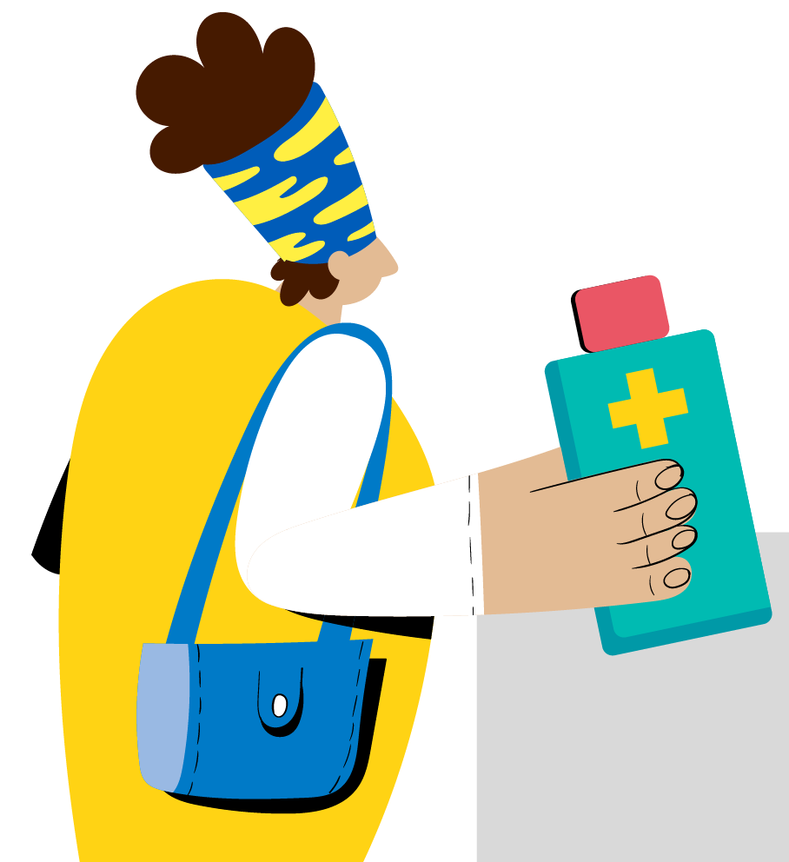
Look: urgent medical needs
Always provide information on what health services are available:
Share what you know, and most importantly explain what you do not.
Let the survivor decide if she wants to access them.
Receiving quality medical care within 72 hours can prevent transmission of sexually transmitted infections (STIs) including HIV, and within 120 hours can prevent unwanted pregnancy.
Notes:
FACILITATOR NOTES
Explain that in some cases medical treatment may be urgent and the information can be life-saving.
It is important that frontline workers make sure that they have up-to-date information and details on the medical services available in their area.
Ask participants if they know whether these medical services:
Offer specialized medical services for persons who have been subject to rape or sexual abuse?
Are free of charge?
Require any documents required for admission of displaced or stateless persons?
Medical personnel is subject to any mandatory reporting requirements? I.e. medical personnel in some countries may be bound by legal obligations to report certain medical indications (e.g. rape, sexual assault, suspected child abuse etc.) to national authorities. NB: mandatory reporting will be discussed later in the session in more detail as well.

Slide 43
Look: urgent safety needs
Consider if the perpetrator or anyone else is present and an urgent threat to the survivor and/or yourself.
Consider if the survivor is a risk to the life of herself or others.
If there is an imminent physical threat to the survivor, others and/or yourself: call the security actor.
If the threat is substantial, but not imminent: consult a GBV specialist in your area.
Notes:
FACILITATOR NOTES
Explain that frontline workers need to consider the survivor’s and your own physical safety, and whether the alleged perpetrator presents an urgent threat. It is also key to be alerted of any self-harm risks, or whereby survivors could form a threat to others (e.g. their children).
Remind participants of the survivor-centred approach, which means also that they should not involve the security actor in case there is a suspected risk that this may cause further harm to the survivor.
In cases when the threat is not imminent, yet there are reasons to believe that there may be a threat to the life of the survivor or others in the near future (e.g. in case a survivor of intimate partner violence who is expected to continue to be abused by her husband resulting in possibly life-threatening injuries; a survivor who is unstable and not able to take care of her children or a severely traumatized survivor with suicidal ideas etc.), it is recommended to consult a GBV specialist for advice without disclosing details that reveal the identity of the survivor, unless there is consent from the survivor or it is absolutely necessary.

Slide 44
Listen: what to say to a survivor
What should I say?
Notes:
FACILITATOR NOTES
https://youtu.be/Gq8mY0nGFJk
Duration: 1.44 mins
Video derived from the IASC Pocket Guide – How to support survivors of GBV when a GBV actor is not available in your area – Training Package, 2018 (https://gbvguidelines.org/en/pocketguide/). In the video, Micah Williams (Senior GBV Advisor at International Medical Corps) shares examples of things you can say to a survivor when approached with a GBV disclosure, as an introduction to the provision of psychological first aid to survivors.

Slide 45
Listen: what not to say to a survivor
What should I not say?
Notes:
FACILITATOR NOTES
https://youtu.be/y1hc9Dy_G6I
Duration: 4.23 mins
Video derived from the IASC Pocket Guide – How to support survivors of GBV when a GBV actor is not available in your area – Training Package, 2018 (https://gbvguidelines.org/en/pocketguide/). In the video, Micah Williams (Senior GBV Advisor at International Medical Corps) shares examples of things you should not to say to survivors of GBV when they disclose their experience with GBV to you.
In case some key messages need to be reinforced, remind participants that in case of disclosure one should:
Find a safe, confidential and quiet space to talk.
Ask if you can provide help.
Don’t ask direct questions that may prompt disclosure, such as “What happened to you?”.
Listen actively: give your full attention, gently nod your head, make eye contact, use body language which shows that you are engaged with what they are saying (this may vary by culture, age, and sex).
Help the person to feel comfortable, e.g. provide water if you can. Although some needs may be obvious, such as a blanket or covering for someone whose clothing is torn, always ask what people need and what their concerns are.
Do not pressure the person to talk and do not expect her to display particular emotional reactions.
Do not raise expectations – be honest and accurate (e.g. do not say: “They will give you money” or “They will solve all your problems”).

Slide 46
Link: what is informed consent?
It is essential to request the informed consent of the survivor before sharing any information with anybody regarding their situation.
Informed consent means that:
The survivor understands the risks and potential consequences of sharing their information with third parties.
The survivor may or may not give her authorization to use or share their information.
Notes:
FACILITATOR NOTES
Build on the video displayed in the beginning of the session, reminding participants what informed consent is.
Make a link between informed consent and the survivor-centred approach (i.e. following the wishes of the survivor).
GBV information must be maintained strictly confidential at all times.
Confidentiality reflects the right of people to choose to whom they will, or will not, tell their story.
Misuse of information can have serious consequences for survivors, their families, communities, or even service providers.
Maintaining confidentiality means not disclosing any identifiable information at any time to any party without the informed consent of the person concerned.
The survivor should be given honest and complete information about referral to case management or other services, any risks or implications of sharing information about her situation, and any limits to confidentiality prior to obtaining consent (see next slides).
Survivors have the right to place limitations on the information to be shared, and to specify which organizations can and cannot be given the information.
Survivors have the right to withdraw consent at any time.

Slide 47
Link: elements of informed consent
Inform/explain to the survivor:
What is going to happen to the survivor if they share information.
The benefits and risks of an intervention (medical treatment, interview, mandatory reporting requirements etc.).
The right to decline or refuse any part of an intervention.
That pressure should not be exerted in any form.
That the survivor has the right to not disclose information that she is not comfortable with (but be clear if there is a context whereby this may be a requirement in order to receive services).
Any mandatory reporting requirements in your context.
That information about the survivor may be discussed in a team.
Ensure that the survivor understands what you have told her.
Notes:
FACILITATOR NOTES
Remind participants that survivors should be able to make an informed decision about their referral to service providers, based the elements mentioned in the slide. This will be practiced in different role plays later on as well.
Mandatory reporting requirements will be explained in the next slide.
Specific considerations with regards to the consent/assent of children and their parents or caregivers are discussed in the session on child survivors.
Persons with disabilities, particularly those with intellectual and psychosocial impairments, are very often denied the right to express their consent. For referrals of persons with disabilities including persons with intellectual and psychosocial disabilities, always assume that a survivor can provide informed consent, but be sure to check for understanding throughout the process. It may be necessary to allocate more time for explanation and arriving at a decision. Some persons with disabilities may wish to ask a trusted person to support them in making an informed decision. Involving caregivers is important, but also carries a certain level of risk, given that caregivers can also be perpetrators. Pay attention to the dynamic between the survivor and caregiver. (IASC Guidelines, Inclusion of Persons with Disabilities in Humanitarian Action, 2019, https://interagencystandingcommittee.org/iasc-guidelines-on-inclusion-of-persons-with-disabilities-in-humanitarian-action-2019 and the Inter-Agency GBV Case Management Training Package (https://www.gbvims.com/gbv-case-management-guidelines/gbv-case-management-training-materials/). A practical tool to promote supported consent (instead of substitute consent, when decisions are taken on behalf of persons with disabilities without their participation) is included in the UNHCR/IRC, Your Guide to Protection Case Management, 2021, p. 141 (https://reliefweb.int/report/world/your-guide-protection-case-management-field-test-version).
Content derived and adjusted from the IASC Guidelines Training Package, Module 4, 2015 (https://gbvguidelines.org/en/capacity-building/module-4-responding-to-gbv-incidents/).

Slide 48
Link: exceptions to informed consent
Risk to the life of the survivor or serious risk of harm to another person (e.g. their children)
In imminent life-threatening situations when a GBV specialist cannot be consulted, report to: [XXXX]
In case the threat is substantial, but not imminent, consult the GBV specialist: [XXXX]
Sexual exploitation or abuse (SEA) by an aid worker
Duty to report according to agency protocols
More details on next slides
Child abuse is suspected and reporting is in the best interest of the child
Mandatory reporting requirement
Consult the child protection/GBV specialist: [XXXX]
[PLACEHOLDER: 4. Other mandatory reporting requirements set out in national legislation – facilitator to add required details]
It is recommended to consult a GBV specialist who can advise on how to navigate mandatory reporting requirements in your context
Notes:
FACILITATOR NOTES
It is recommended to include the points of contact for the operation for the each of the cases displayed in the slide (e.g. security actor, GBV/child protection specialist).
Explain that certain circumstances require us to disregard the consent of the survivor, either related to serious risks to the survivor/others, duty to report and/or mandatory reporting requirements.
If there is an imminent physical threat to the survivor, others and/or yourself, frontline workers are recommended to call the security actor. In case the threat is substantial, but not imminent, yet there are reasons to believe that there may be a threat to the life of the survivor or others in the near future (examples discussed above), the frontline worker is advised to consult a GBV specialist in their area. It is recommended to consult for advice without disclosing details that reveal the identity of the survivor, unless there is consent from the survivor or absolutely necessary.
SEA will be discussed in more detail in the next slides.
Most countries have national mandatory reporting laws regarding child abuse (e.g. in some countries, if a person has information about a child at risk and does not report the case to the authorities, he/she can be charged and taken to court). More details on mandatory reporting of child abuse are included in the next session.
In case there are other mandatory reporting requirements set out by the national legislation (e.g. in some countries, survivors are required to report to the police before being able to access health care, or medical personnel is required to report all cases of sexual violence to the police), the fourth point should be updated accordingly.
While mandatory reporting is often intended to protect survivors (particularly children), in some cases following mandatory reporting procedures conflicts with the guiding principles for working with survivors, including confidentiality and self-determination. It can also result in actions that are not in the best interest of the survivor or against the best interest of the child. For example, mandatory reporting of cases of sexual violence or intimate partner violence to the police can put the survivor at great risk of harm from the perpetrator, family members or community members or in certain contexts survivors may be imprisoned if they have been subject to sexual violence outside of the marriage.
In case of mandatory reporting requirements, it is always recommended to consult a specialist first before proceeding with informing authorities! The specialist can also help the survivor to mitigate some of the risks that mandatory reporting may entail for her and advise the survivor on how to navigate those requirements.
Highlight to participants that in case any of these exceptions to informed consent and/or mandatory reporting requirements apply, they should inform the survivor accordingly. Remind them, that if the survivor shares information that they must report, explain what information they must share, who they will share it with, and what is likely to happen next.
Remember: when seeking the advice of a GBV specialist, do not disclose any identifiable information about the survivor without her consent.
Content derived and adjusted from the Inter-Agency GBV Case Management Guidelines, 2017 (https://gbvresponders.org/wp-content/uploads/2017/04/Interagency-GBV-Case-Management-Guidelines_Final_2017_Low-Res.pdf).

Slide 49
Sexual exploitation and abuse
Sexual exploitation and abuse (SEA) perpetrated by aid workers is a form of GBV.
The UN has zero tolerance on SEA.
UNHCR personnel and partners have the obligation to report SEA allegations, suspicions or concerns.
SEA
GBV
GBV committed by aid workers
Notes:
FACILITATOR NOTES
Explain that this Facilitation Package will not go into detail on Protection from Sexual Exploitation and Abuse (PSEA) but is included here in order to ensure that participants are aware how to handle the disclosure of a GBV incident that is also SEA.
Explain what SEA is:
Sexual exploitation: any actual or attempted abuse of a position of vulnerability, differential power, or trust, for sexual purposes, including, but not limited to profiting monetarily, socially, or politically from the sexual exploitation of another.
Sexual abuse: the actual or threatened physical intrusion of a sexual nature, which can occur by force, under unequal conditions, or under coercive conditions.
SEA can be perpetrated by humanitarian workers, development workers, government officials, and other persons involved in delivery of assistance.
Remind participants of the mandatory PSEA eLearning available through Workday for UNHCR workforce (https://wd3.myworkday.com/unhcr/learning/course/202b865e820710178637e98fc2890000?record=9253f6a1a836100160afbf7143e60000&type=9882927d138b100019b928e75843018d) and on Agora for partners (https://agora.unicef.org/course/info.php?id=7380).
If required, highlight IASC PSEA core principles (https://psea.interagencystandingcommittee.org/update/iasc-six-core-principles):
SEA by aid workers constitute acts of serious misconduct and are therefore grounds for termination of employment.
Sexual activity with children is prohibited regardless of the age of majority or age of consent locally. Mistaken belief in the age of a child not a defense.
Exchange of money, employment, goods or services for sex, including sexual favours or other forms of humiliating, degrading or exploitative behavior, is prohibited. This includes any exchange of assistance that is due to beneficiaries.
Any sexual relationship between staff and beneficiaries that involves improper use of rank or position is prohibited. Such relationships undermine the credibility and integrity of humanitarian aid work.
Where a humanitarian worker develops concerns or suspicions regarding SEA by a fellow worker, whether in the same agency or not, he or she must report such concerns via established reporting mechanisms.
Aid workers are obliged to create and maintain an environment which prevents SEA and promotes the implementation of their code of conduct.

Slide 50
Link: how to handle a SEA disclosure?
Prioritize referrals to GBV services – as per steps outlined in previous sections and only with the informed consent of survivors.
All humanitarian actors have a duty to report. Report all SEA allegations as per the reporting guidelines in your location.
Do NOT investigate or attempt to obtain additional information or verify facts.
Respect the wishes of survivors who do not want their identifiable information to be shared.
Notes:
FACILITATOR NOTES
It is recommended to to display the reporting channels/flowchart of the context on the slide.
All UNHCR workforce have a duty to report instances of SEA . The allegation can be made anonymous. Possible reporting channels for SEA perpetrated by UNHCR workforce or partners include:
UNHCR Inspector General Office (IGO, https://www.unhcr.org/igo-complaints.html);
UNHCR SpeakUp helpline (https://intranet.unhcr.org/en/about/ethics-office/speakup.html ). The SpeakUp Helpline is for UNHCR colleagues only and not for displaced and stateless persons.
PSEA focal point: facilitator to share contact details of PSEA focal point depending on the audience and context (e.g. availability of inter-agency PSEA reporting mechanism, UNHCR PSEA focal point, reference to agency-specific reporting mechanism for mixed audience etc.).
Remind participants that if frontline workers are unsure if the incident that was disclosed was SEA or GBV, they should not ask for more details or prompt the survivor for further information. Instead, they should consult a GBV specialist without sharing any identifiable information.

Slide 51
Link: steps in linking a survivor to services
Provide information
Remember: GBV case management services are the entry point for connecting with survivors with GBV response services.
Obtain informed consent
Remember: elements of informed consent;
Consider: exceptions to informed consent and mandatory reporting requirements, and consult a GBV specialist if needed.
Facilitate referral
Referral via phone; OR
Written referrals/complete the inter-agency referral tool if available (only include when relevant, see next slide); OR
Self-referral
Notes:
FACILITATOR NOTES
This slide summarizes the steps in linking a survivor to services – as discussed on in previous slides. It aims to look into more detail at how to facilitate the referral.
Provide information
Inform the survivor about GBV case management services: briefly explain that case management service providers have specialized staff who assist persons who faced the same problem as her. The staff will listen to them and help the survivor in reaching the different types of assistance they may want, including psycho-social assistance, medical assistance, legal assistance, and assistance to find safe shelter if needed. Explain if these services are free of charge or not.
Remember: the frontline worker should not advise/encourage the survivor to seek a certain types of services. Providing assistance to a survivor is about empowering survivors to make their own decisions about their own lives. It is up to the survivor to decide the best way to solve her problems.
Obtain informed consent
Ask the survivor if she gives you the consent to contact other services to give them her name and describe which information you will share.
Remember: if the survivor is unwilling to be referred for assistance, you need to respect her wishes and can simply provide her with GBV hotline numbers if available, so she will be able to seek help whenever she feels ready.
Facilitate referral
How the survivor is referred will depend on the inter-agency referral pathway and tools agreed at inter-agency level. It is therefore recommended to adjust the third point on the slide according to the context.
Remind participants, that frontline workers should refer survivors (with consent) to the GBV case management services as the entry point for connecting with other services.
It is recommended that referrals by frontline workers are done verbally. For a verbal referral, the frontline worker identifies the GBV case management service provider closest to survivor’s area of residence as per the referral pathway, ensures that he/she is in a confidential environment (no one else can hear them), then call the service provider.
Generally using written documents for referrals by frontline workers is not advisable, if confidentiality procedures are not known or cannot be followed. However, in some contexts written referral tools are agreed at inter-agency level. In this case, the next slide should be used to explain in detail how to use these tools and ensure data protection.
In some contexts, referrals to certain services are not done via other service providers or frontline workers and self-referral is the common practice. In this case, after having been provided with relevant information, the survivor can make a request for assistance to the needed service provider herself, either in person or by phone.
Accompanying survivors: the survivor may want someone to accompany her to the other agencies or actors she will go to for help. It is not the role of the frontline worker to accompany the survivor, as this could put the survivor at further risk. In some settings, frontline workers are known in the community, so walking a survivor to a medical facility or a police station automatically raises curiosity and may inadvertently put the survivor at risk. Instead, the frontline worker should discuss with the survivor if there is anyone else she trusts who can accompany her. The frontline worker could always seek the advice of a GBV specialist in these situations. Remember: when seeking the advice of a GBV specialist do not disclose any identifiable information about the survivor without her consent.

Slide 52
PLACEHOLDER: Referral tool
Optional
Notes:
FACILITATOR NOTES
Expected duration: 30 mins (duration will vary according to the tool)
NB: remove the optional icon when the slide is used.
This slide should ONLY be used if there is an agreement at inter-agency level that frontline workers should use an inter-agency referral tool and/or faciliate referrals in other forms of writing. In this case, it is recommended to include a screenshot and provide a hand-out of any referral tool that frontline workers may be expected to use (e.g.offline form, proGres v4 referral, Kobo etc.) in order to go in detail through the tool and make sure that participants are equipped to use the tool, taking all data protection measures into consideration. If the tool includes a consent form, it is recommended to discuss this in detail as well.
Ask participants if they have used this referral tool before and what challenges they may have experienced with using the tool.

Slide 53
Link: linking survivors when no GBV services available
Optional
Communicate detailed information about other available services/resources (e.g. medical, security actor, psychosocial support, UNHCR or partner focal point, hotline number, provider of remote case management etc.).
Ask if there is someone, a friend, family member, caregiver or anyone else who the survivor trusts to go to for support.
Be honest with the survivor, recognizing the survivor’s courage to share their experience with you, explain what you can and cannot do, and provide comfort.
Notes:
FACILITATOR NOTES
This is an optional slide to be used ONLY for contexts where there are no GBV specialized service providers available. NB: remove the optional icon when the slide is used.
Emphasize that whilst there may be no GBV referral pathway in place, frontline workers should be aware of information and details on other available services – referring to the earlier discussion in the previous section (e.g. how to access, possible mobile services, relevant times and locations, focal points at the service, safe transport options etc).
Highlight the importance of frontline workers not to raise expectations and be honest with the survivor, provide comfort.
Content derived and adjusted from the IASC Pocket Guide – How to support survivors of GBV when a GBV actor is not available in your area – Training Package, 2018 (https://gbvguidelines.org/en/pocketguide/).

Slide 54
Optional
Discussion Challenges in handling a GBV disclosure
Have you used the GBV referral pathway before?
What challenges do frontline workers face in your context when a GBV survivor discloses an incident of GBV to them?
Notes:
FACILITATOR NOTES
Expected duration: 10 mins
Objective: reinforce correct understanding of the role of non-GBV specialists in handling GBV disclosures and address contextual challenges/gaps
NB: remove the optional icon when the slide is used.
Key considerations
Remind participants that all frontline workers should be aware of the GBV referral pathway and the services that are available in the area that they work in.
Their role is to provide accurate, up-to-date information on available services and let the survivor make her own choices.
When a survivor is not willing to be linked to services, respect her choice. It is recommended that available contact details and/or hotline numbers are shared with the survivor, should she change her mind in the future.
The frontline worker’s role is not to provide counselling, conduct an interview, understand what happened and the details, tell her what to do or give your own opinion.
Frontline workers should not engage in repeated sessions or meetings with survivor, counselling or attempts to manage the survivor’s case.
Ensure that participants do not to share details about GBV disclosures they may have experienced as part of this discussion.

Slide 55
Reflection and self-care
Remember that you can do everything right, but you are not going to fix the survivor’s experience or take away her pain.
Hearing the survivor’s story can expose you to her pain, her or trauma or trigger memories of personal experiences.
Think about how to take care of yourself as these feelings come up for you.
Reach out to your own support system, always keeping in mind the survivor’s confidentiality.
[PLACEHOLDER: Staff care resources: facilitator to add required details that may be available in county]
Notes:
FACILITATOR NOTES
It is recommended to add details of staff care resources that may be available in country.
Reassure participants, that whilst they can do everything right, the are not going to fix the survivor’s experience or take away her pain.
Listening to and hearing other people’s experiences can expose them to her painful, traumatic or hurtful experience – also known as experiencing secondary trauma, or trigger memories of personal experiences. While not common, secondary trauma is a risk of humanitarian work as we work closely with individuals who have been through traumatic experiences, and this may be particularly true when working with survivors of GBV. It is important to know that vicarious trauma is a process – it does not happen after one encounter. Rather, it occurs when we begin to identify with persons in a way that changes our thoughts, feelings, and behaviors parallel those of the person who experienced the traumatic experience.
Encourage participants to think about about how to take care of themselves as these feelings come up. Looking after ourselves can also help us to be in a better position to support others in the work we do.
Participants should reach out to their own support system and network, including colleagues, team leader or a GBV specialist, to de-brief on the exchange (keeping in mind the survivor’s confidentiality) and seek support.
There may be specific safe care resources available in your operation for self-care, e.g Staff Counsellor, online support, etc, you may want to share here.
Content derived and adjusted from the IASC Pocket Guide – How to support survivors of GBV when a GBV actor is not available in your area – Training Package, 2018 (https://gbvguidelines.org/en/pocketguide/) and the Inter-Agency GBV Case Management Training Package (https://www.gbvims.com/gbv-case-management-guidelines/gbv-case-management-training-materials/).

Slide 56
Key messages
Frontline workers should NEVER proactively identify or seek out GBV survivors.
Communication strategies to use with survivors include active listening, validation of feelings, using healing statements, following the survivor’s pace, using simple and same language.
In order to link a survivor to GBV services, a frontline worker should provide information, obtain informed consent, and facilitate the referral in a safe and confidential manner.
Frontline workers should be fully aware of exceptions to informed consent and mandatory reporting requirements applicable in their location.
Ensuring urgent medical needs are met and considering immediate safety concerns of survivor and frontline worker, are priorities.
In case of indirect disclosures, the persons reporting the incident should be encouraged to share information about services safely and confidentially with the survivor.

Slide 57
^{SESSION 5}
Considerations for child survivors
Notes:
FACILITATOR NOTES
Expected duration for session
60 mins
This session could be co-facilitated with a child protection specialist, if needed.
Note: It is important to recall that this is not intended to be a child protection training, nor to share child protection core concepts and approaches, nor information on child protection activities/functions. Rather, the aim of this session is to provide guidance on handling disclosures of child survivors of GBV and safely referring them to access support. If a more focused training on child protection is required, this should be provided separately through connecting with child protection specialists.
Explain the learning objectives:
Understand the key considerations for handling a disclosure involving a child survivor vs. adult survivor.
Know how to refer a child survivor of GBV.
Be familiar with the the local GBV referral pathway for child survivors.

Slide 58
GBV against children
Child = any person under 18 years old.
Survivors can be children of all ages, including infants and children in early childhood, of all sexual orientations, gender identities and expressions.
GBV against children may be physical, psychological, sexual or socio-economic.
The alleged perpetrator (either another child or adult) is often a known and trusted person in the child’s life, including potentially family members or other trusted individuals (e.g. neighbors, teachers, religious leaders, health workers, others with contact with children).
Notes:
FACILITATOR NOTES
United Nations Convention on the Rights of the Child (CRC) definition of a child: a child is any person under the age of 18.
Remind participants of the types of GBV discussed in the first session. Ask participants whether they think these same types also affect children. Explain that GBV against children may be physical, psychological, sexual or socio-economic.
Children of all ages can be affected, sometimes infants. It is important never to assume that abuse is not happening because a child is very young. Younger children are often at high risk. The guidance in this session applies to infants and children of all ages.
Remind participants that GBV is rooted in gender inequality and that girls are disproportionately affected by GBV. Girls are at increased risk of GBV as they often have less access to information, services and resources, Explain that some physical, psychological and socio-economic forms of GBV, are only considered GBV when perpetrated against girls or LGBTIQ+ children. When perpetrated against boys, this is considered a child protection risk and should be addressed by child protection actors.
Explain that children, particularly girls, can be affected by the same forms of GBV that affect adults, but that there also are some types of GBV that affect children specifically.
Ask participants about the types of GBV that affect only children. Collect some answers and if participants have not mentioned child marriage and female genital mutilation (FGM), remind them that these are also examples of GBV against children.
Explain that the majority of GBV against children is committed by men, with most of the perpetrators known to the children. Because perpetrators are often known to children, children can be abused over a longer period of time and the abuse can happen more than once.
Explain that when it comes to sexual abuse against children, it is important to understand that physical force is not always used by perpetrators of child abuse. The perpetrator may trick the child (e.g. give the child a gift or threaten the child) to ensure the child does not disclose the abuse.
Derived and adjusted from the UNICEF/IRC, Guidelines Caring for Child Survivors of Sexual Abuse – Training Package, 2012 (https://gbvresponders.org/response/caring-child-survivors/#CCSTrainingMaterials). NB: an updated version of these guidelines is expected to be launched in 2023.

Slide 59
Disclosures of GBV against children
Disclosure can be voluntary or involuntary
If a child survivor tells an adult about GBV it is called voluntary disclosure.
If someone other than the child tells about the GBV incident, and the child did not want someone to tell, it is called involuntary disclosure.
Children do not always tell about GBV
Often, children, especially young children, who are being abused do not tell anyone about the abuse they are being subjected to.
Warning signs of GBV may or may not be present.
Notes:
FACILITATOR NOTES
Explain that there are different ways that information about the occurrence of GBV against children is shared:
Sometimes children want the GBV to be disclosed (voluntary) and sometimes GBV is disclosed against the child’s will (involuntary).
Note the difference between handling GBV incidents for adults that strictly follows the survivor-centred approach where identification should not be sought, and for children where identification is an important entry point for support.
Warning signs will be discussed in the next slide.
Discuss with the participants some of the issues that prevent children from disclosing. As much as possible, focus on the specific issues relating to the context-specific cultural and social norms.
Fear: many children are afraid to tell an adult about what they are going through. There are many reasons why children are afraid, e.g. the alleged perpetrator may have threatened the child; the child is afraid to be taken from the family and fear of where he/she will go, blamed for shaming the family or getting someone in trouble with the law if he/she speaks out.
Manipulation from the perpetrator: children may be manipulated by the perpetrator.
Expectation that they will not be believed: children are often afraid adults will not believe them, especially in situations of sexual abuse. They are afraid that their parents, the community leaders, clan members, religious leaders and others will not believe them and they will not receive help.
Personal blame: children may believe it is their fault, or they think the abuse is normal. In situations of sexual abuse, sometimes the perpetrator tells the child that no one will believe him/her or that the child is responsible for the abuse and will be punished for it.
Protect the perpetrator: the child wants to protect the perpetrator and may feel bad about disclosing, especially because the perpetrator is often close to the child in some way.
Protect parents: children often do not disclose because they want to protect a non-abusive parent from being blamed. A child may feel that he/she allowed the GBV situation to continue and should have stopped it. There are no situations where a child is responsible for any form of GBV.
Shame/guilt: the perpetrator will often make the child feel shameful, embarrassed or guilty about the situation, especially sexual abuse. Sometimes the perpetrator will blame the child, saying it is the child’s fault.

Slide 60
Warning signs of GBV against children
Age | Behavioral signs | Emotional signs | Physical signs
0-5 | Regressive behaviors - lose certain skills, e.g. bladder control; clingy with familiar adults; display sexual knowledge inappropriate to age | Fear leaving places where they feel safe or afraid to go places that may trigger memories; change in eating or sleeping habits | Complain of physical aches & pains with no medical basis; new / unexplained marks / bruises, esp. in genital area; pain, discoloration, sores, cuts, bleeding/ discharge in genitals, anus, mouth; pain during urination / bowel movements; wetting / soiling accidents; weight loss / gain; sexually transmitted infections
6-9 | Ask adults to feed/ dress them; refuse to go to school; touching genitals; avoid family & friends; refuse to eat / eat all the time | Sadness, fear, anxiety & anger; feelings of shame and guilt
10 – 18 | Nightmares/ sleep disorders; talking about abuse; anger; disobedience; drugs / alcohol | Depression (chronic sadness); crying; emotional numbness | As above & pregnancy
Notes:
FACILITATOR NOTES
Show the slide and explain that in addition to direct or indirect disclosure of GBV incidents, frontline workers play a critical role in identifying children experiencing GBV.
Go over the slide with different warning signs of GBV experienced by children, that may help identify a child experiencing GBV.
It is important for frontline workers (particularly those in frequent contact with children) to be aware of these signs, so as to understand what they need to look out for with children of different age groups.
Explain that many children show no signs. For many children, it is often very difficult to disclose a GBV incident. Regularly, children displaying warning signs of GBV may not tell anyone, but rather are identified by others as being at-risk.
Explain that many signs that make us worry about a child’s protection or well-being, do not “prove” what exactly is going on, but they may help us recognise something is wrong. It is critical not to make assumptions and jump to conclusions too quickly; an assessment by a child protection/GBV specialist is often needed to understand a situation.
Remind participants that our own attitudes and experiences can influence our perceptions which we also need to be mindful of (e.g. what we expect from children in different age groups or with disability as per our own culture).
If one is not sure or feels worried about a child being sexually abused, it is always better to consult with a child protection/GBV specialist on what to do (sharing only the information as guided/requested by the child protection/GBV specialist in order for them to provide support).

Slide 61
Best interests of the child
“ In all actions concerning children … the best interests of the child shall be a primary consideration.”
Article 3 – Convention on the Rights of the Child
No specific definition – all elements that contribute to a child’s wellbeing, determined by a variety of factors including:
Views of the child taking into consideration age, maturity, individual circumstances and past experiences;
Social circumstances, protection, health, development needs;
The presence or absence of the child’s family;
Security and the environment of the child.
Notes:
FACILITATOR NOTES
Remind participants of the survivor-centered approach and guiding principles discussed earlier in the second session.
Explain that when it comes to children, the best interests principle has a primary consideration.
According to the Convention on the Rights of the Child (CRC), the best interests principle forms the basis for all decision making/actions affecting children.
Ask participants what do they think we mean by the ”best interests” of the child, before making the second part of the content on the slide appear.
There is no common definition of what constitutes the best interests of a child, as this depends on a wide range of current and past factors and the individual situation of each child.
Each child is unique. However, there are important common factors that need to be considered when assessing/determining what is in the best interests of a child in a given situation.
This session focusses on how frontline workers are expected to consider the principle of the best interests of the child.
If asked (not mandatory):
In various countries around the world, the best interests principle in national law is specific only to custody disputes and adoption and is applied by judges based on reports of child-protection authorities and sometimes other experts. In other words, the CRC broadens the scope of the best interests of the child drastically, applying it to all actions affecting children’s lives by all the above parties.
CRC Committee General Comment No.14, 2013 (https://www.refworld.org/docid/51a84b5e4.html) explains the best interest principle as follows:
A substantive right – or the right of the child to have his or her best interests assessed and taken as primary consideration.
A legal principle - meaning that if a legal provision is open to more than one interpretation, the interpretation which most effectively serves the child’s best interests should be chosen [example: if a child is at imminent risk, child protection/GBV specialists are not available and referral to the police will increase the risks for the child, the referral might be delayed until child protection/GBV specialists are available ].
A rule of procedure – to the effect that whenever a decision is made that will affect a specific child, group of children or children in general, the decision-making process must include an evaluation of the possible impact (positive or negative) of the decision on the child concerned.
Content derived and adjusted from the UNHCR Best Interests Procedure Guidelines, 2021 (https://www.refworld.org/docid/5c18d7254.html).

Slide 62
Referral considerations
Is there an immediate threat to the child’s life or well-being?
Is there a need for immediate basic services or support?
Does the child have adults present who seem safe and supportive (who are not the perpetrator)?
Can the risk be avoided/mitigated? (note that this may not be possible if the threat is at home)
Are other children or adults affected by the risk as well, such as siblings, the other parent/caregiver, etc.?
Is it possible to immediately consult a child protection/GBV specialist?
Is the referral likely to cause further harm?
Is the actor receiving the child likely to take action immediately?
Notes:
FACILITATOR NOTES
Explain that one of the most important things we must do when a possible situation of GBV against children is identified/disclosed, is to consider the level of risk and urgency and whether the referral will serve the best interests of the child. This is something that child protection/GBV specialist will carefully assess, but as the person identifying a child survivor or receiving a disclosure, we also must consider how urgent the situation seems and if the referral is in the best interest of the child to help us decide on next steps.
Recall the different factors that help assessing the best interests of the child that we saw in the previous slide. Highlight that there are some simple questions we can ask ourselves which will help us to take the best course of action, formulated around those different factors, highlighted in the slide.
Conclude that if there appears to be an immediate threat to the child’s life or well-being such as their physical and emotional safety, one should take immediate action and the child should not be left alone.
Note that it is always recommended to consult a child protection/GBV specialist (sharing only the information as guided/requested by the child protection/GBV specialist in order for them to provide support) before referring to authorities as they have better knowledge of the system and its pros, cons and risks involved.
In case it is not possible to reach a child protection/GBV specialist, immediate action may include contacting health services and/or a security actor – if this seems like a safe option and in the best interests of the child.

Slide 63
Parents’/caregivers’ involvement in obtaining consent
The assent of the child AND informed consent of parents/caregivers is a requirement before proceeding to any referral.
There are situations where the consent of parents/caregivers should not be sought:
When parents/caregivers are alleged perpetrators or complicit in the situation;
For children between 15-18 years, the decision to involve parents/caregivers should be made by the child directly and according to the local laws and policies.
Notes:
FACILITATOR NOTES
Assent refers to the expressed willingness by the child to participate in services. While the assent is not legally biding and based on the need to get the views of the child, the parents/ caregivers’ consent is legally biding, and may lead to legal implications if not obtained (especially if referral is made to authorities).
In case a frontline worker is considering not involving a parent/caregiver in providing consent or is unsure if they should, it is recommended to immediately consult a child protection/GBV specialist (sharing only the information as guided/requested by the child protection/GBV specialist in order for them to provide support).
For more information on consent/assent, please refer to the Inter Agency Guidelines for Case Management and Child Protection, 2014 (https://resourcecentre.savethechildren.net/document/inter-agency-guidelines-case-management-and-child-protection/).

Slide 64
Mandatory reporting of child abuse
Mandatory reporting refers to state laws and policies which oblige certain agencies and/or persons in certain professions (e.g. teachers, social workers, health staff, etc.) to report actual or suspected child abuse.
[PLACEHOLDER: facilitator to add required details on mandatory reporting procedures in the context]
Mandatory reporting can raise safety and ethical concerns and may not always be in the child’s best interests.
Always consult a child protection/GBV specialist.
Notes:
FACILITATOR NOTES
It is recommended to explain details about the mandatory reporting legislation and procedures on GBV against children in the specific context, a summary of which should be added to the slide.
Mandatory reporting can raise safety and ethical concerns, in particular in emergency situations where protective systems may not be functional. Therefore, mandatory reporting, may not always be in child’s best interests, especially when:
Authorities lack clear procedures and/or guidelines for reporting;
Lack protection and/or legal support to respond suitably;
Reporting could risk the child’s safety.
In general, but particular in these cases, it is recommended to consult a child protection/GBV specialist (sharing only the information as guided/requested by the child protection/GBV specialist in order for them to provide support) before proceeding with reporting to authorities. Any information added in the slide regarding local mandatory reporting procedures should clarify who is responsible for making a report (e.g. child protection/GBV specialist). It is important that frontline workers understand their role, as mandatory reporting can sometimes be complex/sensitive and requires monitoring/follow-up on the best interests of the child. Therefore, it is not recommended that frontline workers are responsible for making these reports. Rather, child protection/GBV specialists should provide guidance and advice for these cases.

Slide 65
Discussion Referral pathway for child survivors of GBV
Notes:
FACILITATOR NOTES
Estimated duration: 15 mins
Objective: familiarize participants with the local referral pathway for child survivors of GBV
If available, it is recommended to include a screenshot and provide a hand-out of the local referral pathway for child survivors of GBV in order to go in detail through the available services of each of the different service providers – including how to handle urgent cases and/or cases after operating hours of child protection/GBV specialized services.
Ask participants:
Have they seen this referral pathway before?
What are the differences with the referral pathway for adult survivors of GBV?
Key considerations:
Remind participants that it is the role of child protection/GBV specialists to map these services and develop the referral pathway. Frontline workers are expected to be fully familiar with the referral pathway for child survivors and have the contact details of child protection/GBV specialists available to seek support/advice (e.g. a colleague from the Protection team, from another office or a specialized partner).
Frontline workers should be aware of the contact details, operating hours, locations, etc. of quality and reliable services available for child survivors on the referral pathway.
It is recommended that all programmes/partners/offices have access to this basic information before starting to work with the community.
If there is no referral pathway for child survivors of GBV, the recommended course of action is always to contact a GBV/child protection specialist who can advise on the situation. Remember never to share any identifiable information about the child.

Slide 66
Steps in linking a child survivor to services
Inform the child about available services and support.
Obtain consent/assent for collecting and sharing the child’s information.
Explain limitations to confidentiality to the child.
Respect the need-to-know, confidentiality and data protection principles.
Consult a child protection/GBV specialist.
Notes:
FACILITATOR NOTES
Review the slide that summarizes the steps for referring a child survivor of GBV.
Inform the child about available services and support: “I am not best placed to help you, but I know someone who helps children who have experienced this. Their job is to help children in these situations”.
Obtain consent/assent for collecting and sharing the child’s information: Explain who the person is, what their job is and what information you would need to share.
Explain limitations to confidentiality to the child by describing when, why and how you might need to share information without their permission or agreement (mandatory reporting).
Remind participants that the same safe and ethical information sharing considerations that apply to adults survivors also apply to children.
It is always recommended to consult a child protection/GBV specialist (sharing only the information as guided/requested by the child protection/GBV specialist in order for them to provide support), before referring the child to services.

Slide 67
In a nutshell
Voluntary disclosure
Warning signs (identification)
Involuntary disclosure
Be approachable and engaging
DO NOT question or enquire to try and force disclosure
Provide comfort and refer
(with assent/consent)
Consult a child protection/GBV specialist
(sharing information as required by the specialist)
Notes:
FACILITATOR NOTES
Explain that as discussed in the previous slides, a child survivor can come to the attention of frontline workers in different ways: identification (warning signs), voluntary disclosure, or involuntary disclosure.
In situations of voluntary disclosure:
Be approachable if a child wants to seek help, use child friendly communication.
See if the child can be connected to his/her parents/ caregivers when they are not the alleged perpetrators or complicit to the alleged GBV (see below).
Refer to specialized services offering support to child survivors of GBV, upon informed assent/consent of the child and parents/caregivers.
Potential involvement of parents/caregivers in the GBV incident:
In situations where there is reason to believe the caregiver could be the perpetrator, or complicit in the abuse, or the alleged perpetrator may be living in the same house as the child, consult immediately with a child protection/GBV specialist (sharing only the information as guided/requested by the child protection/GBV specialist in order for them to provide support), without discussing with the caregiver or family, as this can put the child at further and immediate risk.
See if the child can be connected to any other adult that the he/she identifies as being safe and trusted; this may not be a family member.
Do not make decisions for children, including forcing the child’s parent/caregiver or any other person to be with them when they talk.
Warning signs (identification) or involuntary disclosure:
If an incident or situation of GBV against children is disclosed involuntarily or the frontline worker identifies a child at risk (e.g. by observing warning signs), the frontline worker should not seek out to the child or start questioning anyone in the community/family. It is not the frontline worker’s job to investigate or assess if a child is experiencing GBV. Doing so can lead to more violence and risks for the child.
The frontline worker should immediately contact a child protection/GBV specialist to ask for advice (sharing only the information as guided/requested by the child protection/GBV specialist in order for them to provide support).
Extremely urgent cases: the frontline worker may receive a very urgent case that requires urgent referral (e.g. referral to the police or health services) and it may not be possible to obtain informed ascent/ consent from child/parents/caregivers. Consult urgently with a child protection/GBV specialist (sharing only the information as guided/requested by the child protection/GBV specialist in order for them to provide support). If child protection/GBV specialists are not available and the child requires immediate attention, the frontline worker should consider what would be in the best interests of the child.

Slide 68
Key considerations for handling a disclosure involving a child survivor vs. adult survivor
Identification of child survivors;
Use of child-friendly communication style;
Best interests of the child principle vs. survivor-centred approach;
Mandatory reporting requirements for GBV against children;
Parents’/caregivers’ involvement in obtaining consent;
Referral to services specialized in supporting child survivors.
Notes:
FACILITATOR NOTES
This slide highlights and summarizes the key differences between handling the disclosure involving a child survivor vs. an adult survivor.
Remind participants that the handling of GBV incidents for adults strictly follows the survivor-centred approach where identification should not be sought, whilst for children, identification is an important entry point for support. It is therefore important that frontline workers have basic knowledge of the warning signs of child sexual abuse that were discussed. However, remember: the frontline worker’s role is to not to assess the child’s situation nor to directly intervene nor investigate. If the frontline worker is not sure or feels worried about a child being abused, it is always better to consult with a child protection/GBV specialist on what to do (sharing only the information as guided/requested by the child protection/GBV specialist in order for them to provide support).
The communication and behaviours in the immediate moments after child abuse has been disclosed will support the child’s recovery and avoid further distress. Frontline workers should listen to the child without judgement, validate the child’s feelings, and stay calm. The first response matters in the long term.
The best interests of the child principle is the primary and overarching consideration in case of a child survivor. Any decisions and actions affecting the child should reflect what is best for the safety, well-being and development of that particular child. Further assessment is often needed by a child protection/GBV specialist to understand what is going on and determine the child’s best interests. Remind participants that the frontline worker’s role is to not to assess the child’s situation but to flag concerns about a child to a child protection/GBV specialist, not to directly intervene or investigate.
Repeat how mandatory reporting requirements are handled in the local context. Remind participants that mandatory reporting can raise safety and ethical concerns and may not always be in child’s best interests.
Depending on the age of the child (especially for children below 15 years old), the general aim to obtain the parent or caregiver’s consent prior to any referral, unless there are reasons to be believe that they could be the perpetrators or complicit in the abuse. Assent of the child on parents’/caregivers’ involvement should be sought. When in doubt, frontline workers should consult with a child protection/GBV specialist on what to do (sharing only the information as guided/requested by the child protection/GBV specialist in order for them to provide support).
Not all GBV service providers offer services to child survivors. Frontline workers should therefore be fully familiar with the local referral pathway for child survivors of GBV.

Slide 69
Discussion The story of Zara
Zara is 10 years old and is seeking asylum with her family. In a conversation with an education assistant in school, she mentions that someone at home touched her in a way that she didn’t like and she starts to cry. “Someone touched me here” says Zara and points to her private parts.
Notes:
FACILITATOR NOTES
Estimated duration: 15 mins
Objective: reflect on child friendly communication styles to engage with GBV survivors and enhance understanding of risks related to engaging parents/caregivers
Read through the slide with the story of Zara. Highlight that this is a voluntary disclosure.
Use the following questions to prompt the discussion:
What do you think are some immediate things that we should and should not say to Zara in this situation?
What body language and non-verbal communication should we use and what should we avoid?
Should we inform Zara’s parents/caregivers?
Invite a few participants to share their ideas that they think will support Zara in this situation.
Focus the discussion on elements specific to handling a disclosure of a child survivor instead of an adult survivor.
Reinforce correct understanding of roles and responsibilities.
Key considerations
Acknowledge that although there is no strict right and wrong, there are certain statements that can be particularly healing for a child survivor, and certain things we should avoid doing as it may generate more stress.
Probing into difficult experiences of children can cause further distress and harm to the child, if not handled properly. Probing into concerns without ensuring that the child is safe may also lead to higher risk and harm. In other words: if you are not a child protection/GBV specialist, you should not ask for details. Rather, allow the child to speak, listen actively, provide reassurance and refer the child to a service provider as soon as possible.
Important reactions and actions include:
Reassure: “This is not your fault.”
Do not blame the child: “Why were you there alone?”, “Why did you decide to go with this person”?, “Why were you out so late? This is something we may have to reinforce many times as children often blame themselves and take responsibility for someone else’s wrongdoings.
Do not overreact or underreact to what the child is telling you: ”That is nothing to worry about”, ”Oh wow! This is terrible”
Be honest: “What you have told me is very important. I am not allowed to keep this a secret, so I will have to talk to someone who has experience helping children who have been in similar situations.”
Offer comfort: Be responsive to the child’s age and maturity to decide what to offer them.
Generally, avoid physical contact to comfort the child, such as holding hand or hugging. Resist the common response to hug the child or hold their hand. Respect the child’s physical space (personal bubble) and child safeguarding principles. Consider what seems most appropriate in the situation/context (e.g. if a young child has become separated from the family during an evacuation, it may be appropriate to hold the child’s hand to provide comfort).
Be patient: The child will most likely not explain everything in chronological order, this is not something for you to investigate or clarify. Your role is to listen and then link the child to specialized services as soon as possible. Do not rush or hurry the child. Avoid looking at the time or your phone, walking around, interrupting the child or get distracted.
Involvement of the parents/caregivers:
Do not try to meet with or discuss with the family, caregivers or people living in the same home as the child.
Instead, consult a child protection/GBV specialist as soon as possible (sharing only the information as guided/requested by the child protection/GBV specialist in order for them to provide support).
In situations where there is any reason to believe the parent/caregiver could be the perpetrator, or complicit in the abuse, or a perpetrator may be living in the same house as the child it is very important that frontline workers consult a child protection/GBV specialist immediately (sharing only the information as guided/requested by the child protection/GBV specialist in order for them to provide support), without discussing with the parent/caregiver or family as this can put the child at further and immediate risk.

Slide 70
Key messages
Children can show a range of physical, emotional, social, and cognitive signs when they experience GBV, though it is common they show no sign at all.
Key considerations for handling a disclosure involving a child survivor include a child-friendly communication style, the best interests of the child principle, procedures related to the mandatory reporting of child abuse, and the possible, parents’/caregivers’ involvement in obtaining consent.
Frontline workers should NOT investigate or intervene, but rather consult a child protection/GBV specialist when suspecting GBV against a child.
Frontline workers should be fully familiar with the local referral pathway and details about the services available to child survivors of GBV.

Slide 71
^{SESSION 6}
Do’s and don’ts in handling disclosures
Notes:
FACILITATOR NOTES
Expected duration of session:
90 mins (core content)
Explain the learning objectives:
Understand do’s and don’ts in responding to a GBV disclosure, based on the survivor-centred approach.
Practice the survivor-centred approach and communication skills for handling a disclosure of a GBV incident.

Slide 72
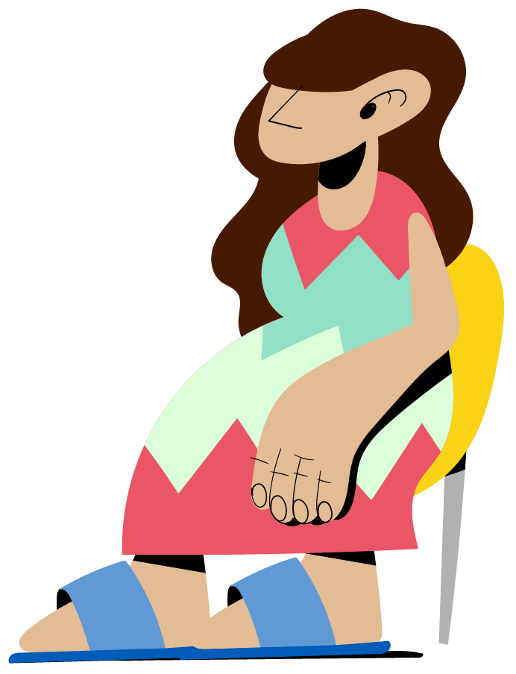
Do’s and don’ts practice
We will read a series of statements about your role and responsibilities.
If you DISAGREE with the statement, please stand up.
If you AGREE with the statement, please remain seated.
Notes:
FACILITATOR NOTES
Expected duration: 30 mins
Objective: understand do’s and don’ts in handling GBV disclosures
As an alternative instruction, participants may raise their hands if they have difficulties standing up.
For each statement, encourage participants to explain why they agree or disagree and facilitate a discussion between the two groups.
Exercise derived and adjusted from the the IASC Pocket Guide – How to support survivors of GBV when a GBV actor is not available in your area – Training Package, 2018 (https://gbvguidelines.org/en/pocketguide/) and Norwegian Church Aid PowerPoint.

Slide 73
DISAGREE
AGREE
In order to understand what a survivor needs, it is important to know her history. You ask her about the violence she has experienced in detail.
Notes:
FACILITATOR NOTES
Disagree: NEVER ask a survivor to tell you about her experience of violence or probe for details. Instead, the frontline worker should offer to provide information about GBV case management and other services and allow a survivor to direct the conversation based on if she want to be referred.

Slide 74
DISAGREE
AGREE
If a survivor is upset, you should comfort her by saying: “Don’t cry. Everything will be okay.”
Notes:
FACILITATOR NOTES
Disagree: The role of the frontline worker is to empathize with the survivor’s feelings. Frontline workers should not make promises that cannot be kept. Instead, it is recommended to say: “I am sorry this happened to you. You are very brave for sharing this with me. I will do everything I can to support you.”

Slide 75
DISAGREE
AGREE
A gay man shares his experience of GBV with you. He is not willing to talk to anyone including any GBV service provider. You listen to his story and then explain him what the GBV service providers can offer and the contact of the GBV case management service provider which offers services to male survivors. But you don’t do anything after that.
Notes:
FACILITATOR NOTES
Agree: This is a right approach. It is the survivor’s choice whom he wants to disclose his experience to and when and how he seeks support. It is important to note that not all GBV service providers offer services to male and/or LGBTIQ+ survivors, so it is important to take note of those who do (if available). It is recommended that available contact details of service providers and/or hotline numbers are shared with the survivor, should he change his mind in the future.

Slide 76
DISAGREE
AGREE
A woman discloses intimate partner violence and asks for your help. You offer to speak with her and her husband to resolve the conflict.
Notes:
FACILITATOR NOTES
Disagree: The frontline worker should NEVER mediate and NEVER speak with the husband in case of intimate partner violence. Instead, the frontline worker should validate the woman’s feelings and inform her of available GBV case management and other services. With her consent, the frontline worker should offer to connect her to these services.

Slide 77
DISAGREE
AGREE
You referred a female survivor of intimate partner violence to GBV case management services a week ago. Today she comes to talk to you to say that no one has been helping her and wants to talk to you. You discuss and make suggestions on how to be safe from her husband.
Notes:
FACILITATOR NOTES
Disagree: It is NOT the frontline worker’s role to follow-up in these instances. Instead, the frontline worker, should let the survivor know that they cannot support but will remind the case management service provider. The frontline worker should let the case management service provider know about this interaction, if he/she continue to get the complaint, it is recommended to contact a GBV specialist to flag the situation and ask for advice.

Slide 78
DISAGREE
AGREE
While conducting a household survey, you notice a girl of about 10 years with clear bruises and a broken arm. The girl sits quietly in a corner on her own, silent and not moving the time you are there. You also notice that she is very scared when approached by her uncle who won't let you speak to her. The uncle is the only caregiver of the girl and her three brothers aged between 4-12 years old who are playing and talking with you and the uncle. You immediately refer the girl to the police and contact the child protection focal point in the camp for follow up and services.
Notes:
FACILITATOR NOTES
Agree: The situation of the girl is clearly alarming. Absence of information of whether there has been an incident of GBV or not, should not be the only determining factor. This is a situation of child abuse that involves a number of children and an intervention is life-saving. Considering the possible involvement of the caregiver in the abuse, no informed consent is needed to refer the case. The best interests of the child should be of primary consideration when referring the case, especially her safety and security. It is better to refer the case directly to a child protection/GBV specialist if immediately available, or ask for their advice remotely if they are not available in your location.
In absence of specialized support, referral to health services, even if it is needed immediately, might not be possible, especially if the caregiver is not in agreement. Immediate referral to the police might be the only way to allow children to have access to different services, including health. Special attention should be given to the capacities of local police to intervene immediately and the possible consequences of the referral if it is not taken into consideration immediately. Safeguards need to be put in place and a discussion with a child protection/GBV specialist (without providing the identifiable information) might help the frontline worker move forward quickly.

Slide 79
Do’s in disclosure
DO believe the survivor. Reassure the survivor that this was not her fault.
DO make sure that both the survivor and you are safe from immediate danger.
DO provide practical care and support (e.g. offer water, somewhere to sit, etc.)
DO listen to the person without asking questions.
DO be aware of and set aside your own judgements.
DO respect the right of the survivors to make their own decision. Inform, do not give advice.
DO limit the number of people informed about the case.
Notes:
FACILITATOR NOTES
Read the “do’s” and ”don’ts” (in the next slide) together and make sure that all participants understand them.
Derived and adjusted from the Shelter Cluster GBV Constant Companion, 2019 (https://sheltercluster.s3.eu-central-1.amazonaws.com/public/docs/constant_companion-_english-_v6.pdf).

Slide 80
Don’ts in disclosure
DO NOT force help on the survivor, be intrusive or pushy.
DO NOT pressure the survivor into providing information or further details.
DO NOT doubt or contradict the survivor.
DO NOT investigate the situation or provide advice.
DO NOT mediate between the survivor and the alleged perpetrator or a third person.
DO NOT write down or record details of the incident or personal details of the survivor.
DO NOT take pictures of the survivor or the signs of violence she has experienced.
DO NOT share any person personal/identifying information about a survivor or her experience, including with your supervisor.
DO NOT assume the needs and wishes of the survivor. Some actions may put the survivor at further risk of stigma, retaliation, or harm.
Once a GBV referral has been made, DO NOT ask for extra information or contact the survivor directly.
Notes:
FACILITATOR NOTES
Derived and adjusted from the Shelter Cluster GBV Constant Companion, 2019 (https://sheltercluster.s3.eu-central-1.amazonaws.com/public/docs/constant_companion-_english-_v6.pdf).

Slide 81
Activity Role play
Notes:
FACILITATOR NOTES
Expected duration: 60 mins
Objective: practice survivor-centred communication and how to handle GBV disclosures
It is recommended to adjust and/or remove certain scenarios based on the context. NB: scenario 1 is sensitive in case camp managers/government authorities attend the training and may need to be adjusted accordingly.
Divide the participants in pairs and provide them with a hand-out of one of the scenarios (see Activity Sheet and below).
Give the pairs 15 minutes to discuss and prepare a 5 minutes roleplay. One person will play the frontline worker and the other the GBV survivor/the person reporting a GBV incident.
Encourage the frontline worker to use the local referral pathway handout during the roleplay, when providing information about available services to the survivor.
After 10 minutes, invite pairs to practice their role play in their pair for 5 minutes.
Ask for volunteer pairs to present their role play in plenary, one pair for each case study.
After each role play, allow the volunteers as well as other participants to provide their feedback, before highlighting the key considerations below. What did the volunteers find challenging? Do the participants have any tips for the volunteers?
In terms of survivor-centred communication skills: correct participants based on the do’s and don’ts. Provide tips based on the survivor-centred communication skills below, as required.
In terms of how to handle disclosures, each scenario has some specific key considerations (see below). Generally, make sure that the participants take into account:
Frontline workers should not probe for information or ask questions about the incident
Do no harm
Confidentiality
Safety
Respect for the wishes of the survivor
Special considerations for child survivors of GBV
Informed consent/assent for children
Mandatory reporting
At the end, reiterate to participants that they do not need to be experts in order to engage supportively and respectfully with survivors.
Scenarios
Scenario 1
NB: this scenario is sensitive in case camp managers/government authorities attend the training and may need to be adjusted accordingly.
The frontline worker is on a shelter activity monitoring visit, taking part in regular focus group discussions (FGDs) in a community centre with beneficiaries of the shelter programme. After finishing a FGD with a group of older women, a woman who appears to be about 75 years of age and has visual impairments, stops you and insists on speaking to you in the next room. You walk with her to the next doorway and she tells you she is having trouble walking because someone sexually assaulted her. The frontline worker remembers the instruction of the manager of the camp where the shelter programme is active, who requested all organizations working in the camp to report incidents of sexual violence to him.
Key considerations scenario 1
The frontline worker should make sure that discussing such sensitive information takes places in a private and safe environment (rather than a doorway).
The frontline worker should consider medical needs as a priority and provide information about available health services and how to access them, taking into consideration the woman’s limited mobility and visual impairment – in addition to a referral to GBV case management services, if the woman provides informed consent. The survivor may need someone to accompany her to medical and other services. In this case the frontline worker should always consider the safety risks. In some settings, frontline workers are known in the community, so walking a survivor to a medical facility or a police station automatically raises curiosity and may inadvertently put the survivor at risk – although in this scenario possibly less likely given the visual impairment and age of the woman. If the frontline worker will not accompany the woman, is there someone else she trusts who can?
As the frontline worker should avoid asking questions about the nature of the incident and there may be shame/unclarity about the incident, it is recommended to share in any case information about the timeframe of 72 hours in which transmission of STIs including HIV can be prevented (as the woman is around 75-years old, there is no risk of pregnancy).
It is important to ensure confidentiality, unless the woman would like the incident to be reported to the camp manager for some reason (always based on informed consent). The instruction of the camp manager does not constitute a legal mandatory reporting requirement. In this scenario, it is also recommended that the frontline worker informs a GBV specialist about the concerns regarding the instruction of the camp manager (without disclosing details of the case), if not already aware, so that the GBV specialist can engage in advocacy with the camp manager.
Scenario 2
As part of health promotion activities, the frontline worker regularly visits a small community that has been displaced to a remote location, including the family of Nadia. The frontline worker has been noticing that Nadia regularly has serious bruises and swollen eyes and the frontline worker provides basic first aid. After several visits, Nadia starts to trust the frontline worker and hints that the injuries are caused by her husband. The frontline worker is concerned about her safety and informs Nadia about the services of a local NGO, which runs a safe shelter in a confidential location in town. Despite the concerns of the frontline worker, with each new injury, Nadia says that her husband is going through a particularly difficult period and that she believes her husband is going to stop.
Key considerations scenario 2
Remind participations that we should abide by the survivor-centred approach, which includes maintaining confidentiality and respect for the survivor’s choices. In case we disregard Nadia’s wishes and breaches her trust, Nadia may not seek medical support again. Meanwhile, the frontline worker can provide Nadia with the contact details of a GBV case management services provider and/or available hotline numbers.
In case the injuries are considered life threatening or there are other serious reasons to believe that Nadia’s life is at risk, the frontline worker should immediately consult a GBV specialist without sharing identifiable information about the case.
In this scenario, it is also recommended that the frontline worker offers to Nadia to bring a GBV specialist along on the next visit who could speak with Nadia about her situation. The frontline worker should only proceed with making this request to the GBV specialist if Nadia provides informed consent (or in case of a life-threatening situation, see above).
Scenario 3
The frontline worker is identifying and registering beneficiaries for a new livelihoods programme. A man tells you that his neighbour is in need of support. Her husband died last year and she struggles to find enough resources to feed her five children. He says that everybody in the neighbourhood knows that she sleeps with a worker of the NGO which provides food assistance, so that she can receive extra food rations. NB: one person plays the role of the frontline worker, whilst the other person plays the role of the man.
Key considerations scenario 3
This is a case of possible sexual exploitation and abuse (SEA) by an aid worker, which is considered as GBV.
The frontline worker should prioritize referrals to GBV services by providing the man with information about available services/hotline numbers and encourage him to share this information safely and confidentially with his neighbour.
Even whilst an indirect disclosure and only an allegation of SEA, the frontline worker has the duty to report the incident to the respective investigative body (e.g. IGO for UNHCR) or to the PSEA focal point working with the organization employing the alleged perpetrators. In this regard, the frontline worker should respect the wishes of survivors who may not want their identifiable information to be shared. As this is an indirect disclosure it is not possible to know if the survivor provides consent for this, therefore the information that could reveal the identity of the neighbour should not be disclosed when reporting the incident.
The frontline worker should not investigate or ask further questions about the SEA and/or perpetrator.
With regards to enrolment of the woman as a beneficiary for the livelihoods programme, this can be further discussed with the PSEA focal point.
Scenario 4
The frontline worker is visiting a woman enrolled in a vocational training programme. Her family has been displaced and lives with a host family. She tells the frontline worker that the husband of the host family has sexually abused her 12-year old daughter and she doesn’t know what to do.
Key considerations scenario 4
The case is clearly an emergency and all actions should be taken to ensure child and mother are safe.
Explain to the mother that her daughter’s case requires a specialized intervention and ask her if she agrees to speak with a child protection/GBV specialist.
The frontline worker should explain that the child protection/GBV specialist will likely ensure she and her daughter are safe before any action is taken against the perpetrator, particularly options of moving the mother and child from the host family, but note that serious precautions must be taken in order to not inadvertently put the family at risk of retribution from the perpetrator.
The mother should also be informed of the mandatory reporting requirements in place and possible implications of referring the child.
Ask participants to recall possible mandatory reporting requirements related to child abuse, in their context and make sure that all participants are aware of these.
Some scenarios derived and adjusted from the UNHCR Facilitator Guide on GBV Risk Mitigation, 2020 (https://unhcr365.sharepoint.com/sites/GSCB-GBVLearning/SitePages/Facilitator-Guide-on-GBV-Risk-Mitigation.aspx), the 2022 Minimum Standards @UNHCR Course and the IASC Pocket Guide Training Package.
Survivor-centred communication skills
Body language
Sit facing the survivor.
Do not put anything between the survivor and us. No desks, no objects. The space between you and the survivor is open.
Lean in towards the survivor. This helps the survivor know we are interested in what she is saying and that we want to stay and listen.
Maintain eye contact with the survivor at all times (unless this is considered to be culturally inappropriate).
Stay in a relaxed sitting position. It does not mean that you should slouch in your chairs and look sloppy, but you do not want to sit very stiff and rigid. You want to be comfortable so that the survivor can feel comfortable and relaxed too.
Verbal Messages
Follow the survivor’s pace, using the same language as the survivor.
Simple explanations are key to ensure the survivor feels safe and comfortable sharing her experience.
It is also good to learn to remain silent and give the survivor time to think and process her emotions, though this can be very difficult for some of us.
Active Listening Skills
Use open-ended questions to really understand how the survivor is thinking and feeling and don’t prompt for further details or investigate further.
Paraphrase and summarize (“Let me see if I understand what you have told me so far”).
Reflect content and/or feeling (“It sounds like you were very scared in the moment when he yelled and raised his fist”).
Reflect how the survivor is feeling and thinking so she can see it like in a mirror.
Help the survivor to see the situation and options more clearly.
Help the survivor to focus.
Content derived and adjusted from the IASC Pocket Guide – How to support survivors of GBV when a GBV actor is not available in your area – User Guide, 2018 (https://gbvguidelines.org/en/pocketguide/).

Slide 82
^{CLOSING SESSION}
Wrap-up
Notes:
FACILITATOR NOTES
Expected duration: 10 mins

Slide 83
Key takeaways
Frontline workers should be fully familiar with the GBV referral pathway and the services available in their area, including for child, male and LGBTIQ+ survivors.
The role as frontline workers is to offer a listening ear, provide information on available services, and refer to case management services when the survivor provides informed consent.
The role of frontline workers is NOT to conduct an interview, understand what happened and the details, tell survivors what to do, or give their own opinion.
In all engagement with GBV survivors, the survivor-centred approach should be prioritized, taking safety and confidentiality into consideration when making referrals.
Key considerations for handling a disclosure involving a child survivor include the best interests of the child principle, procedures related to the mandatory reporting of child abuse, and parents’/caregivers’ involvement in obtaining consent/assent.
Frontline workers should NEVER proactively identify or seek out GBV survivors.

Slide 84
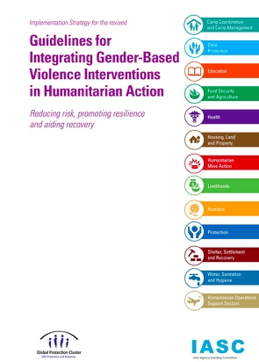
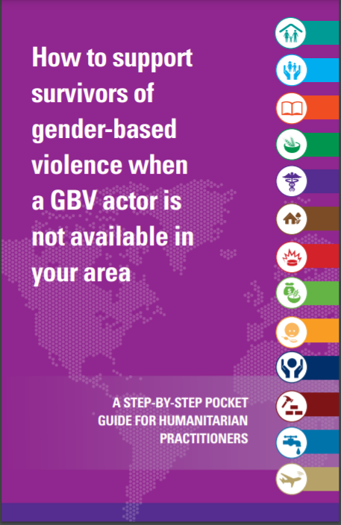
Key resources
UNHCR GBV Learning Hub
Notes:
IASC, Pocket Guide – How to support survivors of GBV when a GBV actor is not available in your area, 2018 (https://gbvguidelines.org/en/pocketguide/) and its mobile App version (https://play.google.com/store/apps/details?id=com.gbvpocketguide&hl=en)
IASC Guidelines for Integrating Gender-Based Violence Interventions in Humanitarian Action, 2015 (https://gbvguidelines.org). NB: on the GBV Guidelines website there is a Community of Practice for non-GBV specialists to exchange on GBV Risk Mitigation.
UNHCR GBV Learning Hub (https://unhcr365.sharepoint.com/sites/GSCB-GBVLearning) – internal to UNHCR workforce only.

Slide 85
Thank you!

Slide 86
FACILITATOR FEEDBACK
Please help us to improve this facilitation material by filling in this online feedback form!
The brief feedback form collects feedback from facilitators using a UNHCR GBV facilitation package or from colleagues using the materials for self-study, with the aim to help GLDC and DIP improve the content and quality of the materials.
It is recommended that facilitators complete the form after conducting the workshop locally.
The feedback form is anonymous and will take around 7 minutes to complete.
THANK YOU!

