Slide 1
READ ME FIRST
The Facilitation Package is meant to be used as facilitation material for in-person workshops targeting UNHCR and partners’ GBV specialists or Protection workforce with GBV responsibilities, promoting discussion, critical thinking, and exchange between participants. It can also be used as self-study material. Prior to undertaking this learning, it is required to possess a solid understanding of GBV basic concepts and principles. Prior to undertaking a workshop based on this Package, learners are expected to complete UNHCR GBV eLearning Level 1 and 2.
Facilitators should be experienced GBV specialists.
It is recommended that facilitators adapt the content of the Package to their context and audience before delivering the sessions. Please note that:
The examples and exercises can be adjusted and contextualized.
Not all content in the Package is relevant for UNHCR partners and can be removed or hidden.
The Package can be adjusted for online delivery.
The Package can be facilitated in separate segments, or in a consecutive workshop. Module 1 takes approximately 10,5 hours to deliver, including 275 minutes of interactive discussions and exercises.
The timeframes indicated in the slides are estimates and may vary according to the facilitation modality (in-person/online), the number of participants as well as how facilitators may adapt the Package based on local context and audience.

Slide 2
READ ME FIRST
Please note that the slides include extensive notes with information and tips for facilitators, including if-asked information, timings and references to key resources. It is important to review the slide notes in full before facilitating this Package. The notes should appear in the dock below the image of the slide when View is set to Normal. If they do not appear, hold the cursor on the thin gray bar at the bottom of the window and drag the bar upwards and the notes section will appear. To view the slides with the notes in large text below them, move the cursor to the top of the window and click View, then Notes Page. To print the slide notes with images of the slides (handy for facilitating for the first time, especially for lengthy teaching segments), click Print, then under Print Layout, choose Notes Pages.
Most slides have animations which implies that certain text, elements or images, appear one at a time by clicking through. These animations are meant to aid facilitators in revealing content on the slide in stages and in a certain order. It is recommended that facilitators becomes familiar with the animated slides ahead of the workshop.
The notes of the presentation refer to the Activity Sheets, which are annexed to this Package. The Activity Sheets correspond to the different exercises in this Package (discussion questions, activities and group work) and contain the same information as the relevant activity slides with facilitator notes. The Activity Sheets are meant to be utilized as stand-alone exercises in case not the entire Package is used, but could also assist facilitators in guiding some of the more complex exercises.
Notes:
NB: Slide adjusted from the UNHCR/IOM, Training package: SOGIESC and working with LGBTIQ+ persons in forced displacement, 2021, available from (https://www.unhcr.org/workingwithlgbtiq-sogiesc-trainingpackage.html)

Slide 3
Graphic Design - REC Design
GBV Prevention Facilitation Package
MODULE 1 – PRIMARY PREVENTION OF GBV
© UNHCR March 2023
Notes:
When using the images/illustrations for other purposes than in the context of the Facilitation Package, please make sure to accredit the graphic designer REC Design.

Slide 4
Learning objectives
Understand UNHCR’s commitment to GBV prevention, anchored in the GBV Policy.
Explain the root causes of GBV and the difference with factors that contribute to its occurrence.
Link the root causes of GBV, to GBV prevention.
Describe programme approaches and principles underlying effective prevention work.
Know what are the key elements and tools to design, plan and monitor GBV primary prevention programming at UNHCR.
Notes:
FACILITATOR NOTES
Refer also to the subsequent and more in-depth module 2 of this Facilitation Package, looking into promising practices of GBV primary prevention, the empowerment and participation of women and girls, and the engagement of men and boys in GBV prevention.
Highlight that the Package does not provide in-depth information on how to implement different primary prevention programme models, for which further specialized training is recommended.
Explain that while the Package focuses on primary prevention, this is also referred to in the text as prevention for simplicity. Please also note that work on primary prevention contributes to wider prevention efforts and this will be explained more in depth throughout the sessions.

Slide 5
Agenda
Welcome and opening | 30 mins
Session 1: Introduction – GBV prevention | 40 mins
Session 2: Root causes of GBV | 120 mins
Session 3: GBV prevention principles and the socio-ecological model | 110 mins
Session 4: Designing and planning a GBV prevention intervention at UNHCR | 180 mins
Session 5: Measuring outcomes and impact of prevention work | 120 mins
Wrap-up | 30 mins
Notes:
FACILITATOR NOTES
Facilitators should adjust the agenda tailored to the delivery method chosen and depending on the adaptations made based on local context and audience.

Slide 6
Introductions
Name
Organization & Position
GBV Prevention Challenge
Notes:
FACILITATOR NOTES
Expected duration: 20 mins
Facilitators introduce themselves and ask participants to write their name and role on a name tag.
Invite participants to introduce themselves by sharing their name, organization and position.
Encourage participants to also share one challenge they have experienced, or that they envisage occurring, related to GBV prevention in their work or in their community. Note these challenges on a flipchart (in key words) and inform participants that the different sessions will refer back to these challenges. Reinforce correct understandings of GBV prevention throughout.

Slide 7
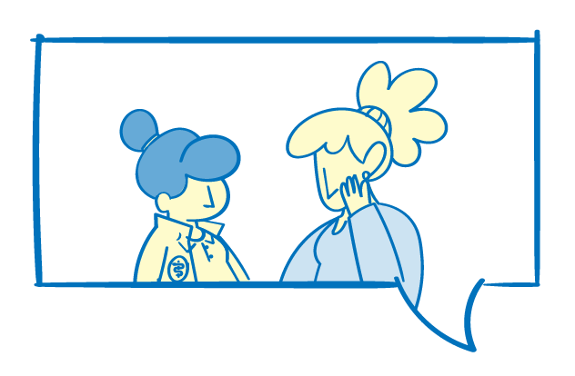
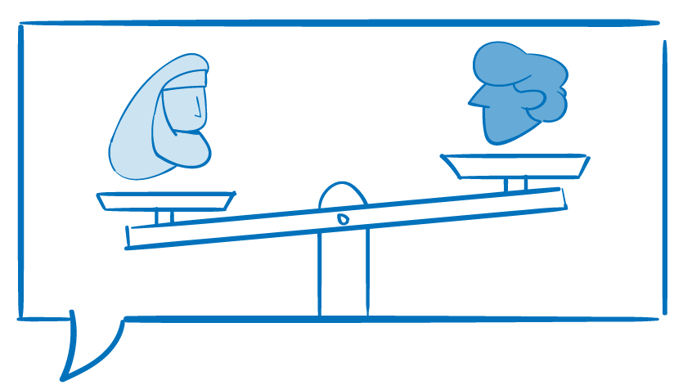
^{MODULE 1 | SESSION 1}
Introduction – GBV prevention
Notes:
FACILITATOR NOTES
Expected duration for session 1: 40 mins
Learning objectives:
Introduce the concept of GBV prevention.
Define primary, secondary and tertiary prevention.
Recall the UNHCR GBV Policy and its commitments on GBV prevention.
Explain why it is important to consider GBV prevention activities at the onset of an emergency.

Slide 8
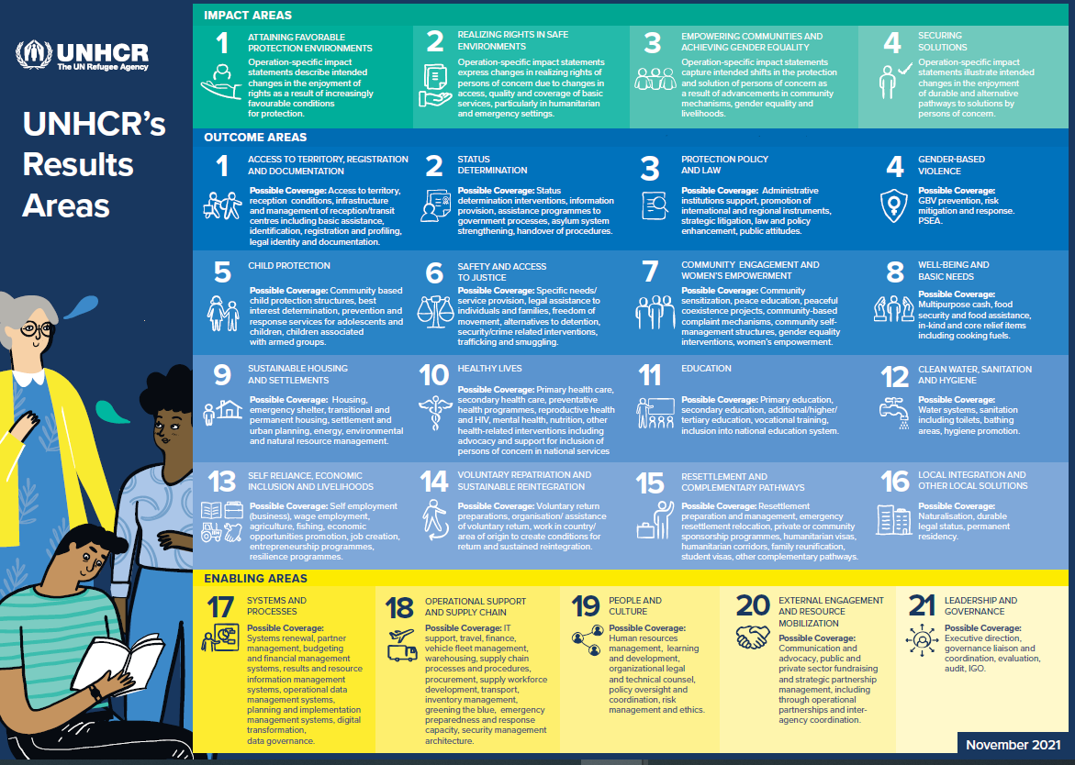
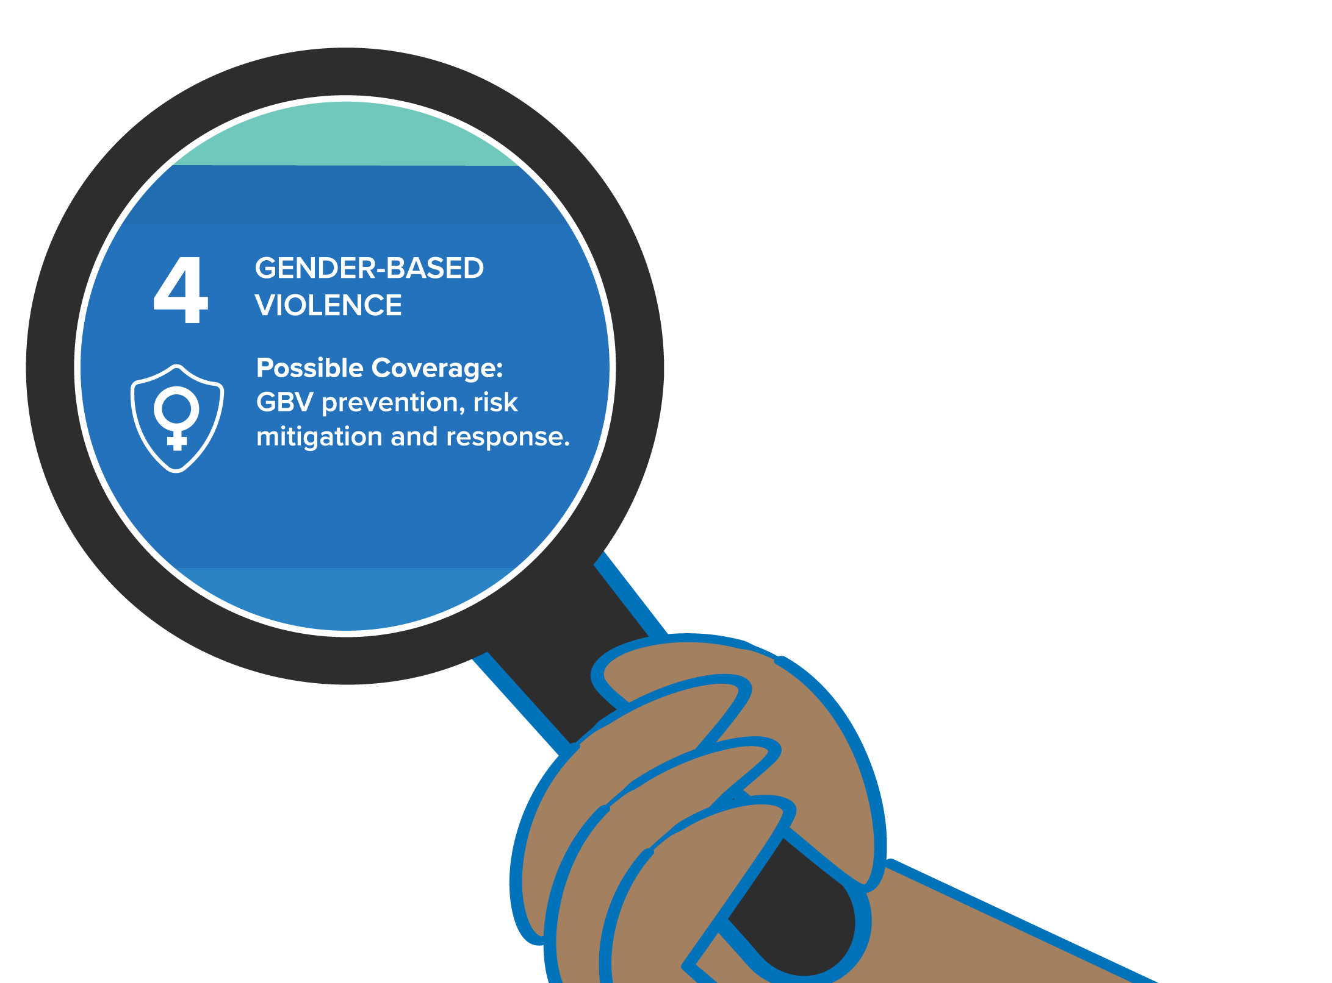
GBV within the UNHCR’s Global Results Framework
GBV within the UNHCR’s Global Results Framework
Notes:
FACILITATOR NOTES
GBV prevention, risk mitigation and response, are one of the eight UNHCR’s strategic priorities (UNHCR Strategic Directions 2022-2026, https://data.unhcr.org/en/documents/details/91745) and have been included as one of the 16 outcome areas within UNHCR's Global Results Framework.
The Global Results Framework is part of COMPASS - UNHCR’s overarching programming framework aimed at enhancing the organization’s capacity to manage results and create positive changes in the lives of displaced and stateless people, which was introduced in 2021. COMPASS approach includes a multi-year strategic planning cycle (3-5 years), the global results framework, and a software tool for planning, budgeting, monitoring and reporting on results.
Later in this module, we will look at designing and planning GBV prevention programming in the context of UNHCR’s multi-year planning cycle and Global Results Framework.

Slide 9
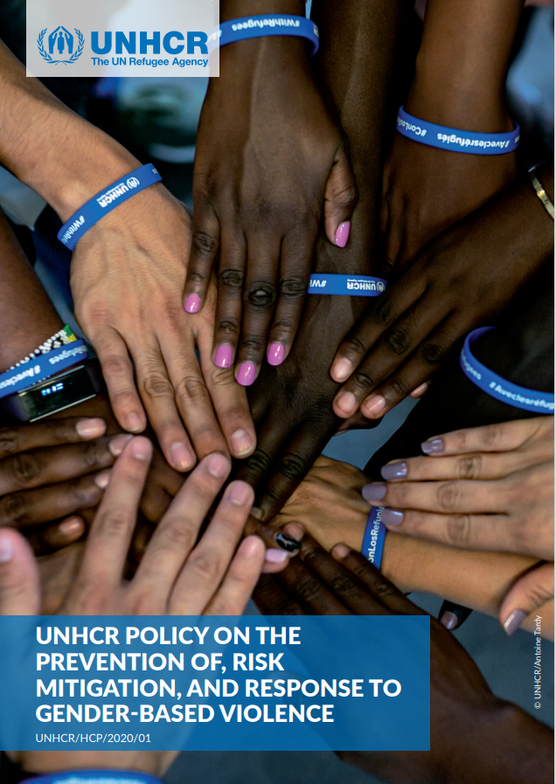
UNHCR`S GBV Policy
Policy outcome GBV is prevented by addressing gender inequality, discrimination and unequal power relations.
Policy core action Operations will advocate, plan and implement prevention programming that promotes gender equality and that aims to address the root causes of GBV in order to effectively change behaviour and social norms, including through long-term approaches, that are accountable to women and girls.
Notes:
FACILITATOR NOTES
Introduce the module with a reference to the policy outcome and core action from the UNHCR Policy on the Prevention of, Risk Mitigation, and Response to Gender-based Violence, 2020 (hereafter referred to as the GBV Policy) related to GBV prevention.
The GBV Policy reflects the long-standing work of UNHCR and partners on addressing GBV. Compliance with the GBV Policy is mandatory for all operations.
The Policy has two mutually reinforcing objectives:
The first is with reference to reducing the risk of GBV for all persons we serve and this refers to prevention and risk mitigation interventions
The second is with reference to safe access to quality GBV services that are in line with GBV guiding principles and other standards set forth in key guidelines. This means that survivors should have access to specialized services according to their needs.
The GBV Policy should be seen as three parts:
The GBV Policy itself, which was signed by the High Commissioner.
The Monitoring and Compliance (Section 11) of the GBV Policy refers to a mandatory monitoring framework. The mandatory monitoring framework is provisional, and it is being finalized. It will be launched together with a supporting tool to easily capture data in a KoBo tool. The monitoring framework does not include indicators, it includes a series of milestones to be achieved overtime, which will help operations track progress in alignment with the GBV Policy. Policy milestones related to prevention programming will be reviewed in the last session of this module.
A set of operational guidances, one per core action, to explain the milestones in the monitoring framework and how to comply and strive toward achieving the GBV Policy core actions. These include practical steps and are based on key guidance documents (e.g. the IASC GBV Guidelines, the Inter-Agency Case Management Guidelines, the Inter-Agency Minimum Standards) and core standards related to the different technical areas. The operational guidance are currently being developed and will be released in 2023.
Different elements of the policy outcome and core action on GBV prevention (on the slide) will be unpacked over the course of the different sessions of Module 1 of this Package.

Slide 10
GBV prevention approaches
Notes:
FACILITATOR NOTES
https://www.youtube.com/watch?v=IYmBOTi1d9U&list=PLk83Ra7kAz5HQymFMdS79dryet14pn8YS&index=5
Duration: 4.49 mins

Slide 11
GBV prevention approaches
Secondary prevention
Tertiary prevention
Risk mitigation
Primary prevention
Addressing the consequences of various forms of violence (response)
Focusing on the long-term impact of violence when untreated
Addressing contributing factors that increase exposure to GBV
Preventing GBV before it occurs, tackling its root causes
Notes:
FACILITATOR NOTES
Explain that prevention activities fall into four categories. GBV prevention programming covers a spectrum ranging from immediate risk mitigation in the acute emergency to longer-term social norms and systemic change.
Inform participants that the Package focuses on primary prevention, in line with UNHCR's GBV Policy. This is referred to throughout the Package as prevention for simplicity.
Some examples for each category of intervention:
Risk mitigation: providing adequate lights in camps; appropriate space for living conditions; sex-segregated and lockable bathrooms; fuel-efficient stoves; firewood patrols; building schools and play areas in safe locations; monitoring school premises; involving women in the distribution of shelter materials; providing lighting in communal areas; engaging the community in organizing security patrols or community watch groups; ensure police/military/peacekeepers are present in camps/settlements and trained on GBV; advocating to ensure female police officers are recruited.
Primary prevention: life-skills for adolescent boys and girls addressing communication, conflict-resolution, rights, reproductive health etc.; community mobilization interventions (e.g. through social media; educational entertainment, including mobile phone applications, street theatre, radio and television; and large scale campaigns); more specialized activities such as gender dialogues, transformative gender work or masculinity work to challenge negative gender norms and replace them with more balanced gender norms (e.g. through workshops with men and women, or group training for couples on shared decision making and non-violent behaviour); empowerment activities for women and girls and/or LGBTIQI+ persons; introducing gender-transformative school curricula.
Secondary prevention: health care for GBV survivors; PSS including case management.
Tertiary prevention: community reintegration and acceptance; addressing trauma and the long-term medical and psychosocial needs a survivor may have; raising awareness in the community so that community members fully understand their rights, the remedies available to GBV survivors, how to access justice and the legal mechanisms in place; training personnel in formal and informal legal systems about the rights of GBV survivors; advocating for laws and legal systems to conform to international human rights standards.
Note that while the focus of this Package is on primary prevention, the work on transforming social gender and norms contributes to broader prevention outcomes.
For more information refer to Inter-Agency Minimum Standard 13 (https://gbvaor.net/gbviems).
For more information on GBV Risk Mitigation refer to the 2015 IASC Guidelines for Integrating Gender-Based Violence Interventions in Humanitarian Action (https://gbvguidelines.org/en/) and for an additional learning tool on GBV risk mitigation refer to the UNHCR Facilitator Guide on Mainstreaming Risk Mitigation (https://unhcr365.sharepoint.com/sites/GSCB-GBVLearning/SitePages/Facilitator-Guide-on-GBV-Risk-Mitigation.aspx).

Slide 12
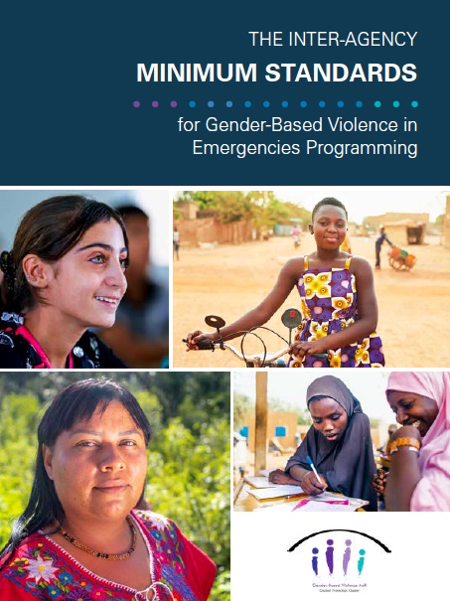
“Transforming norms and systems that perpetuate gender inequality can have a tangible impact on women’s and girls’ health, safety and security”
Inter-Agency Minimum Standard 13
Notes:
FACILITATOR NOTES
Introduce the Inter-Agency Minimum Standards for GBV in Emergencies Programming, 2019 (hereafter referred to as the Inter-Agency Minimum Standards) as a key resource document for GBV programming, highlighting Minimum Standard 13 on Transforming Systems and Social Norms, dedicated to GBV prevention.
The Minimum Standard 13 presents the various elements required to effectively address root causes of GBV and contains the following elements: introductory text, Key Actions, Indicators, Guidance Notes (on GBV prevention, accountability to women and girls, social and behavioral change communication), and Tools and Resources.
Highlight that Minimum Standard 2 (on Women’s and Girls’ Empowerment and Participation) also provides useful guidance that is relevant to GBV prevention approaches and principles (e.g. the guidance on ensuring participation of all women and girls, overcoming constraints in their participation, engaging men and boys to support women’s and girls’ participation and the monitoring of women’s and girl’s empowerment).
The Inter-Agency Minimum Standards are referenced as a key guidance document throughout this module. (https://gbvaor.net/gbviems)

Slide 13
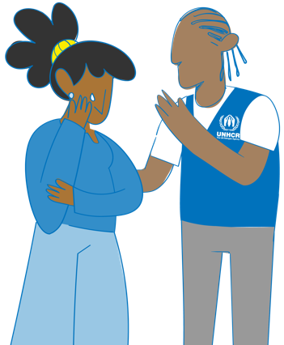
Discussion GBV prevention in emergencies
In an acute emergency situation, response to GBV survivors should be prioritized over prevention work.
What do you think?
Do you agree?
Why or why not?
Can you give an example of a prevention activity that can be implemented at the onset of an emergency?
Notes:
FACILITATOR NOTES
Expected duration: 10 mins
Objective: reflect on the importance of GBV prevention in emergencies
Invite participants to share their ideas in plenary. See the next slide for key considerations to orient the discussion.

Slide 14
Relatively simple prevention actions can be life saving and need to be implemented immediately from the onset of an emergency.
“All GBV prevention
Programming should only be initiated once essential
services are in place to respond to incidents”
UNHCR GBV Policy
Notes:
FACILITATOR NOTES
GBV prevention often receives less attention during acute emergencies, as it is seen as less urgent than providing support to survivors. Prevention activities may be perceived as longer-term measures to be considered at a later phase of displacement. However, prevention actions can be life-saving, given that they can stop violence from occurring, or reduce the frequency and severity of violence if it has already happened. For this reason, GBV prevention interventions need to be implemented immediately, from the onset of an emergency.
Although crises can exacerbate pre-existing gender inequalities and increase the risk of GBV, they also provide opportunities for social change. There may be shifts in conventional roles, attitudes, beliefs and practices, or new opportunities to discuss subjects that were previously proscribed. Space may open to build positive social and cultural norms that challenge GBV and a culture of impunity for perpetrators.
Given the increasingly protracted nature of humanitarian crises, promoting positive gender and social norms from the start of the emergency response provides a basis for continued efforts throughout the crisis and sets a foundation for longer-term interventions, acknowledging that changes to attitudes, beliefs and practices may take time.
Ensure essential services for health and psychosocial support, at minimum, are functional before beginning more transformative social norms and systems change activities. This is also one of the provisions of the UNHRC GBV Policy which states that response services must be in place when starting programming that aims to transform the systems and social norms that perpetuate gender inequality and discrimination.
Examples of prevention activities at the onset of an emergency: promote women’s and girls’ participation and create opportunities for increased decision-making from the onset of the emergency. Participation is a key aspect of empowerment. Empowerment is a process that means that women can take control over their lives, including by making decisions, setting their own agendas, gaining skills (and/or having their skills and knowledge recognized), solving problems and developing self-reliance. Let participants know that over the course of the session we will have the chance to explore more activities related to participation. (Inter-Agency Minimum Standard for Gender-based Violence 13).
Emphasize that GBV is underreported for many reasons (including fear of stigma or retaliation, limited availability or accessibility of trusted service providers, impunity for perpetrators, and lack of awareness of the benefits of seeking care). Recorded cases represent only a small fraction of the overall incident total, and it should always be assumed that GBV is occurring. Obtaining prevalence data is not a priority at the onset of an emergency and prevention and response measures are to be put in place without any need for proof or evidence.

Slide 15
Key messages: Introduction– GBV prevention
GBV prevention, risk mitigation and response are one of the eight UNHCR’s strategic priorities, and prevention of GBV is a core action of the UNHCR GBV Policy.
GBV prevention is a specialized intervention that is life-saving, and needs to be implemented from the onset of an emergency.
Promoting positive gender and social norms from the onset of the emergency, sets a foundation for longer-term interventions, acknowledging that changing knowledge, attitudes, skills and behaviours may take time.
GBV prevention programming should only be initiated once essential services are in place to respond to GBV incidents.

Slide 16
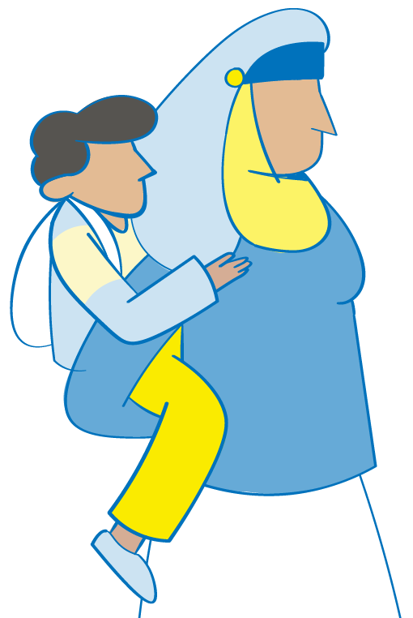
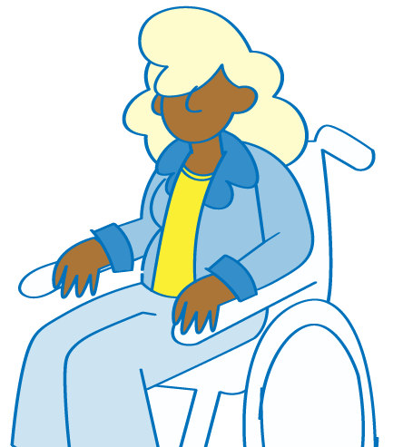
^{MODULE 1 | SESSION 2}
Root causes of GBV
Notes:
FACILITATOR NOTES
Expected duration for session 2: 120 mins
Learning objectives:
Explain that GBV prevention refers to actions that prevent GBV from occurring, by addressing its root causes, which are gender inequality, systemic discrimination and unequal power relations.
Apply intersectionality when analyzing gender inequality, systemic discrimination and unequal power relations.

Slide 17
Activity Root causes of GBV
Notes:
FACILITATOR NOTES
Expected duration: 25 mins
Objective: deepen participants’ understanding of root causes of GBV and distinguish causes from factors that contribute to GBV
Divide participants into groups.
Draw a GBV tree on a flipchart.
Ask them to write what they think the causes of GBV are on individual post-its.
Invite them to affix the post-its on the root of the GBV tree, telling the rest of the group their thoughts as they go.
Ask the whole group to come and rearrange the post-its so that the most important/deepest causes are the deepest roots.
Once the group has finished, power and/or status inequality should be placed as the deepest root, with religion, culture, traditions and norms at the next level up (these are how we learn, understand and enact differences in power and status).
If there are suggestions like displacement, conflict, poverty, illiteracy, alcohol, drugs and anger - talk through these as a group, using the following discussion questions, to distinguish between causes and contributing factors – placing them as rain around the tree (they help it to ‘grow’):
If X (poverty, illiteracy, conflict) did no exist, would we still have GBV?
Did GBV occur prior to displacement?
Is there still GBV in contexts or families without poverty or illiteracy?
Does everyone who gets angry still perpetrate GBV?
Does a man who gets angry or loses control of himself beat up or rape his boss? His friends?
Drugs, alcohol, unemployment and anger are most often used as excuses and justifications, allowing perpetrators to get away with violence. However, GBV is an intentional choice - perpetrators who abuse their wives do not behave in this way with other people they respect, which shows that it is a choice - they also most often do so in secret, which shows that they realize it is wrong.
Remind participants that displacement is NOT a cause of GBV, but rather a contributing factor.
GBV can be the impetus that compels people to flee; it also occurs during flight and refuge. Regardless of the reason for displacement, the risk of GBV is heightened for asylum seekers, refugees, stateless persons, internally displaced persons, and returnees – during and after displacement – especially for women and girls.
Exercise derived from the Inter-Agency GBV Case Management Training Package, 2017 (https://www.gbvims.com/gbv-case-management-guidelines/gbv-case-management-training-materials/).

Slide 18
Address the ROOT CAUSES of GBV:
Systemic discrimination
Gender inequality
Unequal power relations
Notes:
FACILITATOR NOTES
Once everyone’s post-its have been placed at the bottom of the tree, discuss what is displayed: the root causes of GBV are gender inequality, systemic discrimination and unequal power relations. Go through the definitions of each concept as per the below.
Gender inequalities are deeply rooted in a society’s notions of how women and men “should be” and “should behave” in one’s culture. These preconceptions determine what society expects of men and women, their roles, privileges and limitations. Gender inequality between women and men exists in all societies. It is this gender inequality and these often rigid gender norms that are considered the root cause of GBV. Gender norms are influenced by history, tradition, culture and religion, all of which change over time.
Systemic discrimination can overlap with other forms of oppression, discrimination and marginalization to further harm and disempower women, girls and others at risk who are affected differently based on their intersecting identities (i.e. race, ethnicity, social class, age, sexual orientation and gender identity, disability, etc.). This form of discrimination is found within institutions, organizational processes and society and results in unequal access to services, assistance and opportunities. In the absence of gender sensitive intersectional responses, different forms of systemic discrimination already faced by women and girls will be exacerbated.
Unequal power relations between men and women: GBV is an abuse of power. The United Nations Declaration on the Elimination of Violence against Women (DEVAW, 1993) emphasizes that such violence is “a manifestation of historically unequal power relations between men and women, which have led to the domination over and discrimination against women by men and to the prevention of the full advancement of women.”

Slide 19
Prevention
Notes:
FACILITATOR NOTES
GBV primary prevention work addresses these root causes discussed in the previous slide.
Explain that in order to take actions to prevent GBV we need to understand the root causes of GBV and take action to revert those. We need to understand why GBV occurs at a specific time and place. This can be a complex question. In this module we will further reflect on the general underlying causes of GBV: gender inequality, systemic discrimination and unequal power relations, and consider how to use Gender and Power Analysis to delve deeper into the causes and understand how they manifest in a specific setting.

Slide 20
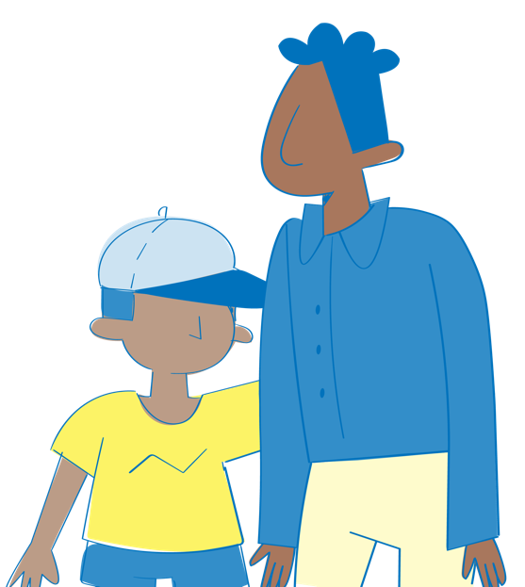
Discussion Agree or disagree?
Gender inequality, systemic discrimination and unequal power relations are the root causes of GBV against men and boys.
Agree
Not Sure
Disagree?
Notes:
FACILITATOR NOTES
Expected duration: 10 mins
Objective: understand how/when violence against men and boys can be considered a form of GBV
Put three signs on the wall around the room: “Agree”, “Disagree” and “Not sure”.
Ask participants to move to the sign reflecting their opinion about the statement on the slide. They can stand in between the different signs as well, along an imaginary gliding scale.
Ask participants to explain their opinion and allow discussion to take place.
Key point: Violence against men and boys that is rooted in gender discrimination is considered GBV.
GBV is understood as predominantly men’s violence against women and girls, however it also includes some forms of violence against men and boys (as described below). At the heart of this interpretation is the understanding that violence is used with the view of reinforcing dominant forms of masculinity linked to power in order to maintain in place a gendered order/hierarchy. This includes physical, emotional and sexual violence against women and girls, and/or various types of violence targeting persons with diverse sexual orientation, gender identity, gender expression and sex characteristics (SOGIESC) that do not conform to prevailing sociocultural norms, as well as sexual violence against men and boys.
The UNHCR GBV Policy reiterates this position that men and boys can be subjected to sexual violence. They may be exposed to sexual violence committed for the “explicit purpose of reinforcing inequitable gender norms of masculinity and femininity.” In addition, they may also be targeted because of reduced power and status in view of diversity characteristics or other intersecting inequalities. There are “forms of discrimination that lead to increased risk of sexual violence for men and boys,” including but not limited to “socioeconomic status, birth country and legal status, including asylum status.” In addition, risks may be heightened for men and boys in detention, unaccompanied children or for children with disabilities.
Inter-Agency Minimum Standards: Men and boys may be targeted for abuse because of reduced power and status based on age, disability, sexual orientation, gender identity and other intersecting inequalities. Homophobia, bi-phobia, and transphobia increase the risk of violence, including sexual violence. Men and boys with disabilities also face an increased risk of violence, including sexual violence.
Gender norms can also contribute to certain types of sexual violence against males in conflict settings. In these instances, men may be targeted for “emasculation” such that gender inequitable norms related to masculinity and femininity increase their exposure to some forms of sexual violence; this violence against males is based on socially constructed ideas of what it means to be a man and exercise male power.

Slide 21
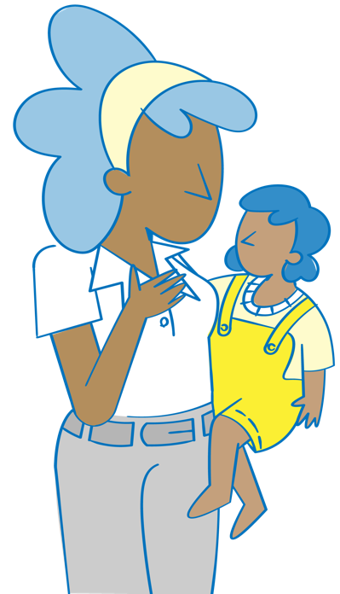
Women and girls are disproportionately affected
GBV prevention programming focuses on women and girls because of structural and systemic gender inequality and discrimination that lead to their documented higher risk of GBV.
Women and girls not only face increased risks but also additional barriers to accessing services and recovering from GBV.
Women and girls who are at increased risk of GBV include:
adolescent girls;
women and girls with disabilities;
women and girls from ethnic or religious minority groups;
women and girls with diverse sexual orientation, gender identity, gender expression and/or sex characteristics (SOGIESC) that do not conform to prevailing sociocultural norms;
older women.
Notes:
FACILITATOR NOTES
As the Inter-Agency Minimum Standards recall, women and girls experience multiple forms of GBV and face many additional barriers to accessing services and recovering from GBV due to systemic gender inequality and other forms of discrimination.
Explain to participants that men have more power in most societies simply by virtue of the unequal status and power afforded to them at birth. These differences are not based on skill or experience, but socialized power inequality, perpetuated by cultures and norms.
Women experience this inequality throughout their lives, and it is the foundation upon which violence develops and is perpetuated. Of course, not all men are the same, and not all women are the same. Even within those groups, there are significant differences of power and privilege – associated with status, age, physical ability, wealth, etc. However, even with those differences you’ll notice that men are in general much further ahead than women.
UNHCR fully recognizes that women and girls are disproportionately affected by GBV and is strongly committed to enhance its programmes to protect women and girls from GBV (i.e. increase funding and quality of specialized programmes for women and girls). UNHCR refers to the IASC definition of GBV (“Gender-based violence is an umbrella term for any harmful act that is perpetrated against a person’s will, and that is based on socially ascribed (gender) differences between males and females”) because GBV is primarily and disproportionally targeted against women and girls. UNHCR also recognizes that individuals with diverse sexual orientation, gender identity, gender expression and/or sex characteristics (SOGIESC) are at increased risk of GBV.
Women and girls who are at increased risk of GBV include adolescent girls, women and girls with disabilities, women and girls from ethnic or religious minority groups, women and girls with diverse SOGIESC, and older women. These groups face increased risks of sexual violence; intimate partner violence; child marriage; denial of opportunities, services and resources; and sexual exploitation and abuse. They are often invisible, face additional barriers to accessing services and joining support networks, and require specific targeted action to benefit equitably from GBV programming.

Slide 22
Persons with diverse SOGIESC
Sexual Orientation
Gender Identity
LGBTIQ+ persons are at increased risk of exposure to GBV.
LGBTIQ+ persons encounter distinct GBV risks because their real or perceived SOGIESC do not conform to prevailing social and gender norms.
Violence against people with diverse SOGIESC is per definition a form of GBV, rooted in gender inequality and discrimination.
Assume that violence against LGBTIQ+ people is taking place in any context where a GBV prevention programme is being planned.
Queer
Heterosexual
Asexual
Pansexual
Lesbian
Bisexual
Gay
Genderqueer
Genderfluid
Woman
Agender
Non-Binary
Man
Trans/Transgender
Gender Expression
Gender Expression
Fluid
Feminine
Gender Non-Conforming
Masculine
Androgynous
Female
Intersex
Male
Notes:
FACILITATOR NOTES
Please note the terminology: the acronym SOGIESC (sexual orientation, gender identity, gender expression and/or sex characteristics) is the most updated to use (see the resource in the slide, referenced below), instead of SOGI as stated in the UNHCR GBV Policy. “Persons with diverse SOGIESC” is often used to describe LGBTIQ+ persons. Remember! everybody has SOGIESC.
Studies from all over the world reveal high rates of GBV based on SOGIESC targeting LGBTIQ+ people. Experiences of GBV often start in childhood and continue throughout life – at home, in school, in communities, in institutions, and in cyberspace. (Source: What Works to Prevent Violence Against Women and Girls, Ending Violence Against LGBTQI+ People, Global evidence and emerging insights into what works, 2022 (https://ww2preventvawg.org/evidence-hub/ending-violence-against-lgbtqi-people-report))
Use the illustration to highlight that LGBTIQ+ persons are not a homogenous group and their risks of experiencing GBV are distinct. Sexual orientation, gender identity, gender expression and sex characteristics are separate components of the SOGIESC acronym, and we cannot make assumptions about individuals based on our knowledge of some of the components. Although LGBTIQ+ people may share some experiences, their needs and GBV risks are also quite distinct, depending on their sexual orientation, gender identity, gender expression and sex characteristics (SOGIESC) and on other age, gender and diversity factors such as their nationality, ethnicity, faith, socioeconomic background, level of education, physical appearance and disability. Evidence suggests that people who experience multiple forms of marginalisation are at increased risk of violence, and that LBQ women, trans people, non-binary people and intersex people face particularly high rates of violence. (Source: What Works to Prevent Violence Against Women and Girls, Ending Violence Against LGBTQI+ People, Global evidence and emerging insights into what works, 2022 (https://ww2preventvawg.org/evidence-hub/ending-violence-against-lgbtqi-people-report))
GBV against LGBTIQ+ people is rooted in inequitable and discriminatory social norms and gender norms which dictate expectations about how women and men should look, behave and interact with each other. These are based on an assumption that only two distinct genders exist – ‘women’ and ‘men’. This gender binary is one of the pillars upholding heteronormativity, which is the organisation of social structures, relationships, and societal institutions based on the assumption that all people are heterosexual. The gender binary and heteronormativity prescribe rigid views on masculinity and femininity, gender roles, and sexual and romantic relationships. Transgression of these norms can trigger GBV as a way to ‘punish’ LGBTQI+ people.
GBV against LGBTIQ+ people is underpinned by different forms of discrimination including homophobia, biphobia, transphobia, and interphobia, which intersects with gender inequality, racism, and other systems of oppression.
Remind participants that “Women and girls at risk” includes women and girls with diverse SOGIESC.
When referring to “(women, girls and) other at risk groups” for the purpose of this module, we refer to:
LGBTIQ+ persons who may not associate themselves with a female gender identity, gender expression and/or sex characteristics, but are at risk of GBV because of their diverse SOGIESC.
Men and boys who are at risk to be subjected to sexual violence, e.g. in conflict settings or in detention.
Men and boys with disabilities.
Unaccompanied boys.
Other groups who may be at risk due to specific contextual factors.
Resources:
UNHCR, Need to Know Guidance: Working with Lesbian, Gay, Bisexual, Transgender, Intersex and Queer Persons in Forced Displacement, 2021 (https://www.refworld.org/docid/4e6073972.html).
Image derived from Slide derived and adjusted from the UNHCR/IOM, Training package: SOGIESC and working with LGBTIQ+ persons in forced displacement, 2021 (https://www.unhcr.org/workingwithlgbtiq-sogiesc-trainingpackage.html).
What Works to Prevent Violence Against Women and Girls, Policy Brief: Ending Violence Against LGBTQI+ People, Global evidence and emerging insights into what works, 2022 (https://ww2preventvawg.org/sites/default/files/2022-09/WhatWorks-PolicyBrief.pdf)
What Works to Prevent Violence Against Women and Girls, Ending Violence Against LGBTQI+ People, Global evidence and emerging insights into what works, 2022 (https://ww2preventvawg.org/evidence-hub/ending-violence-against-lgbtqi-people-report)

Slide 23
Intersectionality
Notes:
FACILITATOR NOTES
https://www.youtube.com/watch?v=IYmBOTi1d9U&list=PLk83Ra7kAz5HQymFMdS79dryet14pn8YS&index=5
Duration: 4.49 mins

Slide 24
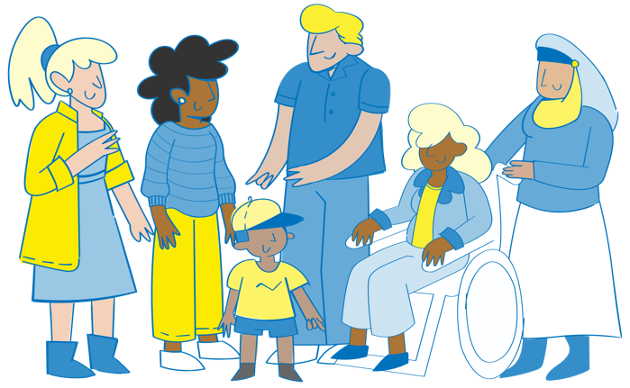
Intersecting forms of discrimination increase the risk of GBV
Nationality
Race
Age
Religion
Economic Status
Disabilities
Ethnicity
Gender Identity
Sexual Orientation
Gender Expressions
Refugee Status
Sex Characteristics
Notes:
FACILITATOR NOTES
Why is intersectionality important in our work?
Intersectionality is an analytical framework for understanding how aspects of a person's social and political identities combine to create different modes of discrimination and privilege. Intersectionality identifies multiple interconnected factors of advantage and disadvantage that influence power, privilege and oppression. The experiences of women differ vastly across the world. Intersectionality helps us understand what barriers individuals face over time, and how gender inequality, systemic discrimination and unequal power relations affect them.
While UNHCR seeks greater gender equality for people of all sexes and/or gender identities, our work focuses primarily on those people that most experience gender discrimination: women and girls and marginalized groups (including particularly individuals with diverse SOGIESC). GBV programming across all the three pillars of risk mitigation, response and prevention must take into consideration the intersection between different interrelated risk factors.
Research has found that women with disability are twice to four times more likely to experience intimate partner violence than other women. (What Works to Prevent Violence Against Women and Girls, Video: Disability and Violence against Women, 2018 (https://vimeo.com/281426654?embedded=true&source=video_title&owner=32168174) and LGBTIQ+ women and girls face a lack of inclusive services, and can be excluded from resources offered to their cisgender and heterosexual counterparts (Changing the picture – full suite of resources | Suite of resources | Our Watch - Our Watch).
Inter-Agency Minimum Standards: in practical terms, applying an intersectional lens means engaging community members and, in particular, diverse women and girls, from the onset of a crisis, to identify, analyse and determine strategies to address intersecting forms of structural oppression.

Slide 25
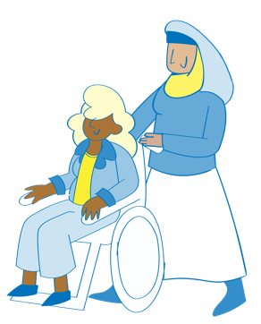
Activity Power walk
Notes:
FACILITATOR NOTES
Expected duration: 25 mins
Objective: enhance participants’ understanding of unequal power relations and differences in access to opportunities, services and resources
Two volunteers are each given a character, 'Alieva' and 'Amina’.
Provide print-outs of the scenarios to the groups (see the Activity Sheet and below).
The rest of the group will read out the different scenarios experienced by each character.
The volunteers take steps forward or steps backwards according to how the scenario promotes opportunities for and strengthens assets of that individual.
An individual may have both positive and negative things happening in each scenario, and so they may take multiple steps forward or backwards accordingly.
There may also be events that affect the other women and girls in the family, and this may have additional impact on the individual.
Refer to these key questions to facilitate discussion on whether each girl should move forward or backward:
What are the good and bad things that are happening in this scenario for the girl?
What personal/social/physical/financial assets are they developing?
What personal/social/physical/financial assets are they missing?
What kind of power exists in the relationships around them? (e.g. power over/power within/ power to/power with)
How does this affect their vulnerability or resilience to challenges?
How does this affect their risk of or protection from GBV?
This exercise is about the unequal power relations and differences in access to opportunities, services and resources. These differences are not based on skill or experience, but socialized power inequality and intersecting factors, perpetuated by cultures and norms. Women experience this inequality throughout their lives, and it is the foundation upon which violence develops and is perpetuated. Of course, not all men are the same, and not all women are the same. Even within those groups, there are significant differences of power and privilege – associated with status, physical ability, wealth, etc.
Scenarios Alieva
Alieva is 15 years old. She was born with her disability – she has difficulty moving, and was slow to develop her speech. The doctors said that Alieva would never go to school, and so she spends most of her time inside the house.
Alieva’s mother helps her with daily care, like washing and going to the toilet. Her father recently left the family, and now Alieva’s mother must find a way to get income for the family. Alieva’s younger sister must stay at home to help her with things when their mother goes out for meetings.
Alieva’s sister and another neighbor have started attending a group a local women’s center with Alieva. The social workers spend time talking to Alieva – when she is ready, they organize transportation so the three girls can travel together to the center. Alieva looks forward to these days being around the other girls, and is hoping to learn more about computers.
One day you meet with the girls to identify the activities they would like to do at the center. Alieva doesn’t speak at this meeting and all the other girls want hairdressing. They all say that Alieva will enjoy this, as they can all do her hair for her – she can be the client, and doesn’t need to stand up to do that.
Scenarios Amina
Amina is 16 years old. She finished her primary education, but has missed a lot of her secondary school because her family members are always asking her to undertake different chores. Her aunt has been encouraging her to do some classes, so she can get a job one day.
Amina has a lot of friends from primary school. They meet sometimes in the shops and talk a lot on the phone. Some of her friends are going to the center to learn accounting, and Amina would like to join them. Her friends give her lots of information that she shares with her parents, and they say it is OK for her to go, as long as she is able to continue her other work.
Amina has learned a lot at the center and now has many more friends. Her brothers sometimes take away her phone to prevent her from talking to these friends. The other girls at the center sometimes have the same thing happen, and they discuss different ways to talk to their families about this.
Amina has passed her accounting course and wants to find work. The teachers at the center give her some different ideas of places to look for work and how the recruitment processes work. Amina talks to her aunty – she also works and has a lot of experience. Amina’s aunty supports her when she discusses this idea with her family.
Activity derived and adjusted from the WRC/IRC Toolkit for GBV Practitioners: Building Capacity for Disability Inclusion in GBV Programming in Humanitarian Settings, 2015 (http://www.womensrefugeecommission.org/wp-content/uploads/2020/04/GBV-Disability-Toolkit-English.pdf)

Slide 26
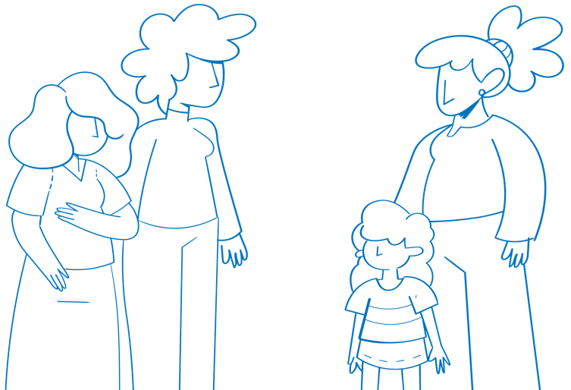
Discussion Gender inequality
What examples do you see in your community of gender inequality?
What intersecting factors play a role in this lack of equality?
Notes:
FACILITATOR NOTES
Expected duration: 10 mins
Objective: identify different forms of intersecting gender inequalities in own community
Brainstorm with participants to think of examples from their own community of gender inequality, a root cause of GBV, and how intersecting factors play a role in the power differentials and discrimination.
Possible examples:
The belief that boys should receive preferential access to education over girls.
The belief that men should have decision-making power over women.
The belief that people with disability are not suited for work or study.
Rigid gender roles that define masculinity in terms of honour, dominance and aggression and ask that men be family protectors and decision-makers.
Rigid ideas which impose that women stay at home, take care of the house and children and are main caregivers also of older persons or persons with disabilities.
National legislation that supports child and forced marriage and does not recognize intimate partner violence.
Beliefs and practices, including laws, that blame the survivor.
Beliefs and practices that limit adolescent girls' mobility
A perceived lack of value for women’s work and their contribution to society.
Discriminatory land, inheritance and property rights.
GBV programming that promotes transformational change is based on understanding GBV to be the result of gender inequality. Gender inequality is compounded by a number of contributing factors. Intersecting factors of oppression, such as age, ethnicity, class, gender identity and sexual orientation, and disability further harm and disempower women and girls. (Inter-Agency Minimum Standards)

Slide 27
Key messages: Root causes of GBV
The root causes of GBV are gender inequality, systemic discrimination and unequal power relations.
Displacement is not the cause of GBV. GBV exists prior to displacement. Factors relating to displacement can exacerbate GBV.
Primary prevention of GBV means identifying, understanding and addressing its root causes. It is different from risk mitigation, which addresses factors contributing to GBV.
Women and girls are at increased risk of GBV and face additional barriers to accessing services, due to systemic gender inequality and other forms of intersectional discrimination.

Slide 28
^{MODULE 1 | SESSION 3}
GBV prevention principles and the socio-ecological model
Notes:
FACILITATOR NOTES
Expected duration for session 3: 110 mins
Learning objectives:
Understand how GBV prevention programming aims to transform social norms and systems across the socio-ecological model.
Apply the main GBV guiding principles and approaches for GBV work to prevention activities.
Point out that the first two sessions have set the stage for the rest of the module. Now that we have identified the root causes of GBV, we will explore more in depth how to prevent it.

Slide 29
Guiding principles and GBV prevention
Community-led engagement and processes.
Accountability to women and girls.
Survivor-centred.
Do no harm.
Notes:
FACILITATOR NOTES
Explain that GBV prevention activities should reflect the GBV guiding principles (Inter-Agency Minimum Standard 1). Among these, prevention work should especially uphold the four principles on the slide.
Changing gender norms should be a community-led process, with the engagement of diverse groups and categories, including men and boys. This requires long-term, sustained action and commitment, However, evidence shows that changes in attitudes and behaviour do not need to take a generation and can be achieved within shorter time frames when implemented in line with the principles outlined in the slide.
Accountability to women and girls at every level of male involvement efforts is critical to ethical and effective GBV programming and to securing women’s and girls’ full and equal rights. Within the context of male engagement efforts, accountability means:
Promoting and ensuring women’s and girls’ leadership in work on GBV;
Listening to the demands and advice of diverse women and girls when undertaking male engagement efforts;
Recognizing the existing gender hierarchy and striving to transform a system of inequality from which men benefit;
Working at both individual and structural levels to change personal behaviour while transforming patriarchal systems;
Ensuring that male involvement efforts demonstrably empower women and girls and honour women’s leadership; and
Examining funding decisions to ensure that gender hierarchies are not inadvertently reproduced.
Remind participants that even at the onset of an emergency, concrete steps can be taken to promote the empowerment of women and girls. One example is making sure that women have a truly representational and meaningful voice on site governance committees or other community structures, such as child protection groups, livelihood committees etc. Module 2 of the GBV Prevention Facilitation Package will delve deeper in the topics of participation and empowerment of women and girls.
A survivor-centred approach creates a supportive environment in which survivors’ rights and wishes are respected, their safety is ensured, and they are treated with dignity and respect. A survivor-centred approach is based on the four GBV guiding principles of safety, confidentiality, non-discrimination and respect.
Do no harm
Transformative programming must be undertaken carefully and requires gauging community openness before engaging in conversations on deep-rooted issues.
Ensure essential services for health and psychosocial support, at minimum, are functional before beginning more transformative social norms and systems change activities.
A GBV prevention strategy is incomplete and unsafe unless it includes specific measures and resources to support women, girls and other at risk groups, including survivors, to recover and build support and solidarity.
Programming that does NOT promote positive gender and social norms (e.g. shared control of resources and decision-making) reinforces harmful stereotypes or compounds risks to women and girls.
Content derived and adjusted from the Inter-Agency GBV Minimum Standards.

Slide 30
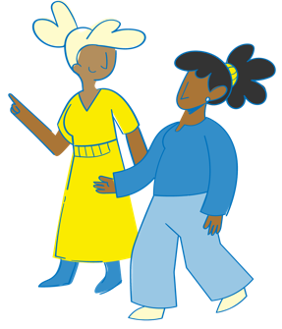
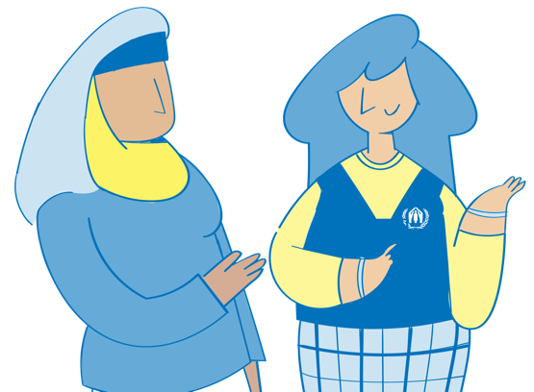
Activity Principles in practice
Notes:
FACILITATOR NOTES
Expected duration: 20 mins
Objective: strengthen participants’ understanding on how to apply GBV guiding principles in GBV prevention activities
Put four signs on the wall, each with one of the four guiding principles written on it (“Community-led”; “Accountable to women and girls”; Survivor-centred”; “Do no harm”).
Ask participants to write a GBV primary prevention activity (preferably an example from ongoing programming if available), on a post-it note.
Invite each participant to come to the front of the room and stick their note to one of the signs with one principle, randomly chosen.
Invite participants to provide an example of a way to make that action or intervention sensitive to the principle chosen, in other words invite them to explain how the action/initiative is survivor-centred, or accountable to women and girls, or does not produce harm, or is community-led.
This exercise should stimulate the revision of the principles and help participants translate them in practice, as well as trigger critical reflections on how to adapt interventions to respect the GBV guiding principles.
Throughout the exercise, highlight the importance of long-term initiatives as well as immediate steps that can be taken to promote gender equality. There will be overlaps between the different principles for each of the examples.
Examples of steps to take to adhere to the principles of community-led processes and accountability to women and girls:
Establishing responsive accountability and feedback mechanisms to ensure that prevention programming is led and guided by women and girls’ interests and needs, including by facilitating regular listening sessions with women and girls from the community to seek feedback on the harmful and helpful effects of GBV prevention programme activities.
Facilitating women and girls’ leadership in prevention programming and ensuring that prevention programming is safe, accountable and responsive to the needs of women and girls.
Addressing the practical barriers faced by women and girls to participating in committee meetings (e.g. transportation, child care, meeting times and locations).
Ensuring the composition of committees is representationally inclusive of women and the ground rules are gender-sensitive.
Engaging female and male community leaders, religious institutions and other opinion leaders to support social norms change on gender inequality and GBV prevention activities and ensure their accountability to women and girls.
Adapting discussion forums in ways that are culturally sensitive, such as by holding separate meetings for men and women so that each group can freely express their views, or by having a female meeting facilitator so that participants feel freer to raise sensitive issues such as GBV.
Providing female leadership training following participatory approaches.
Working with local women’s movements and women’s rights activists to understand the gaps in legal protection against GBV and gender discrimination/lack of gender equality embedded in local law/justice systems and participate in joint action to promote systemic change to achieve equal rights for women and girls under the law.
Examples of steps to take to adhere to the principles of do no harm and survivor-centred approach:
Design of prevention programmes informed by a Gender and Power Analysis and a Theory of Change analyzing local social norms and masculinities.
Avoiding the singling out of survivors of GBV in GBV prevention programmes as this could unintentionally draw attention to survivors and put them and their families at risk.
Carefully promoting women leadership in contexts where leadership roles are traditionally assigned to men, as this could trigger retaliation against women if not done gradually and using participatory approaches.

Slide 31
Discussion Agree or disagree?
Unequal power relationships between men and women will never change.
Agree
Not Sure
Disagree?
Notes:
FACILITATOR NOTES
Expected duration: 10 mins
Objective: deepen participants’ understanding that power relations and gender norms are social constructs subject to change
Put three signs on the wall around the room: “Agree”, “Disagree” and “Not sure”.
Ask participants to move to the sign reflecting their opinion about the statement on the slide. They can stand in between the different signs as well, along an imaginary gliding scale.
Ask participants to explain their opinion and allow discussion to take place.
Make sure the below points are raised and highlighted during the discussion.
Power relations and gender norms are social constructs (influenced by history, tradition, culture and religion) that change over time. Although it is important to understand the social and cultural context in an emergency setting, culture should also be viewed as dynamic, subject to many influences over time, and therefore subject to change. As history shows, women and men around the world have gained (and lost) many privileges and opportunities over the course of time.
Many aspects of culture are highly contested within the culture itself; some segments of society may be keen to change a cultural practice while others, particularly those who benefit from it, may fight to maintain it. Therefore, GBV programme actors should not assume cultural consensus, but rather identify allies and opinion leaders who can promote positive shifts to prevent GBV.
Recall that, although crises can exacerbate pre-existing gender inequalities and increase the risk of GBV, they also provide opportunities for social change. There may be shifts in conventional roles, attitudes, beliefs and practices, or new opportunities to discuss subjects that were previously proscribed. Space may open to build positive social and cultural norms that challenge GBV and a culture of impunity for perpetrators.

Slide 32
What does transformative GBV programming do?
Shifts social expectations, not just individual attitudes.
Publicizes the changes.
Catalyses and reinforces new norms and behaviours.
Recognizes the importance of increasing women’s agency, widening women’s spaces to act and engaging with and transforming the systems that maintain inequality.
Assumes cultural diversity – NOT consensus – and identifies allies and opinion leaders who can promote positive shifts to prevent GBV.
Notes:
FACILITATOR NOTES
In the previous slide, we discussed that unequal power relationships are subject to change. The fact that gender norms can change, is the key entry point for GBV primary prevention work.
GBV primary prevention programming aims to transform inequitable and discriminatory norms and systems.
Although it is important to understand the social and cultural context in an emergency setting, culture should also be viewed as dynamic and subject to change. Moreover, many aspects of culture are highly contested within the culture itself; some segments of society may be keen to change a cultural practice while others, particularly those who benefit from it, may fight hard to maintain it.
IMPORTANT to NOTE: Community outreach and awareness-raising are necessary to increase timely and safe access to services and mitigate risks of GBV -- BUT awareness-raising ALONE is not sufficient to affect social norms change.
Content derived and adjusted from the The Facilitator’s Guide: Applying and Understanding the Inter-Agency Minimum Standards for Gender-Based Violence in Emergencies Programming, PPT (https://gbvaor.net/gbviems).

Slide 33
Resistance to GBV prevention programming
Carefully gauge community openness before engaging in conversations on deep-rooted issues.
Identify potential forms of resistance that can occur during an intervention and see them as resistance and not just “challenges”.
Integrate Gender and Power Analysis into project conceptualization and design, as well as risk mitigation covering resistance in particular.
Create spaces for dialogue and sharing with communities – that is, adopting inclusive and intersectional approaches rather than defensive positions when presented with opposition or questions on the prevention work.
Notes:
FACILITATOR NOTES
Because prevention programming often seeks to change social norms, it can inadvertently cause backlash or resistance when not implemented carefully. This backlash may not only be targeted to women and girls who are a part of the prevention programming, but also to other women and girls in the community where the programming is taking place.
Forms of resistance across a spectrum that ranges from passive denial to aggressive action to preserve the status quo include: omission (e.g. absence of violence against women/girls in laws and policies); denial of the issue; minimizing of the issue; disavowal of responsibility for taking action; inaction; justifying the issue; victim-blaming; comparing victimhood; reinforcing norms; appeasement; appropriation and co-option of feminist goals, gender-based movements and gender-sensitive language; political backlash and backsliding on gender commitments; and repression and violence.
It is key to engage communities and carefully gauge community openness before engaging in conversations on deep-rooted issues, other strategies for effectively anticipating and mitigating this backlash are listed in the slide, with further details here:
Recognize, identify and, where possible, strategize for potential forms of resistance that could occur during an intervention. See them as resistance, not just “challenges” that have to be dealt with in the course of the intervention.
Integrate Gender and Power Analysis into project conceptualization and design: a power analysis can help identify how resistance could emerge – more on Gender and Power Analysis will be covered in session 4.
Integrate risk mitigation exercises into programme design to mitigate some of the risks and resistance the programme may encounter. For example, interventions can anticipate different types of resistance, such as passive or active resistance, or go further to consider forms of omission such as denial and appeasement, so and include measure that can help pivot and adapt should the need arise.
Create space in the timelines of interventions for project teams to reflect on resistance, including time for routine monitoring discussions and reporting exercises. For example, some routine reporting documents have sections on challenges and how they were overcome, but there could be more explicit sections to document resistance.
Where possible, build partnerships with community-based organizations to better leverage each other’s complementary skills, capacities and approaches. Recognize that organizations can collaborate and do not need to do everything by themselves. Partnerships also build resilience to resistance from state actors – more on Localization in session 4.
When identifying legitimate gaps in state provision and support, we should also identify resistance within institutions (including donors) that could hinder the processes of change and adjust their interventions accordingly. Communicate and consult with donors on the forms of resistance they face, as this is key to adjusting their strategies or activities and clearing them for implementation.
Creating spaces for dialogue and sharing with other community-based organizations can help build awareness, educate potential partners and bring them on board. Adopting inclusive and intersectional approaches rather than defensive positions when presented with opposition or questions on prevention work is a pathway to reaching agreement on an ultimate goal.
Content derived and adjusted from the 2022 UNHCR GBV Standard Operating Procedure (SOP) guidance (forthcoming) and Viswanathan, R. (2021)/UN Trust Fund to End Violence against Women, Learning from Practice: Resistance and Backlash to Preventing Violence against Women and Girls (https://untf.unwomen.org/sites/default/files/Field%20Office%20UNTF/Publications/2021/Prevention%20briefs/Resistance%20and%20backlash/Synthesis%20Review%207%20-%20resistance%20and%20backlash_v2_compressed.pdf).

Slide 34
Video: GBV prevention in Rwanda
Notes:
FACILITATOR NOTES
http://www.youtube.com/watch?v=XN07X6Vjk_I
Duration: 4.12 mins

Slide 35
Group work Reflections on the video
What are the root causes of GBV in this situation?
What are the factors that contribute to GBV in this situation?
As you consider this video, what can you say about the prevention principles discussed earlier?
In your opinion, how successful was this programme in addressing harmful social and gender norms?
Notes:
FACILITATOR NOTES
Expected duration: 20 mins
Objective: deepen participants' understanding of how GBV principles can be applied in GBV prevention programming and encourage reflections on transforming harmful social and gender norms
Divide the participants in groups.
Let the participants reflect on the questions in groups.
Encourage groups to use a flipchart when desired.
Allow time at the end for feedback from the groups in plenary, to present key observations and answers to the questions.
Stipulate:
Harmful social and gender norms and discrimination are the root causes of GBV: girls are perceived as having less value, women are blamed for the sex of their babies, husbands are perceived as having the right to dominate their wives and women are treated as inferior to men.
GBV contributing factors include poverty, pressure from other community members, alcohol abuse, and lack of knowledge about reproductive health issues.
Success of the programme: according to Fidele’s feedback it seems that he continues to believe that girls have less value than boys. One of the key points he says to have learned from the programme is that it is the man’s chromosome that determines the sex of the child – rather than him understanding and believing that girls are to be considered equal to boys. Therefore, the programme may not have sufficiently transformed all harmful social and gender beliefs Fidele has.

Slide 36
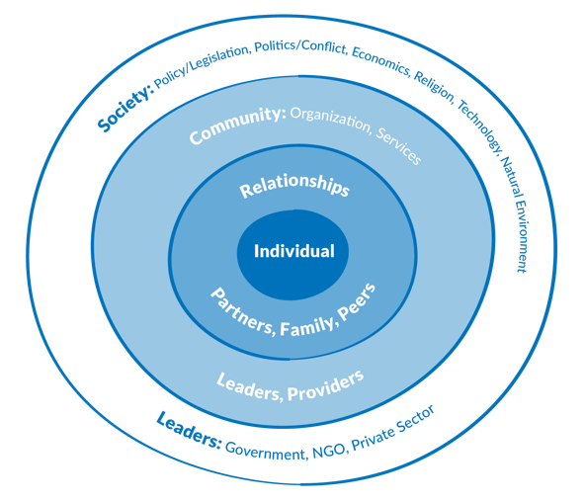
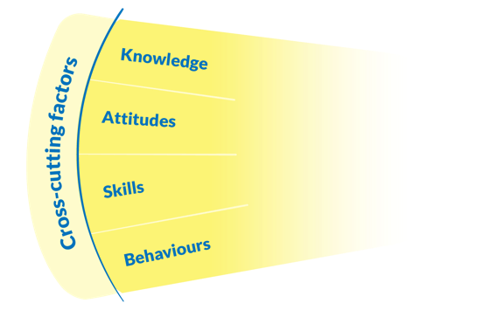
The socio-ecological model
Notes:
FACILITATOR NOTES
Point out that, as we have been discussing, gender inequality, systemic discrimination and unequal power relations, the root causes of GBV, are replicated across different levels, as captured in the socio-ecological model – ranging from individual expectations and attitudes to social norms, legal frameworks and systems (Inter-Agency Minimum Standard 13).
Explain that the socio-ecological model provides a good framework for ensuring that primary prevention strategies operate across these different levels in order to effectively transform systems and social norms.
It is key for prevention programming to include multisectoral interventions and work across the socio-ecological model for shifts in unequal power relations.
For example, successful gender-transformative approaches work from the individual level of girls who are not empowered to advocate for their rights through to the level of communities where girls’ choices are limited, and through systems such as education where gender-unequal pedagogies flourish. Using a socio-ecological model helps us to understand and track changes in social expectations of boys, girls, and male and female roles, and in gender-based values, beliefs and practices.

Slide 37
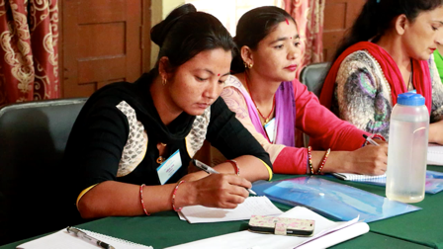
Group work Equal Access Nepal
Notes:
FACILITATOR NOTES
https://www.whatworks.co.za/resources/film-and-audio/item/400-equal-access-Nepal
Duration: 5.42 mins
Expected duration: 15 mins (incl. video)
Objective: reinforce participants' understanding of the socio-ecological model
Divide the participants in groups.
Let the participants work in groups for 5 minutes, inviting them to reflect on the extent that the prevention strategy of Equal Access Nepal works across the different levels of the socio-ecological model.
No plenary feedback session, the main aim of the exercise is to reinforce understanding of the socio-ecological model.
Notes:
Individual level: life skills building, mainly focused on communication in marriage.
Relationships level: direct work with couples, facilitated group discussions about healthy relationships.
Community level: social and behavioural change communication through community outreach, e.g. through role play, theatre.
Society level: using media (radio campaign) for social and behavioural change communication.

Slide 38
Key messages: GBV prevention principles and the socio-ecological model
To be effective, primary prevention strategies should:
Follow GBV guiding principles and engage in community-led processes; be accountable to women and girls; ensure a survivor-centred approach; do no harm.
Operate across the socio-ecological model: aim to shift social expectations, not just individual attitudes, publicize the changes, catalyse and reinforce new norms and behaviours.
Anticipate and manage resistance to changes in gender and social norms.

Slide 39
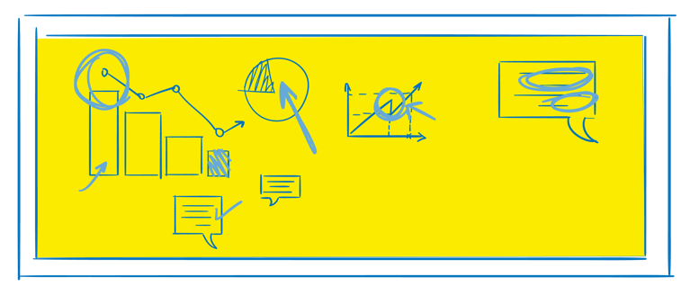
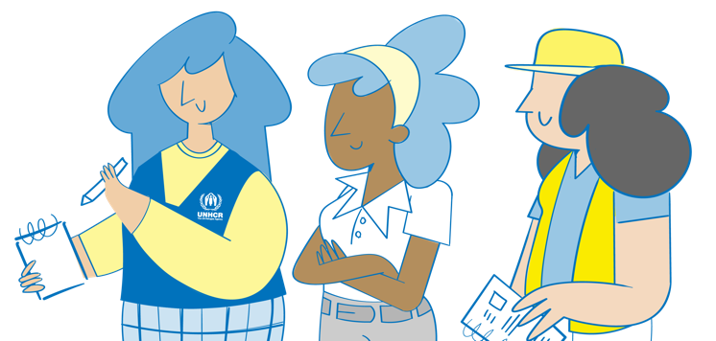
^{MODULE 1 | SESSION 4}
Designing and planning a GBV prevention intervention at UNHCR
Notes:
FACILITATOR NOTES
Expected duration for session 4: 180 mins
Learning objectives:
Understand how GBV prevention programming fits into UNHCR’s Results Framework and multi-year programme cycle.
Explain how GBV prevention programming is part of UNHCR’s commitments and global priorities.
Apply partnership and localization approaches to GBV prevention programming.
Explain the importance of engagement and participation of women, girls and other at risk groups
Understand how Gender and Power Analysis can inform the development of a Theory of Change in order to design and adapt GBV prevention programming tailored to a specific context.

Slide 40
UNHCR GBV Policy commitments
Interventions addressing GBV must be prioritized as lifesaving in multi-year protection/solution strategies and in other internal and inter-agency planning processes.
Operations will plan and implement context-appropriate programming that aims to transform the systems and social norms that perpetuate gender inequality and discrimination.
Programming must address the root causes of GBV in order to effectively change behaviour and social norms, including through long-term approaches, and will require the engagement of men and boys as well as programming that empowers women and girls.
All GBV prevention programming must be accountable to women and girls.
UNHCR will advocate for and support the inclusion of displaced and stateless persons in related national prevention programming, and through targeted interventions, as appropriate.
Notes:
FACILITATOR NOTES
Remind participants also of the following related key points from the UNHCR GBV Policy, which has mandatory compliance:
UNHCR GBV Policy core action: operations will advocate and allocate resources for GBV prevention, risk mitigation across sectors and areas of work, and response programming.
Operations need to make provisions for prevention, risk mitigation and response to GBV as a standard element of their operations plan in accordance with relevant guidelines. UNHCR must prioritize effective fundraising to enable sufficient allocation of resources and to put in place measures to address GBV from the onset of an emergency.
Programme design should contribute to dismantle, not reinforce, abusive and unequal power relations.
All GBV prevention programming must be accountable to women and girls.
Prevention programming should only be initiated once essential services are in place to respond to incidents.

Slide 41
https://unhcr365.sharepoint.com/sites/GSCB-GBVLearning/SitePages/Webinar-2.aspx
Multi-year programme cycle
PLAN
Review situation analysis
Design multi-year strategies
Manage and plan for emergencies
GBV prevention programming
Gender and Power Analysis
Theory of Change
GET
Update implementation plans annually
Monitor implementation plans
Manage and adjust implementation plans
GBV prevention programming
GBV prevention partnerships
Monitoring of partnerships
SHOW
Conduct strategy implementation review
Report on core indicators
Evaluate strategies
GBV prevention programming
Annual reporting
Notes:
FACILITATOR NOTES
Explain that now we will be looking now at how the planning and design of GBV primary prevention activities fits into UNHCR multi-year programme cycle. The multi-year programme cycle is a new framework that has been introduced by UNHCR in 2022.
By 2024, the whole organization will move to a multi-year programme cycle. The multi-year programme cycle is composed of three inter-related phases with defined processes and specific set of products/documents:
PLAN Phase: strategic planning and budgeting
GET Phase: annual implementation planning, monitoring, managing and adjusting implementation
SHOW Phase: reviewing strategy implementation and reporting on results.
The new multi-year strategic programme cycle of 3-5 years, offers an important opportunity for the implementation of longer term GBV prevention strategies. Whilst GBV prevention programming through partnerships may continue to be concluded on an annual basis based on annual budget allocation, the multi-year strategic planning allows for the planning of longer social norm change and gender transformative programming in line with the UNHCR GBV Policy.
Even though the budget is allocated annually, operations are encouraged to conclude multi-year partnerships, as these will facilitate the prioritization of budget allocation towards longer term prevention programming.
For more information refer participants to the 2022 webinar recording and PPT on UNHCR’s results-based management and GBV: https://unhcr365.sharepoint.com/sites/GSCB-GBVLearning/SitePages/Webinar-2.aspx.

Slide 42
Women and girls' engagement
Localization
Key elements of GBV prevention programme design and planning
Consultation with key stakeholders
Gender and Power Analysis
Partnership
Theory of Change
Notes:
FACILITATOR NOTES
Explain that all concepts in the outer part of the circle are key elements for the design and planning of effective GBV prevention programmes. Highlight that all of these concepts are interconnected.
We will delve into all these concepts in this session, with the exception of consultation with key stakeholders. Emphasize that particularly government authorities are key stakeholders to consult when designing and planning GBV prevention programming, depending on the context – aiming to include and complement national GBV prevention strategies and programming.
NB on Theory of Change: for the purpose of this module, we refer to a Theory of Change specific to for GBV prevention programming. This is different from the Theory of Change that is part of UNHCR’s multi-year programme cycle. At UNHCR, developing a Theory of Change is considered as a key, mandatory step for the development of multi-year strategies. Operations are requested to develop a Theory of Change for each impact area identified in their multi-year strategy. The Theory of Change used for the purposes of planning and implementing GBV primary prevention programming can inform the wider UNHCR Theory of Change developed to inform the multi-year programme cycle. For more please check UNHCR’s Theory of Change development package related to the multi-year strategy: https://intranet.unhcr.org/content/dam/unhcr/intranet/protection-operations/compass/en/guidance/toc-package/TOC%20package.zip

Slide 43
Engagement and participation of women, girls and other risk groups
Engagement and participation of women, girls and other at risk groups is a preventative activity in itself and should be implemented from the onset of an emergency.
Participation is a key aspect of empowerment.
Engagement and participation of women, girls and other at risk groups is critical throughout the programme cycle, to ensure safe, effective and accountable programming. This will:
Inform programming;
Promote community resilience by building on their capacities and resources;
Support monitoring, including unintended harmful consequences.
Notes:
FACILITATOR NOTES
The inclusion and active participation of women, girls and other at risk groups is a preventative activity in itself. GBV programming should promote and support women’s and girls’ inclusion in leadership positions from the start of an emergency response, while understanding that interventions related to social norms and systemic change should be implemented when basic GBV response services are functional.
Participation is a key aspect of empowerment. Empowerment is a process that means women and girls can take control over their lives, including by making decisions, setting their own agendas, gaining skills (and/or having their skills and knowledge recognized), solving problems and developing self-reliance.
Empowerment allows women and girls to control their assets, and influence the policies, processes and institutions that affect their lives (including the structures and institutions that reinforce and perpetuate gender discrimination and inequality). The concept of empowerment has a long history in social change work that emphasizes the importance of gaining the ability to make meaningful choices.
Recall Inter-Agency Minimum Standards ky guidance on women and girls’ participation:
Consult quarterly (at minimum) with women and girls on GBV risks and constraints to their participation in programme activities.
Ensure women and girls inform the design of GBV programming at every stage of the programme cycle by facilitating their participation (e.g. recruiting them as personnel and volunteers, providing transportation and translation).
Identify and address barriers and risks to participation through consultations with women and girls and promote a better understanding of specific barriers and discrimination that create increased risk of GBV for certain women and girls.
Together with women and girls, identify those who face the greatest marginalization and risk, and design approaches to ensure their participation.
Support representation of older adolescent girls and older women in community leadership structures and support the capacity development of female leaders on women’s rights, leadership skills, negotiation skills and public speaking.
This topic will be discussed in depth the module 2 of the prevention Facilitation Package.

Slide 44
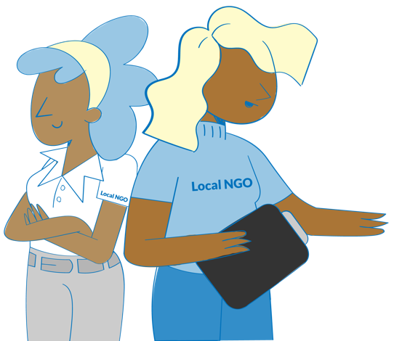
Discussion Partnerships and localization
What partners does UNHCR have in your operation working on GBV prevention?
What is the value of partnering with IDP and refugee-led, women-led and/or LGBTIQ+-led organizations in GBV prevention programming?
What are the challenges in partnering with these organizations and how can these be addressed?
How can engagement with these organizations be improved in your own GBV prevention programming?
Notes:
FACILITATOR NOTES
Expected duration: 20 mins
Objective: deepen participants' understanding of the importance and challenges of localization, and encourage reflections on own localization efforts
Invite participants to reflect on the questions in the slide in plenary.
Remind participants of the UNHCR GBV Policy core action outcome: through an expanded and diversified range of partners, timely and quality services are established and coordinated to prevent and respond to GBV. The UNHCR GBV Policy recognizes the importance of partnerships with local civil society and community groups, IDP and refugee-led as well as local and national women-led and women-focused organizations, and/or LGBTIQ+ organizations.
Localization: is a key part of the commitments made by the international community during the World Humanitarian Summit in May 2016 through the Grand Bargain (https://interagencystandingcommittee.org/grand-bargain-hosted-iasc). This is not specific to GBV partnerships and applies to all UNHCR’s programmatic areas. Localization, as used in the humanitarian sector, refers to the process of better engaging local and national actors in all phases of humanitarian action, including greater support for locally-led action.
Women-led organization
Women-led organizations (WLOs) are a wide range of women- and girl-led groups, organizations, networks and movements, operating at community, national, regional and/or global level.
WLOs should have clear organizational values, principles/commitment on gender equality and accountability to women and girls.
2/3 of the leadership and management structure are people who identify as women and girls. The entire organization should have equal or higher representation of women across.
IDP/refugee-led organization
An organization or group in which persons with direct lived experience of forced displacement play a primary leadership role and whose stated objectives and activities are focused on responding to the needs of refugees and/or related communities.
Some, but not all IDP/refugee-led organizations are officially registered.
Engagement of LGBTIQ+ organizations: national LGBTIQ+ support, advocacy and umbrella organizations in asylum countries can be effective key partners. It is worthwhile advocating for them to integrate LGBTIQ+ displaced persons into their programmes. Nevertheless, it is important to note that some LGBTIQ+ organizations in the host country may not have the capacity, resources or interest to work with LGBTIQ+ displaced persons; some may also be penalized by their governments for working with persons perceived to be irregular migrants. It is best to bear this in mind when engaging local LGBTIQ+ support organizations. (Source: UNHCR Need to Know Guidance: Working with Lesbian, Gay, Bisexual, Transgender, Intersex and Queer Persons in Forced Displacement, 2021)
Value
Directly promotes their empowerment.
WLOs play a key role in leading change and sustainable progress on GBV and gender equality – improved links with development.
GBV prevention programming requires carefully gauging community acceptance before engaging in conversations on deep-rooted issues, engaging community-based organizations will improve access to communities, foster trust within the community/stronger community acceptance and allow a better Gender and Power Analysis.
Promotes accountability to women and girls.
Communities affected directly by a crisis have skills, competencies and coping mechanisms that can be extremely important to help restore women’s and girls’ dignity, and strengthen individual resilience.
Patriarchal humanitarian systems that curtail local women’s opportunities to participate in and influence decision making can further undermine women’s rights and drive social norms that perpetuate GBV.
Reduced costs.
Possible challenges
Limited access to funding (e.g. pooled funds), due to e.g. lack of registration, limited organizational structure, complicated application processes for funding/grants etc. → Please take note of the new UNHCR “Grant Agreement with Organizations led by displaced and stateless people” which seeks to ensure that displaced and host communities are treated as equal and active partners. It provides grant funding to organizations led by displaced and stateless persons in order to empower them to realize their own projects and build their capacity. It also allows UNHCR to work directly with the people it serves without having to use intermediaries. Each organization can receive up to USD 4,000 per grant/project and up to USD 12,000 in total funding per year.
Need for capacity strengthening and amplifying their voices in coordination forums. → Please take note of the guidance note that has been developed on ensuring the participation of these organisations in the Refugee Coordination Mode and the external information repository for organizations led by displaced and stateless people to access guidance, tools, good practices, and capacity-building materials.
Patriarchy and hierarchy within the humanitarian system and at the country level, that is rigid and male-dominated, resulting in a lack of emphasis on gender transformative work, barriers to women's leadership and unequal salaries of local partners.
Resources
Briefing Note, UNHCR’s Task Team on Engagement and Partnership with Organisations led by Forcibly Displaced and Stateless People, 2022: https://www.unhcr.org/publications/brochures/61b28b094/unhcrs-task-team-engagement-partnership-persons-concern-led-organizations.html?query=RLO.
Briefing Note, UNHCR Grant Agreements with Organizations led by displaced and stateless people, 2022: : https://www.unhcr.org/publications/brochures/61b28c784/unhcr-grant-agreements-organizations-led-persons-concern-poc-briefing-note.html?query=grant%20agreements.
UNHCR, Refugee-led Innovation Fund: https://www.unhcr.org/innovation/refugee-led-innovation-fund/ .
UNHCR, Localization in UNHCR-led Coordination Structures, https://intranet.unhcr.org/content/dam/unhcr/intranet/staff%20support/partnership/documents/english/poc-orgs/Localization-in-UNHCR-led-coordination-structures.pdf.
Information repository for Organizations led by forcibly displaced and stateless people: https://data.unhcr.org/en/situations/repository-organisations-led-by-forcibly-displaced-and-stateless.
Webinar recording and PPT on localization: https://unhcr365.sharepoint.com/sites/GSCB-GBVLearning/SitePages/Webinar-3.aspx.
GBV AoR/CARE/ActionAid, GBV Localization: Humanitarian Transformation of Maintaining Status Quo? A Global Study on GBV Localization through Country-Level GBV Sub-Clusters (2019): https://careevaluations.org/wp-content/uploads/GBV-Localization-Mapping-Study-Full-Report-FINAL.pdf

Slide 45
GBV assessment and analysis
Notes:
FACILITATOR NOTES
https://www.youtube.com/watch?v=-CXyZjc23Xo&list=PLk83Ra7kAz5HQymFMdS79dryet14pn8YS&index=7
Duration: 3.19 mins
Recall that according to the UNHCR GBV Policy, operations should conduct a GBV situation assessment for each location at least once a year, linked to relevant assessment, planning and prioritisation processes.
GBV assessments seek to identify and improve GBV programme actors’ understanding of the nature and scope of violence against women, girls and other at risk groups, protective and risk factors for GBV (e.g. age, minority status, disability), gaps in the quality and scale of available multisectoral services, and whether GBV programme actors have the appropriate level of resources and capacity to respond. Assessments do not aim to identify individual or groups of survivors or whether GBV is happening.
Assessments, when conducted safely and ethically, may also have the effect of opening up a safe space for affected populations to talk about GBV, and may lead some survivors to disclose an incident of violence. Therefore, basic response services should be in place prior to the assessment and the assessment team should be briefed on how to respond to disclosure of GBV or other protection issues arising during the course of the assessment, including by providing information to survivors on how to access care.
The assessment in itself is an intervention through its participatory nature, offering an avenue for participation and empowerment of women, girls and other at risk groups.
Explain that methods of data collection and information-gathering should be both quantitative and qualitative to provide a more comprehensive understanding of the nature and scope of GBV.
A key assessment and analysis tool for prevention work is a Gender and Power Analysis of local social norms and masculinities that sustain gender inequality and GBV, the next slides will be delving into this tool more in detail.

Slide 46
Gender and Power Analysis
A key assessment and analysis tool for prevention programming is the Gender and Power Analysis of local social norms and masculinities that sustain gender inequality and GBV.
It is a pre-requisite for effective GBV prevention programming.
It is recommended to undertake a Gender and Power Analysis jointly with partners, particularly IDP and refugee-led women and/or LGBTIQ+-led organizations.
Notes:
FACILITATOR NOTES
A Gender and Power Analysis is a tool that helps to understand the context in which a project or an initiative operates. It helps elicit information on aspects related to gender equality and when it is used to design prevention programming, specifically about social and gender norms to consider or to be addressed with programme activities.
It allows UNHCR workforce, partners, and communities to design and adapt programming that positively transforms unequal power relations and to ensure all stakeholders can equitably access, participate in, be decision-makers for, and benefit from activities.
A Gender and Power Analysis can take different forms, depending on the context, focus, project budget, time, and stage of project implementation.
A Gender and Power Analysis is a GBV specialized assessment, so whenever there is no specific Gender/GBV expertise in the operation, RB/HQ support should be sought.
There is no standard tool/template in use at UNHCR for this purpose, and partners may use their own institutional template.

Slide 47
Why a Gender and Power Analysis?
Ensure prevention programming is based on an accurate understanding of the distinct GBV risks faced by women, girls and other at risk groups in a specific context.
Analyse how systems of oppression based on sex, gender, age, disability, ethnicity, socio-economic status, and other power differentials intersect and shape people’s life choices, access to resources, and opportunities.
Understand existing efforts at all levels (individual, interpersonal, community, society) that challenge gender and social inequalities.
Facilitate the design and adaptation of culturally appropriate and gender-responsive prevention programmes and ensure they effectively reach marginalized women, girls and other at risk groups.
Ensure activities do not cause harm by perpetuating or increasing existing gender and social inequalities and mitigate any potential unintended negative consequences.
It is ideal to conduct Gender and Power Analysis at the start of an intervention to ensure that the findings and recommendations inform the design and implementation.
Notes:
FACILITATOR NOTES
This slide will review in detail why a Gender and Power Analysis is key for GBV prevention programming.
A Gender and Power Analysis enables UNHCR and partners to work with a diverse group of stakeholders to:
Highlight opportunities, resources and strengths, by harnessing the capacity of women, girls and other at risk groups to actively participate and identify solutions to transform social and gender norms.
Gauge community acceptance before engaging in conversations on deeply rooted issues to avoid possible resistance and backlashes.
Develop evidence-based and context-specific recommendations to:
Design or adapt project/initiative processes and activities to increase equitable access, participation, decision-making power, and benefits for people who experience inequality.
Ensure practices and interventions do not cause harm by perpetuating or increasing existing gender and social inequalities and mitigate any potential unintended negative consequences.
When to conduct a Gender and Power analysis?
It is ideal to conduct Gender and Power Analysis as soon as possible to ensure that the findings and recommendations inform the design and implementation. That said, UNHCR and partners can conduct a Gender and Power Analysis at multiple points across the multi-year programme cycle.
This approach enables evidence generation and analysis at each stage to inform decision-making, design and adaptation of activities, risk mitigation, and learning. It also allows UNHCR and partners to measure changes over time.
UNHCR and partners can use a modified/rapid Gender and Power Analysis process to inform new funding opportunities.
During proposal development, a rapid Gender and Power Analysis can support the design of projects or initiatives that promote gender equality and transform unequal gender and social norms, systems, and structures. Once the project or initiative begins, a full Gender and Power Analysis can be carried out to test, confirm, and expand on findings from the rapid Gender and Power Analysis.
The presence of a Gender and Power Analysis and Theory of Change is more and more frequent as criterion that donors request as minimum standard to ensure that programmes are designed to be gender transformative.
Content derived and adjusted from the Save the Children Gender & Power Analysis Guidance and Tools, 2021 (https://resourcecentre.savethechildren.net/document/gender-power-gap-analysis/).

Slide 48
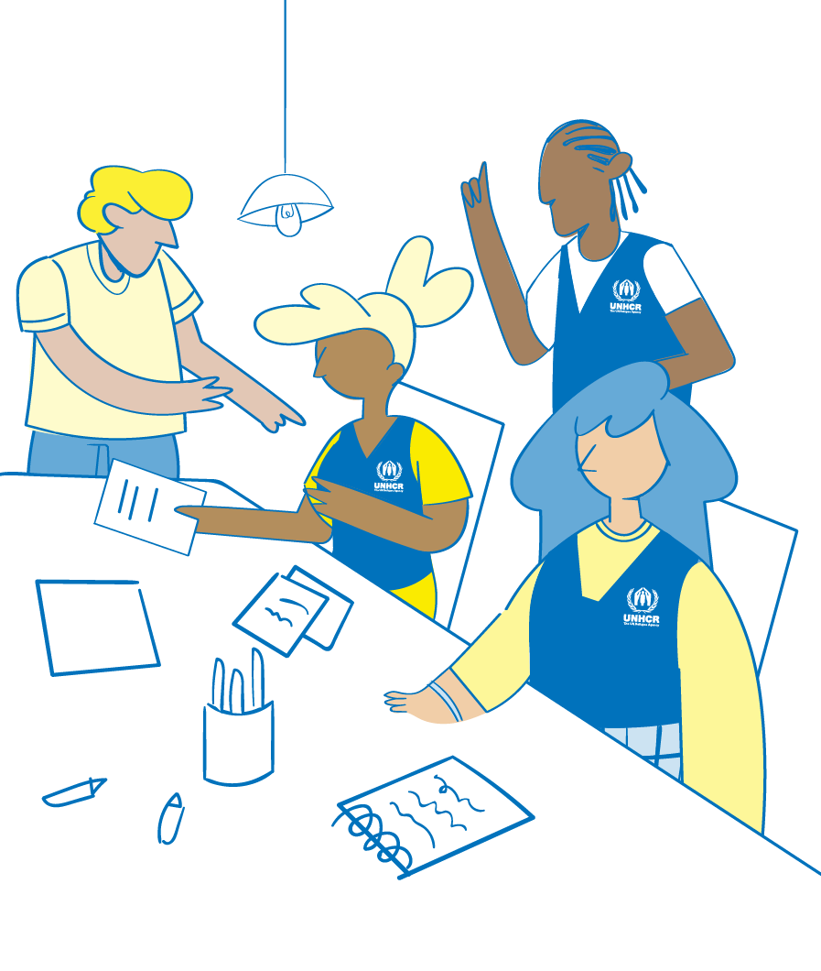
Discussion Analyzing gender and power
Why it is important to analyse gender and power?
How are these two elements connected?
Notes:
FACILITATOR NOTES
Expected duration: 15 mins
Objective: reflect on the importance of a Gender and Power analysis
Ask participants the question: why it is important to analyse gender and power and how are these two elements connected ? Invite participants to share their feedback in plenary. Make sure the below points are raised and highlighted during the discussion.
Gender norms and hierarchies exist in all aspects of social life. They shape everything from our family roles and decision-making power to our aspirations and job opportunities to our land and inheritance rights.
Key feminist theories of power, like intersectionality, emphasize gender as a critical power differential that overlaps with others, such as age and ethnicity, to shape experiences of oppression.
The Gender and Power analysis, therefore, draws attention to the numerous power hierarchies and interconnected systems of oppression that cause inequality. It enables an examination of how unequal power relations overlap with sexism to deepen or produce specific inequalities and forms of discrimination.
The Gender and Power framework also highlights that power is exercised across a series of social domains and levels of the socio-ecological model (individual, relational, community, and society).
Power shapes individual’s and group’s access to and control over resources and opportunities, their ability to exercise their agency and rights, and their experiences of inequality and discrimination.
Using a gender and power framework enables UNHCR and partners to identify, understand, and address the root causes of inequality, rather than only the symptoms, supporting us to design and deliver transformative prevention programming. It helps move beyond social inclusion, which tends to focus on including people with marginalized identities and characteristics within existing systems, leaving the causes of inequality unexamined and unchanged.
By focusing on power, the Gender and Power Analysis framework reveals the unequal power hierarchies and systems that cause gender inequality and social injustice and supports programming that tackle GBV these root causes.
Content derived and adjusted from the Save the Children Gender & Power Analysis Guidance and Tools, 2021 (https://resourcecentre.savethechildren.net/document/gender-power-gap-analysis/).

Slide 49
Domains of Gender and Power Analysis
Laws, policies, regulations, and institutional practices.
Social norms, beliefs, and practices.
Roles, responsibilities, and time use.
Patterns of decision-making.
Access to and control over resources;
Safety, dignity, and well-being.
Notes:
FACILITATOR NOTES
The following domains are used in a Gender and Power Analysis to examine key gaps, risks, and barriers that limit gender equality and social justice in different arenas of life. They also help to identify groups’ experiences of power and privilege or lack thereof as well as drivers of positive social change.
It is also important to investigate how intersecting power differentials and systems of oppression operate within each domain.
Laws, policies, regulations, and institutional practices (including formal and informal/customary systems and practices) create, reinforce, or challenge gender and social inequalities. A Gender and Power Analysis should examine laws, policies, regulations, and institutional practices to determine if direct or indirect biases exist, how they may reproduce inequitable gender and power relations, and how they impact different populations.
Social norms are the informal rules that outline acceptable and appropriate behaviours within a group or setting. As a set of social expectations, social norms are shared and reinforced through social sanctions (e.g. verbal reprimands and social stigma) or rewards (e.g. social inclusion and access to resources). They can change over time and vary across settings. Social norms and beliefs influence behaviour and shape social interactions, structures, and power dynamics. They also influence how people interpret information and the world around them. Unequal gender and social norms and beliefs reinforce and are shaped by unequal systems (economic, political, legal, and cultural systems). People in positions of power—power-holders—may enforce social norms that maintain their power and privilege. Inequitable gender and social norms, beliefs, and practices should be explicitly identified in a Gender and Power Analysis.
Roles, responsibilities, and time use Gender and other power differentials shape how roles and responsibilities are allocated and adopted by people in every arena from informal housework to paid labour. A Gender and Power Analysis examines individuals’ and group’s roles, responsibilities, and time use during paid work, unpaid work, leisure time, and community service. Research findings help to provide an accurate portrait of inequalities inside and outside the household
Patterns of decision-making This domain considers people’s ability to make decisions freely, exercise power over their bodies, control and influence others, and make or influence economic, educational, health, and political decisions within the family, community, and society. Trends in how people make decisions at different levels of the socio-ecological model are outlined in a Gender and Power Analysis. This examination helps to reveal who has or lacks power, agency, and status and what systems of oppression maintain gender and social inequalities.
Access to and control over resources This domain considers the degree to which people can access, use, and/or control the resources—assets, education, income, social benefits, health, technology, and information—necessary to survive and to participate fully in society. Access is the opportunity to make use of a resource while control is the power to determine if, how, and when a resource is used and who can obtain it. Access to resources does not ensure equitable use, so it is important to investigate how and why usage of resources may vary across groups and circumstances (e.g. among household members).
Safety, dignity, and well-being This domain considers how rights violations, including discrimination, inequality, exclusion, and GBV affect people’s lives. Safety includes physical and psychological safety. People’s ability to live with dignity and be respected within their families, communities, and societies is critical to ensure they live healthy and fulfilling lives. Under this domain, a Gender and Power Analysis investigates the people, systems, policies, and institutions, which enable interpersonal and systemic rights violations. It also examines the means by which a country and existing power structures prevent and address GBV.
Content derived and adjusted from the Save the Children Gender & Power Analysis Guidance and Tools, 2021 (https://resourcecentre.savethechildren.net/document/gender-power-gap-analysis/).

Slide 50
Group work Domains of a Gender and Power Analysis
Which key aspects would you chose to analyse from the different domains of Gender and Power Analysis in the context of Gardenia?
Notes:
FACILITATOR NOTES
Expected duration: 25 mins
Objective: familiarization with the key elements of a Gender and Power Analysis
Divide the participants in groups.
Provide print-outs of the Gardenia scenario to the groups (see Activity Sheet and below).
Let the participants reflect on the question in groups.
Display the previous slide to remind participants of the domains of the Gender and Power Analysis.
Encourage groups to use a flipchart when desired.
Allow time at the end for feedback from the groups in plenary, to present key observations and answers to the question.
Make sure that the following points are reflected on during the discussion:
Laws, policies, regulations, and institutional practices: labor laws/regulations for refugees; school closure during the health pandemic; legal age of marriage, mandatory reporting.
Social norms: gender roles that confine women’s role to a reproductive one while men are considered to be the productive segment of society; social norms that restrain women and girls’ mobility; denial of access to school and tertiary education for girls (as opposed to boys); limitations of movement and social contacts as well as access to reproductive health services for unmarried girls; social norms promoting early marriage despite being illegal in the country; stigma associated with seeking help; honor killing.
Roles, responsibilities, and time use: women and girls reproductive role vs men productive role, denial of access to school and tertiary education for girls (as opposed to boys); limitations of movement and social contacts as well as access to reproductive health services for unmarried girls.
Patterns of decision-making: limited women and girls (in particular) ability to make decisions freely, exercise power over their bodies, control and influence others.
Access to and control over resources: Limited women and girls (in particular) access, use, and/or control the resources—assets, education, sexual and reproductive health, and information. Denial of resources is so normalized within communities, women and girls are often unaware these incidents constitute GBV.
Safety, dignity, and well-being: limited access to GBV response services for women and girls, honor killing, early marriage, limited mobility and increased risks at home.
Scenario
Twelve years into the Farmenian crisis, refugees remain in exile as their country continues to face a protracted conflict and an overwhelming humanitarian crisis. In neighbouring Gardenia, over 80% of registered refugees live outside of camps, primarily concentrated in urban and rural areas.
Farmenian refugees are legally allowed to work in Gardenia. For women, employment and income generating opportunities continue to be governed by the expectation of the society to fulfill their gender roles. Women participation in labor force is restrained by restrictions on their movement and social interaction under the pretext of protecting them from sexual abuse and harassment, domestic care burdens, and supporting children education due to schools’ closure during the health pandemic the country just faced.
In 2022, around 95% of reported cases of GBV survivors assisted by case management service providers organizations were female – this is in line with global GBV trends highlighting that women and girls are disproportionately affected by GBV. Home remains unsafe for women and girls, around 86% of perpetrators are intimate partners.
Controlling behaviors reported by girls include denial of access to school and tertiary education, limitations of movement and social contacts as well as access to reproductive health services for unmarried girls. Husbands or male relatives also prevent girls from attending girls’ empowerment activities and other services. Denial of resources is therefore normalized within communities, women and girls are often unaware these incidents constitute gender-based violence. Early marriages made up the largest number of forced marriages, predominantly affecting girls of 15-17 years old despite being illegal in the country.
Sexual assault and rape constitute some of the most severe forms of GBV with life-threatening consequences, yet they are the most under-reported forms of violence. The stigma associated with seeking help when subjected to sexual violence and the fear of mandatory reporting to the police constitute a major barrier for survivors’ ability to come forward, coupled with the risk of honor killing.

Slide 51
Steps of Gender and Power Analysis
Find
Collect
Analyse
Validate
Finalize
Notes:
FACILITATOR NOTES
Explain to participants what are the key steps of gender and power analysis.
Find available data that is disaggregated by sex and age, and existing analysis on gender relations. Examine relevant power differentials & domains of analysis. Disaggregate data by gender, age, disability, and other relevant power differentials.
Collect additional data by sex and age. Make sure that before collecting data you identify risks and ethical considerations. Use feminist inclusive safe and ethical methodologies.
Analyse highlighting knowledge and views of women, girls and other at risk groups. Focus on domains of analysis & intersecting power differentials.
Validate findings with diverse groups of stakeholders.
finalize drawing practical recommendation based on the analysis to inform the Theory of Change and primary prevention programming.
Remind participants that data collection should be conducted safely and ethically in accordance with GBV Information Management guiding principles and practices. For more information please visit the GBVIMS website (GBVIMS: Gender-Based Violence Information Management System)

Slide 52
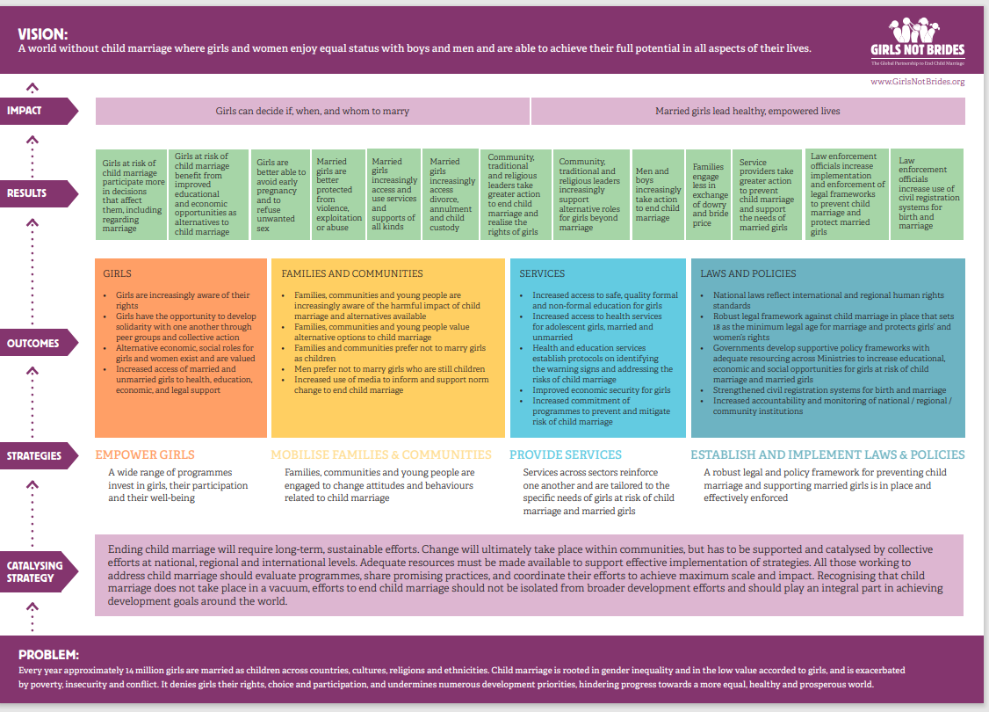
What is a Theory of Change?
Theory of Change is an explicit process of thinking through and documenting how a programme or intervention is supposed to work, why it will work, who it will benefit (and in what way) and the conditions required for success.
It is important for the Theory of Change to take a nonlinear view of change, recognizing that efforts to increase women and girls’ participation and empowerment may encounter backlash or resistance
Notes:
FACILITATOR NOTES
The end goal of the Gender and Power Analysis process is the creation of Theory of Change that informs the primary prevention activities design and implementation. In order to develop the Theory of Change, a workshop can be conducted over 1-2 days with the participation of key colleagues and partners.
Definition: Theory of Change (Weiss, 1995) is an explicit process of thinking through and documenting how a programme or intervention is supposed to work, why it will work, who it will benefit (and in what way), and the conditions required for success.
Point out that the image shows an example of a Theory of Change of a GBV prevention programme (on early marriage), illustrating the different elements of a Theory of Change. Further details on these elements will be provided in the next slide.
Not one approach on its own will lead to transformative change for women, girls and other at risk groups, particularly around something as culturally embedded as violence against them. A Theory of Change can thus help us show how we expect GBV prevention outcomes and impact to occur over the short, medium, and longer term as a result of our work.
It is important for the Theory of Change to take a nonlinear view of change, recognizing that work to increase women and girls’ participation is likely to provoke backlash, which must be anticipated and managed. A key consideration when determining the appropriate mix of activities in a particular setting is the “readiness” of the population to adopt the new norm.
Given the nature of GBV primary prevention programming related to transformative change, the process of developing a Theory of Change is highly recommended, in order to ensure effective, safe and accountable GBV prevention programming.
Image derived from Girls Not Brides,Theory of Change on Child Marriage (https://www.girlsnotbrides.org/documents/1002/Girls-Not-Brides-Theory-of-Change-on-Child-Marriage.pdf)

Slide 53
Theory of Change
There is no standardized way of developing a Theory of Change. However, it is recommended for Theories of Change to address a few key areas:
Definition of the situation and desired results.
Establishing programme boundaries.
Exploring potential solutions.
Articulation of assumptions.
It is recommended to develop a Theory of Change jointly with partners, particularly IDP and refugee-led women and/or LGBTIQ+-led organizations.
Notes:
FACILITATOR NOTES
Key areas of a Theory of Change :
Define the situation and desired results: identify the problems or opportunities within the community which are mapped through the Gender and Power Analysis that require a programme response, the causes and consequences of those problems/opportunities, and the people most likely to be affected by them. Describe what the programme aims to achieve in the long- term by addressing the situation.
Establish programme boundaries: scope the aspects of the situation the programme aims to focus on and those the programme can focus on. What the programme can focus on will depend on several factors including the resources, conditions attached to funding receives and what other service providers are doing in the area.
Explore potential solutions: research and explore possible ways to address the situation - those that are in and out of scope - and determine any necessary conditions for achieving outcomes (i.e. spaces, practices, people, timing, etc.) and anything that might stop or stall progress towards the desired impact. The Theory of Change should also acknowledge any gaps in existing knowledge to signal areas that need further research.
Articulate assumptions: list the assumptions about why programme decisions and strategies are expected to work. For example, to realize the Theory of Change, an assumption may be that participants will turn up and complete the intervention. This is a necessary precondition for the intervention or programme to work. Part of the process of doing a Theory of Change might be to see how realistic or uncertain these assumptions are.
There is no standard tool/template in use at UNHCR to develop a Theory of Change for GBV prevention programming and partners may use their own institutional template.
Important to remind participants that key elements of the Theory of Change developed to inform GBV prevention progamming could be used to feed UNHCR’s multi-year programme cycle and partnership agreements (e.g. COMPASS multi-year strategy, indicator selection, activity description, impact/outcome/output statements in PPA, results framework in PPA etc.).

Slide 54
Key messages:
Interventions addressing GBV must be prioritized as lifesaving in multi-year protection/solution strategies of each operation and in other internal and inter-agency planning processes.
Engagement and participation of women, girls and other at risk groups, as well as IDP and refugee-led women and/or LGBTIQ+-led organizations, is critical to ensure safe, effective, sustainable and accountable GBV prevention programming.
Operations should conduct a Gender and Power analysis of local norms and masculinities sustaining gender inequality and GBV, to inform strategies and ensure effective prevention programming.
The Gender and Power Analysis should feed into the development of a Theory of Change that shows how we expect GBV prevention outcomes/impact to occur over the short, medium, and longer term as a result of our work.

Slide 55
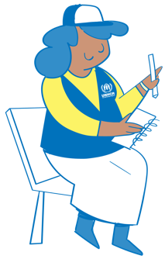
^{MODULE 1 – SESSION 5}
Measuring outcomes and impact of prevention work
Notes:
FACILITATOR NOTES
Expected duration for session 5: 120 mins
Learning objectives:
Explain how to measure changes and use findings of programme monitoring to inform adjustments and new strategies.
Describe UNHCR’s Results Framework on GBV, the UNHCR GBV prevention core indicator and related monitoring tools.

Slide 56
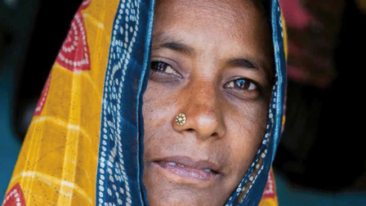
Video: Violence is Preventable – What works?
Notes:
FACILITATOR NOTES
https://www.whatworks.co.za/resources/film-and-audio/item/668-video-violence-is-preventable-what-works
Duration: 3.27 mins
The video captures the results from the What Works to Prevent Violence Against Women & Girls Global Programme, funded by UK Aid. Their online resource details findings and lessons from rigorous evaluations across 15 countries in Africa, Asia and the Middle East on what works (and doesn’t) to prevent violence, the results of which show that violence against women and girls is preventable. The successor programme, What Works – Impact at Scale, will scale up effective interventions, test new innovations, and use the evidence to influence a more effective global response to VAWG prevention.

Slide 57
Discussion Effectiveness of prevention activities
What makes prevention activities effective?
How do you monitor GBV prevention activities in your operation/organization?
What are the challenges?
Notes:
FACILITATOR NOTES
Expected duration: 10 mins
Objective: reflect on the effectiveness of GBV prevention activities
Invite participants to reflect on the questions in the slide in plenary.
Recall:
Key concepts, principles and approaches discussed in previous sessions: adhering to GBV guiding principles, ensuring participation, engagement and accountability to women, girls and other at risk groups, working across the ecological model, working with refugee- and women-led organizations.
Anchoring of GBV prevention activities to a solid Theory of Change, based on a Gender and Power Analysis.
Some of the specific challenges of monitoring GBV prevention work will be discussed in the following slide
If asked:
Monitoring: systematic and continuous process of collecting, analysing and using information to track a programme’s progress towards reaching its objectives and the use of allocated funds.
Evaluation: systematic and objective assessment of an ongoing or completed project, programme or policy, its design, implementation and results. The aim is to determine the relevance and fulfilment of objectives, efficiency, effectiveness, impact and sustainability.
Definitions derived and simplified from the UNHCR/CARE, FRAME Toolkit: Framework for Assessing, Monitoring and Evaluating the environment in refugee-related operations, 2009 (https://www.unhcr.org/protection/environment/4a97d1039/frame-toolkit-framework-assessing-monitoring-evaluating-environment-refugee.html).

Slide 58
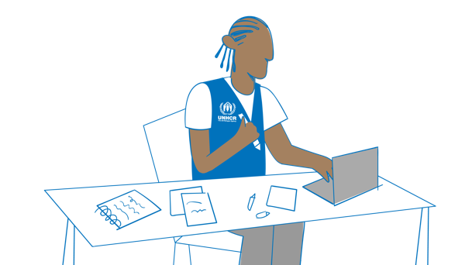
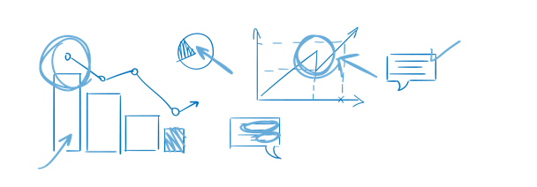
Measuring outcomes and impact of GBV prevention activities
Measuring outcomes and impact of GBV prevention activities
The outcomes and impact of GBV prevention activities are not easy to measure
Challenges exist because progress is often measured over a long period of time and manifests at different levels of the ecological model.
Changes in social and gender norms are observed by tracking changes in knowledge, attitudes, skills and behaviours.
A robust Theory of Change can facilitate the measurements of milestones, outcomes and results
Notes:
FACILITATOR NOTES
Primary prevention of GBV involves addressing the root causes of GBV. This is a long-term process, which means that evaluation of impact is not easy. Even where action involves concrete short-term prevention measures, it is not easy to demonstrate how and which specific factor(s) have an impact on the levels of GBV occurring: it is easier to say how many GBV survivors received services than to point out how many people did not experience GBV thanks to prevention interventions. This is further constrained during emergencies, when there is a focus on visible and measurable services.
To measure primary prevention activities it is recommended to use proxy-indicators that do not have a requirement to count or even know about incidents. These are based on what can be considered best practice related to programming which have positive influence on different types of programming.
It is suggested to use a mix of qualitative and quantitative indicators, qualitative information helps to gather greater depth on participants’ perceptions of programmes. Consultations with the community, especially women, girls and other at risk groups, are essential.
Remind that it is key to make sure that you use safe and ethical methodologies for consulting communities on their priorities and GBV risks (not incident specific). Consultations should continue throughout implementation to ensure that any harmful unintended consequences can be promptly adjusted. Safety audits are one of the tools that could be used for consultations. For more information please refer to the UNHCR GBV Safety Audits toolkit (https://intranet.unhcr.org/en/protection-programme/gender-based-violence/tools.html).
If asked: impact vs. outcome vs. output
Impact: positive and negative long-lasting results arising, directly or indirectly from a project, intended or un-intended (OECD/DAC definition).
Outcomes are the likely or achieved short-term and medium-term effects of a project’s outputs (OECD/DAC definition).
An output is a specific deliverable within the control of UNHCR and/or a partner implementing a project that contributes towards the achievement of the objective. (UNHCR definition).
For further information on safe and ethical GBV IM please visit the GBVIMS website (GBVIMS: Gender-Based Violence Information Management System)

Slide 59
UNHCR`s Results Framework
If you are doing: | Then choose: | For:
GBV prevention, risk mitigation and response | Outcome Area 4: Gender-based Violence | Relevant Population type: all indicators are applicable to Refugees & Asylum Seekers, Stateless, IDPs, Returnees, Others of Concern, Host Communities
Core Indicators for Outcome Area 4: GBV (Mandatory for Operations) | 30 mins
4.1: Proportion of displaced and stateless persons who know where to access available GBV services | 4.2: Proportion of displaced and stateless persons who do not accept violence against women | 4.3: Proportion of survivors who are satisfied with GBV case management services
GBV Response | GBV Prevention | GBV Response
And contextualize the following results chain based upon your activities | 30 mins
GBV prevention activity | Good practice output indicators
Awareness raising activities, Information campaigns, 16-days of activism, Women Safe Spaces, Empowerment group activities, EMAP, SASA, EASE | % of prevention activities led by women and girls from the community
Women Safe Spaces, Empowerment group activities, Livelihoods group activities, EMAP, SASA, EASE, Adolescent Girl Groups, activities | # of women and girls who participate in targeted empowerment activities as part of GBV prevention programmes
Awareness raising activities, Information campaigns | # of displaced and stateless persons targeted with information-sharing activities on GBV in the onset of an emergency
Notes:
FACILITATOR NOTES
The UNHCR results framework is a key part of the planning and monitoring of GBV prevention programming at UNHCR. Recall the GBV outcome area 4, as introduced in the first session. Introduce the different indicators for UNHCR GBV prevention programming that are part of our Global Results Framework, by going through the animated elements of the slide.
Background on indicators:
Mandatory “core” outcome indicators: three mandatory outcome indicators exist – including one for GBV prevention programming (“Proportion of displaced and stateless persons who do not accept violence against women”). These indicators must be selected if the GBV outcome area is selected. We will look into the core GBV prevention outcome indicators in more detail shortly.
Minimum recommended good practice output indicators: these indicators are minimum indicators recommended for each selected output area – they are optional to select. If an outcome area is selected it is strongly recommended that these indicators are also selected (“% of prevention activities led by women and girls from the community”, “#of women and girls who participate in targeted empowerment activities as part of GBV prevention programmes”, “#of displaced and stateless persons targeted with information-sharing activities on GBV in the onset of an emergency”).
Optional self-selected customized output indicators: additional indicators can be determined by operations who wish to include these. These should be used in addition to the mandatory outcome and minimum output indicators above . The Inter-Agency Minimum Standards also include some good practice indicators that could be considered for this purpose.
Highlight that the activities noted in the slide are mere examples of GBV prevention activities (e.g. awareness-raising, information campaigns, Women Safe Spaces, EMAP etc.).
REMEMBER! While community outreach and awareness-raising are necessary to increase timely and safe access to services and mitigate risks of GBV, awareness-raising is not sufficient to affect social norms change. To transform harmful social norms, GBV programming must: (1) shift social expectations, not just individual attitudes; (2) publicize the changes; and (3) catalyse and reinforce new norms and behaviours. Explain to participants that awareness raising sessions on their own do not constitute prevention programming, unless they are part of a broader and longer-term approach.
2022 webinar recording and PPT on UNHCR’s results-based management and GBV: https://unhcr365.sharepoint.com/sites/GSCB-GBVLearning/SitePages/Webinar-2.aspx

Slide 60
UNHCR core outcome indicator for GBV prevention programming
Outcome Area 4: GBV Prevention
4.2: Proportion of displaced and stateless persons who do not accept violence against women.
Unit of measurement: Individuals Numerator: # of displaced and stateless persons aged 15 and older who disagree that a husband is justified in hitting or beating his wife for all of the following reasons:* Going out without telling him. Neglecting the children. Arguing with him. Refusing to have sexual intercourse with him. Burning food. Only displaced/stateless persons who say “NO, a husband is not justified in hitting or beating his wife” for all of these five reasons, are counted in the numerator. Denominator: Total # of displaced/stateless persons aged 15 and older.
This indicator is suggested as a survey-based indicator.
Notes:
FACILITATOR NOTES
Remind participants that this is a mandatory indicator for UNHCR if the GBV outcome area is selected in the operation: “Proportion of displaced and stateless persons who do not accept violence against women”. This indicator measures the proportion of persons of concern who disagree that a husband is justified in hitting or beating his wife for a list of specific reasons. This serves as a proxy indicator for those who do not accept violence against women. The proxy measurement is used to mitigate expected effects of social desirability: When asking respondents directly whether they accept violence against women, the overwhelming majority would be expected to say no. Violence against women is a manifestation of gender inequality. This indicator seeks to measure changes in behaviours and attitudes of persons of concern towards violence against women and by this, the changes in social norms on gender equality and the right to freedom of violence.
Supportive attitudes should not necessarily be interpreted as approval of wife-beating, nor should they imply that a woman or girl will inevitably become a victim of intimate partner violence. Rather, they should be seen as indicative of the degree of social acceptance of such practices. This can be influenced by the perception that women and girls have a lower status in society than men and boys or the expectation that they should fulfil certain gender roles. (MICS methodology). Standard phrasing for survey question is included in the guidance on collecting data on core indicators (see below).
Data collection frequency: Ideally annually, but frequency depends on the availability of survey data per country and group of displaced/stateless persons.
Global Reporting Frequency: Annually. Indicator values for years in between survey rounds may need to be estimated using extrapolation from previous years.
Derived and adjusted from UNHCR, COMPASS Core Indicators Metadata – Updated, 2021 (https://intranet.unhcr.org/content/dam/unhcr/intranet/protection-operations/compass/en/guidance/3/coreindicatorsmetadata/2.0%20Core%20Indicator%20Metadata%2004%2010%202021.pdf).

Slide 61
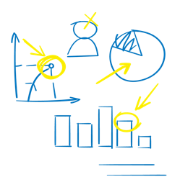
Group work Good practice output indicators for GBV prevention programming
% of prevention activities led by women and girls from the community;
# of women and girls who participate in targeted empowerment activities as part of GBV prevention programmes;
# of displaced and stateless persons targeted with information sharing on GBV at the onset of an emergency;
Are these indicators relevant for your own GBV prevention activities?
Are there any challenges in collecting data on these good practice output indicators?
GOOD PRACTICE INDICATORS SAVE TIME & ENERGY!
Notes:
FACILITATOR NOTES
Expected duration: 20 mins
Objective: familiarization with the good practice output indicators for GBV prevention programming and encourage reflections on monitoring of GBV prevention programming in own programming/context
Divide the participants in groups.
Encourage groups to use a flipchart when desired.
Allow time at the end for feedback from the groups in plenary, sharing some general conclusions on each question.
Minimum recommended good practice output indicators: these indicators are minimum indicators recommended for each selected output area – they are optional to select. If an outcome area is selected it is strongly recommended that these minimum recommended indicators are also selected.
In relation to the third indicator: REMEMBER! While community outreach and awareness-raising are necessary to increase timely and safe access to services and mitigate risks of GBV, awareness-raising is not sufficient to affect social norms change. To transform harmful social norms, GBV programming must: (1) shift social expectations, not just individual attitudes; (2) publicize the changes; and (3) catalyse and reinforce new norms and behaviours. Explain to participants that awareness raising sessions on their own do not constitute prevention programming, unless they are part of a broader and longer-term approach.

Slide 62
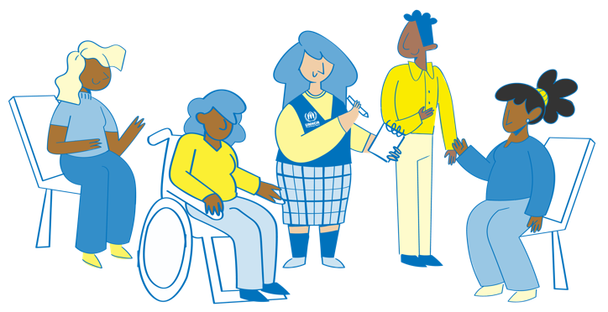
Monitoring tools for GBV prevention programming
Surveys.
Safety audits.
Focus group discussions.
Key informant interviews.
Observation.
Tools for specific prevention methodologies/models.
Notes:
FACILITATOR NOTES
Highlight that these tools are mostly oriented on measuring outcome looking at changes in knowledge, attitudes, skills and behaviours, ie. monitoring tools for the outcome level – rather than for the output level (whereby programme activities are tracked).
Tools:
Surveys: data for the core mandatory outcome indicator on GBV prevention is recommended to be collected through a survey. UNHCR is in the process of developing a standardized household survey module for this purpose.
Safety audits: refer to the UNHCR GBV Safety Audit Toolkit, 2021 (https://intranet.unhcr.org/en/protection-programme/gender-based-violence/tools.html).
Focus group discussions, key informant interviews and observation can be used as tools as part of a safety audit or assessment, to analyse changes in knowledge, attitudes, skills and behaviours at individual or community level.
Monitoring tools for specific prevention methodologies: some specific prevention methodologies/models may include dedicated monitoring tools, e.g. for SASA! Together, Girl Shine and Engaging Men in Accountable Practices (EMAP).
IMPORTANT! Recall that when it comes to GBV data collection it is key to respect basic GBV safe and ethical Information Management principles and practices. In the next slide there will be two videos that explain those principles and practices more in detail.

Slide 63
Safe and ethical data collection (1)
Notes:
FACILITATOR NOTES
https://www.youtube.com/watch?v=IUDfUATsITI&list=PLk83Ra7kAz5HQymFMdS79dryet14pn8YS&index=7
Duration: 3.22 mins
Play this video and the related video on the next slide, before highlighting some key points reflected in the notes on the next slide.

Slide 64
Safe and ethical data collection (2)
Notes:
FACILITATOR NOTES
https://www.youtube.com/watch?v=JYhsaqLRfv8&list=PLk83Ra7kAz5HQymFMdS79dryet14pn8YS&index=8
Duration: 4:30mins
After playing the video on the previous and current slide, emphasize that these minimum standards for data collection do not apply only to GBV programme monitoring, but apply to all data collection exercises throughout the programme cycle, in particular collecting assessment data. Given the highly sensitive and potentially life-threatening nature of GBV, any type of qualitative or quantitative assessment, survey or other data collection activity must follow robust ethical and safety considerations, accepted international standards and “do no harm” principle. A failure to do so places women, girls and other at risk groups, GBV survivors and personnel at risk. (Key resource: WHO Ethical and safety recommendations for researching, documenting and monitoring sexual violence in emergencies, 2007 (https://www.who.int/publications-detail-redirect/9789241595681).
Quality assessments, risk analyses, and monitoring and evaluation should inform programmatic interventions and learning to improve the GBV prevention programming. Ethically collected data on the nature and scope of GBV ensure that programme development and implementation, advocacy and resource mobilization are based on the needs and solutions identified by the affected population.
When information is collected through community-based, participatory approaches, it improves the impact and outcomes of humanitarian interventions. UNHCR is committed to using participatory methodologies to incorporate the capacities and priorities of displaced and stateless persons, and in the context of GBV especially for women, girls and other at risk groups. Participatory approaches refer to data collection and analysis activities that aim to involve and empower local communities, and ensure that the results can be used by and for the affected community. In all methods employed to collect data, it is essential that the participation of all relevant community groups is promoted and facilitated, with a specific focus on including women, girls and other at risk groups. Community participation in data collection should be encouraged with caution in situations where this poses potential security risks or increases the risk of GBV.
Research can play an important role in understanding how violence affects women’s and girls’ lives, and what works to best address and prevent it, especially when research is led by women’s organizations using feminist-informed approaches. During the acute emergency stage, research is not prioritized because the focus is on life-saving services; however, existing research, particularly by local researchers, can and should be used to inform and contextualize interventions.
Some important points on surveys:
Surveys must not contain any questions which aim at identifying survivors or could lead to stigma or further harm;
Need contextualize the phrasing of survey question(s) and test it with communities prior to the roll-out of the survey;
Advisable to administer surveys to members of the household separately in confidential spaces;
Ensure same-sex enumerators.

Slide 65
Closing the feedback loop
Acknowledgement by UNHCR and partners
Women and girls and other at risks groups' feedback
An essential part of the data collection process is closing the feedback loop by explaining to women, girls and other at risk groups how their feedback was taken into account.
At the start of the programme, in addition to sharing ways in which feedback can be provided, it is essential that women, girls and other at risk groups know about the ways in which UNHCR and its partners will respond to feedback received.
A closed feedback loop
Feedback data analysed and shared with relevant parties
Response, clarification and follow-up actions (if taken, or not taken) are communicated back to women, girls and other at risk groups
UNHCR’s Accountability to Affected People (AAP) is a commitment to the intentional and systematic inclusion of the expressed needs, concerns, capacities, and views of persons of concern in their diversity; and being answerable for our organizational decisions and staff actions, in all protection, assistance and solutions interventions and programmes.
Notes:
FACILITATOR NOTES
It is important to note that when establishing who needs to access and use the information generated through assessments and feedback mechanisms, we should consider how to ensure that relevant information is also shared with the community we are working with.
In addition to having access to the data provided, community members can engage in analysing it or making sense of the issues that are flagged through the feedback mechanism. The idea is that if community members are provided with access to this data and engaged in its initial analysis, they can use the data for their own, locally driven advocacy purposes with other agencies and their local authorities.
Closing the feedback loop is one of the actions that contributes to maintaining UNHCR’s commitment on Accountability to Affected People (AAP). The Principals of the Inter-Agency Standing Committee (IASC), including the High Commissioner for Refugees, have endorsed the 2017 Commitments on Accountability to Affected People and Protection from Sexual Exploitation and Abuse and agreed to incorporate them into organizational policies and operational guidelines and promote them with all partners.
UNHCR’s AAP framework is outlined in core actions 2-5 of the 2018 Age, Gender and Diversity Policy:
• Participation and Inclusion (Core Action 2);
• Communication and Transparency (Core Action 3);
• Feedback and Response (Core Action 4); and
• Organization Learning and Adaptation (Core Action 5).
Closing the feedback loop is one ok the key elements that contribute all 4 the UNHCR Core Actions.
For further information on UNHCR’ AAP framework please refer participants to the UNHCR Operational Guidance on Accountability to Affected People (AAP). UNHCR-AAP_Operational_Guidance.pdf
Content derived from ALNAP, Practitioner Guide: Closing the Loop - Effective feedback in humanitarian contexts, 2014 (https://www.alnap.org/system/files/content/resource/files/main/closing-the-loop-alnap-cda-guidance.pdf), where you can find additional information on how best to close feedback loop in humanitarian response.

Slide 66
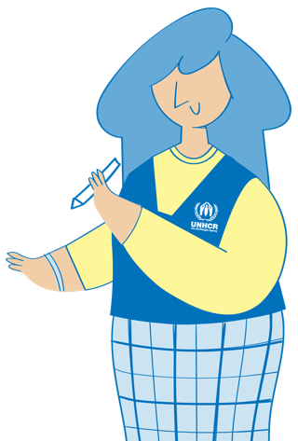
Group work Outcomes and outputs of our own GBV prevention programming
How does the outcome statement relate to changes in social and gender norms?
How do the output indicators contribute to the result in the outcome statement?
Would you reformulate anything to better measure outcome and impact of the GBV prevention activity?
Notes:
FACILITATOR NOTES
Expected duration: 25 mins
Objective: reflect on results-based management of own GBV prevention activities
Prepare in advance hand-outs that include the outcome statements and output indicators from partnership agreements, workplans and monitoring frameworks from your operation(s) that include GBV primary prevention activities. Each hand-out should include one outcome statement on GBV prevention and two or three of the output indicators that fall under that outcome.
Divide the participants in groups.
Let the participants work in groups, discussing the questions on the slide.
Encourage groups to use a flipchart when desired.
Allow time at the end for feedback from the groups in plenary, sharing some general conclusions on each question – without going into the details of the content of the specific indicators.
In the discussions, remind participants of:
Outcome statements reflect the changes in institutional and behavioural capacities that are necessary to realize the impact. They express something that institutions or people do differently (behavioural change) or better (change in performance).
Changes in social and gender norms are observed by tracking changes in knowledge, attitudes, skills and behaviour.
Formulation of UNHCR’s three good practice output indicators as recommended example.
Indicators need to SMART: Specific, Measurable, Achievable, Relevant and Time-bound.
Indicators related to the number of reported GBV incidents should never be used to measure the success of GBV prevention programming (nor for response programming and risk mitigation activities).

Slide 67
Key messages: Measuring outcomes and impact of prevention work
GBV prevention strategies should be monitored tracking changes in knowledge, attitudes, skills and behaviours.
Indicators related to the number of reported GBV incidents should never be used to measure the success of GBV programming, including GBV prevention.
UNHCR`S Global Results Framework offers tools for monitoring outputs and outcomes of our GBV prevention programming.

Slide 68
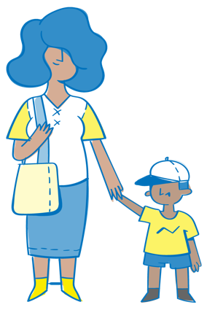
^{MODULE 1 | CLOSING SESSION}
Wrap-up
Notes:
FACILITATOR NOTES
Expected duration: 30 mins

Slide 69
UNHCR GBV Policy
Monitoring milestones:
Gender and Power Analysis of local norms sustaining gender inequality/GBV is completed.
Strategy including transformative and empowerment interventions is implemented.
Women’s and girl’s leadership in prevention programming is facilitated.
Regular feedback sessions with women and girls are conducted.
GBV prevention strategy is incorporated into strategic planning.
Capacity development conducted for members of the workforce on attitudes, knowledge and behaviour change.
GBV prevention strategy and programmes have a monitoring plan.
Advocacy with Government conducted on inclusion into available national programming.
Notes:
FACILITATOR NOTES
Explain that, as the module is coming to an end, the monitoring framework of the UNHCR GBV Policy mirrors most of the topics covered in the module and hereby serves as a recap of important milestones expected of UNHCR operationsand partners engaged in GBV prevention activities.
Please explain that although not explicitly mentioned in the UNHCR GBV Policy it is necessary for GBV prevention strategy to be informed by a Theory of Change developed based on the Gender & Power analysis.
Recall the policy outcome and core action of the UNHCR GBV Policy:
Policy outcome: GBV is prevented by addressing gender inequality, discrimination and unequal power relation
Policy core action: Operations will advocate, plan and implement prevention programming that promotes gender equality and that aims to address the root causes of GBV in order to effectively change behaviour and social norms, including through long-term approaches, that are accountable to women and girls.
The monitoring framework of the UNHCR GBV Policy does not include indicators, it includes a series of milestones to be achieved overtime, which will help operations track progress in terms of alignment with the GBV Policy.
The monitoring milestones of the UNHCR GBV Policy reflect what we have discussed throughout the sessions and serves here as reminder of our GBV Policy commitments and also as a wrap up of module 1.
Further guidance on the monitoring framework of the GBV Policy is currently provisional and subject to change: https://intranet.unhcr.org/content/dam/unhcr/intranet/protection-operations/sexual-and-gender-based-violence/documents/english/gbv-policy-monitoring-framework/GBV%20modules%20Policy%20Monitoring%20Framework%20-%20provisional%20release.pdf.

Slide 70
Key takeaways: Introduction – GBV prevention
GBV prevention, risk mitigation and response are one of the eight UNHCR’s strategic priorities, and prevention of GBV is a core action of the UNHCR GBV Policy.
GBV prevention is a specialized intervention that is life-saving, and needs to be implemented from the onset of an emergency.
Promoting positive gender and social norms from the onset of the emergency, sets a foundation for longer-term interventions, acknowledging that changing knowledge, attitudes, skills and behaviours may take time.
GBV prevention programming should only be initiated once essential services are in place to respond to GBV incidents.
Notes:
FACILITATOR NOTES
These key takeaways slides correspond to the key messages from each of the 5 sessions.
FACILITATOR NOTES
These key takeaways slides correspond to the key messages from each of the 5 sessions.

Slide 71
Key takeaways: Root causes of GBV
The root causes of GBV are gender inequality, systemic discrimination and unequal power relations.
Displacement is not the cause of GBV. GBV exists prior to displacement. Factors relating to displacement can exacerbate GBV.
Primary prevention of GBV means identifying, understanding and addressing its root causes. It is different from risk mitigation, which addresses factors contributing to GBV.
Women and girls are at increased risk of GBV and face additional barriers to accessing services, due to systemic gender inequality and other forms of intersectional discrimination.

Slide 72
Key takeaways: GBV prevention principles and the social-ecological model
To be effective, primary prevention strategies should:
Follow GBV guiding principles and engage in community-led processes; be accountable to women and girls; ensure a survivor-centred approach; do no harm.
Operate across the socio-ecological model: aim to shift social expectations, not just individual attitudes, publicize the changes, catalyse and reinforce new norms and behaviours.
Anticipate and manage resistance to changes in gender and social norms.

Slide 73
Key takeaways: Designing and planning a GBV prevention intervention at UNHCR
Interventions addressing GBV must be prioritized as lifesaving in multi-year protection/solution strategies of each operation and in other internal and inter-agency planning processes.
Engagement and participation of women, girls and other at risk groups, as well as IDP and refugee-led women and/or LGBTIQ+-led organizations, is critical to ensure safe, effective, sustainable and accountable GBV prevention programming.
Operations should conduct a Gender and Power analysis of local norms and masculinities sustaining gender inequality and GBV, to inform strategies and ensure effective prevention programming.
The Gender and Power Analysis should feed into the development of a Theory of Change that shows how we expect GBV prevention outcomes/impact to occur over the short, medium, and longer term as a result of our work.

Slide 74
Key takeaways: Measuring outcomes and impact of prevention work
GBV prevention strategies should be monitored tracking changes in knowledge, attitudes, skills and behaviours.
Indicators related to the number of reported GBV incidents should never be used to measure the success of GBV programming, including GBV prevention.
UNHCR`S Global Results Framework offers tools for monitoring outputs and outcomes of our GBV prevention programming.

Slide 75
Key resources
UNHCR Policy on the Prevention of, Risk Mitigation and Response to Gender-Based Violence, 2020
UNHCR GBV Policy Monitoring Framework
16 Inter-Agency Minimum Standards GBV in Emergencies Programming, 2019
UNHCR Policy on Age, Gender and Diversity, 2018
UNHCR Need to Know Guidance: Working with Lesbian, Gay, Bisexual, Transgender, Intersex and Queer Persons in Forced Displacement, 2021
UNHCR Results Based Management and GBV, 2022
What Works to Prevent Violence Against Women and Girls Global Programme, online resource
UNHCR GBV Learning Hub
Notes:
FACILITATOR NOTES
This slide contains a number of key resources and is not meant to serve as an exhaustive list of resources related to GBV primary prevention programming. Other resources were used when designing the module and relevant references can be found in the facilitator notes.
Some links here and throughout the slide refer to internal resources from UNHCR’s Intranet or GBV Learning Hub and are therefore unfortunately not accessible directly for partners.

Slide 76
Thank you!

Slide 77
FACILITATOR FEEDBACK
Please help us to improve this facilitation material by filling in this online feedback form!
The brief feedback form collects feedback from facilitators using a UNHCR GBV facilitation package or from colleagues using the materials for self-study, with the aim to help GLDC and DIP improve the content and quality of the materials.
It is recommended that facilitators complete the form after conducting the training locally.
The feedback form is anonymous and will take around 7 minutes to complete.
THANK YOU!

